Slide 1
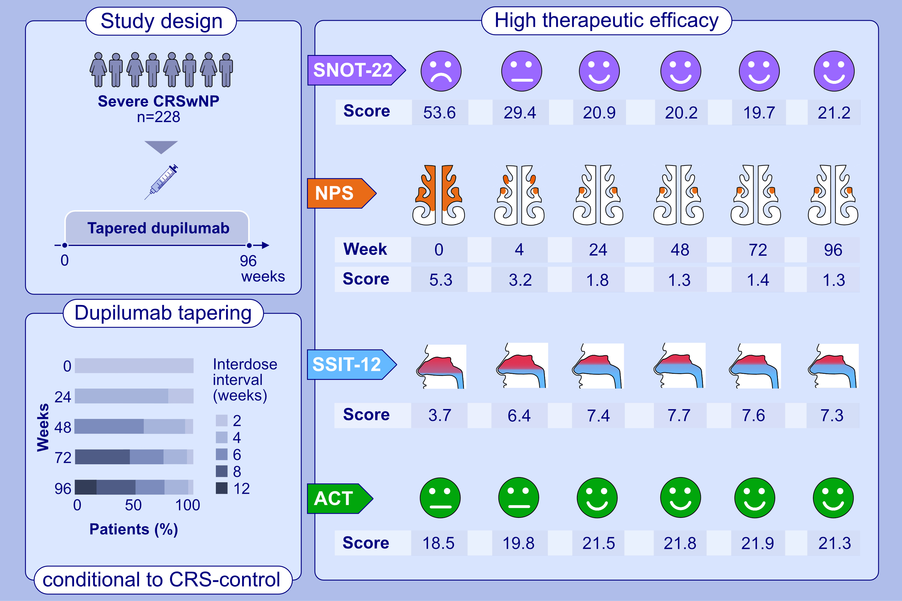
Two-year results of tapered dupilumab for CRSwNP demonstrates enduring efficacy established in the first 6 months
Rik Johannes Leonardus van der Lans, Josje Janna Otten, Gwijde Flavius Jacobus Petrus Maria Adriaensen, Dinand Rienk Hoven, et al.
Allergy. 2023; pages: 2684-2697
https://doi.org/10.1111/all.15796
© 2019 EAACI and John Wiley and Sons A/S. Published by John Wiley and Sons Ltd.
Notes:
HIGHLIGHTS
Two-year results of tapered dupilumab for severe chronic rhinosinusitis with nasal polyps (CRSwNP) from a real-life prospective observational cohort (n=228, tertiary referral center).
Marked improvements show for disease specific quality of life, nasal polyp score, asthma control and olfaction, principally established within 24 weeks.
Stepwise tapering dupilumab conditional to therapeutic effect is feasible up to 300mg/8 weeks.
Abbreviations: ACT, asthma control test; CRSwNP, chronic rhinosinusitis with nasal polyps; NPS, bilateral nasal polyp score; SNOT-22, 22-item sinonasal outcome test; SSIT-22, Sniffin’Sticks-12 identification test

