Slide 1
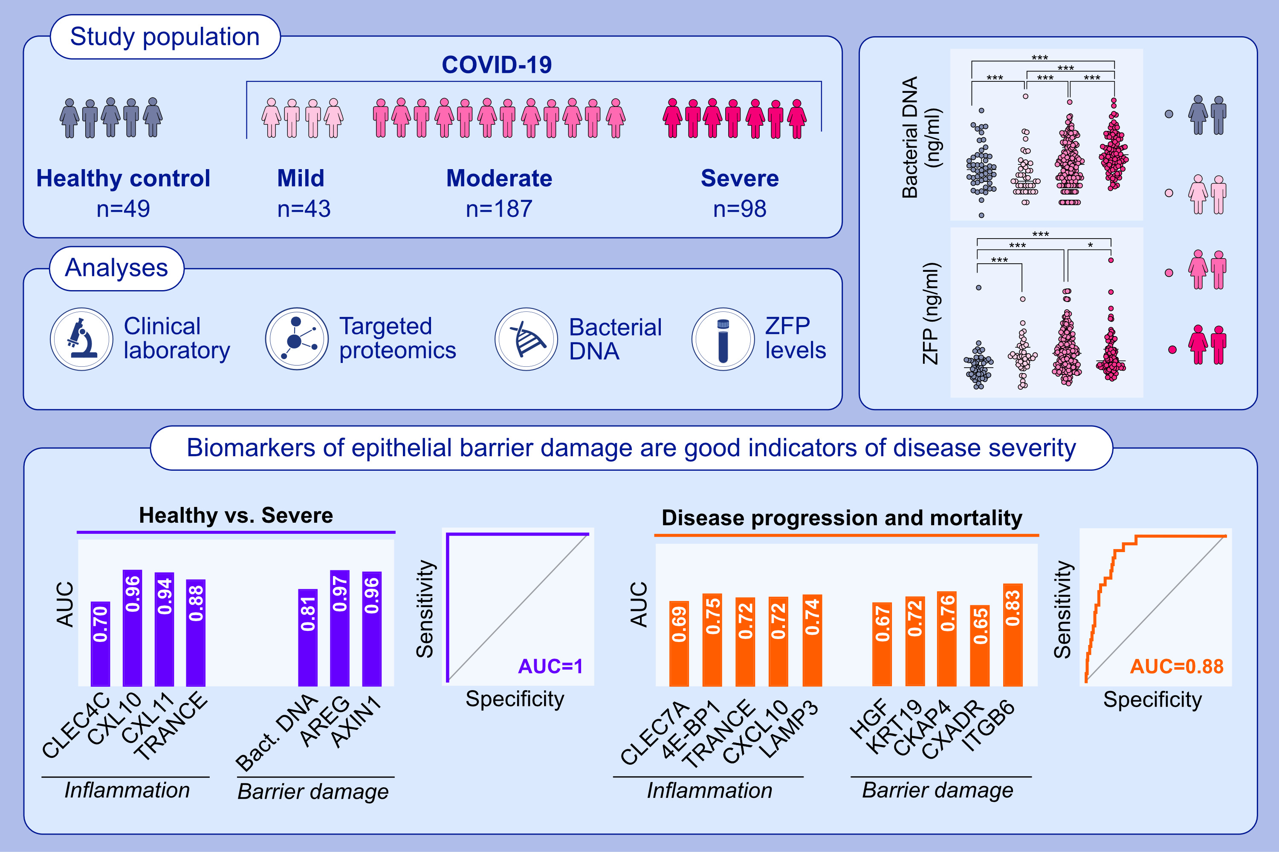
Disrupted epithelial permeability as a predictor of severe COVID-19 development
Duygu Yazici, Eren Cagan, Ge Tan, Manru Li, Evan Do, Ozan C. Kucukkase, et al.
Allergy. 2023; pages: 2644-2658
https://doi.org/10.1111/all.15800
© 2019 EAACI and John Wiley and Sons A/S. Published by John Wiley and Sons Ltd.
Notes:
HIGHLIGHTS
This study provides evidence that epithelial barrier function is compromised in severe COVID-19, which is also in line with the epithelial barrier theory.
We identified predictive biomarkers to powerfully discriminate severe COVID-19 cases from mild cases and healthy controls at the time of admission.
We demonstrated certain protein biomarkers with disease progression from moderate to severe COVID-19 and death.
Abbreviations: AREG, amphiregulin; AUC, area under the curve; AXIN1, axis inhibition protein 1; CKAP4, cytoskeleton-associated protein 4; CLEC4C, C-type lectin domain family 4 member C; CLEC7A, C-type lectin domain family 7 member A; COVID-19, coronavirus disease 2019; CXCL, C-X-C motif chemokine; CXADR, coxsackievirus and adenovirus receptor; DNA, deoxyribonucleic acid; HGF, hepatocyte growth factor; ITGB6, integrin beta-6; KRT19, keratin, type 1 cytoskeletal 19; LAMP3, lysosome-associated membrane glycoprotein 3; TRANCE, tumor necrosis factor ligand superfamily 11; ZFP, zonulin family peptides; 4E-BP1, eukaryotic initiation factor 4E-binding protein 1

