Slide 1
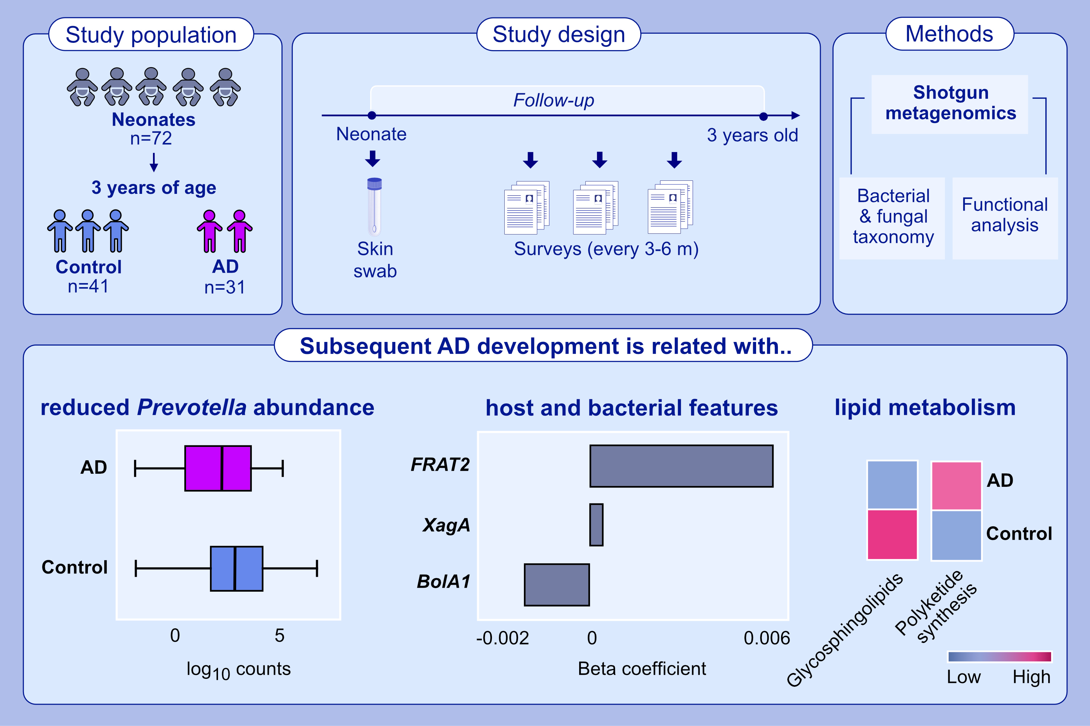
Shotgun metagenomic sequencing on skin microbiome indicates dysbiosis exists
prior to the onset of atopic dermatitis
Prem Prashant Chaudhary, Ian A. Myles, Jordan Zeldin, Shareef Dabdoub, Varsha Deopujari, et al.
Allergy. 2023; pages: 2724-2731
https://doi.org/10.1111/all.15806
© 2019 EAACI and John Wiley and Sons A/S. Published by John Wiley and Sons Ltd.
Notes:
HIGHLIGHTS
Using a larger cohort, this study reproduces the prior findings indicating that the dysbiosis associated with AD predates diagnosis.
Expansion to use of shotgun metagenomics identified Prevotella, Candida, and lipid metabolism of Proteobacteria as additional biomarkers of subsequent onset of AD.
This work may foster primary prevention by using the microbiome signature from the first week of life to identify high risk newborn.
Abbreviations: AD, atopic dermatitis; BolA1, BolA Family Member 1; FRAT2, frequently rearranged in advanced T-cell lymphomas 2; XagA, Proteobacteria quorum sensing and biofilm regulator

