Slide 1
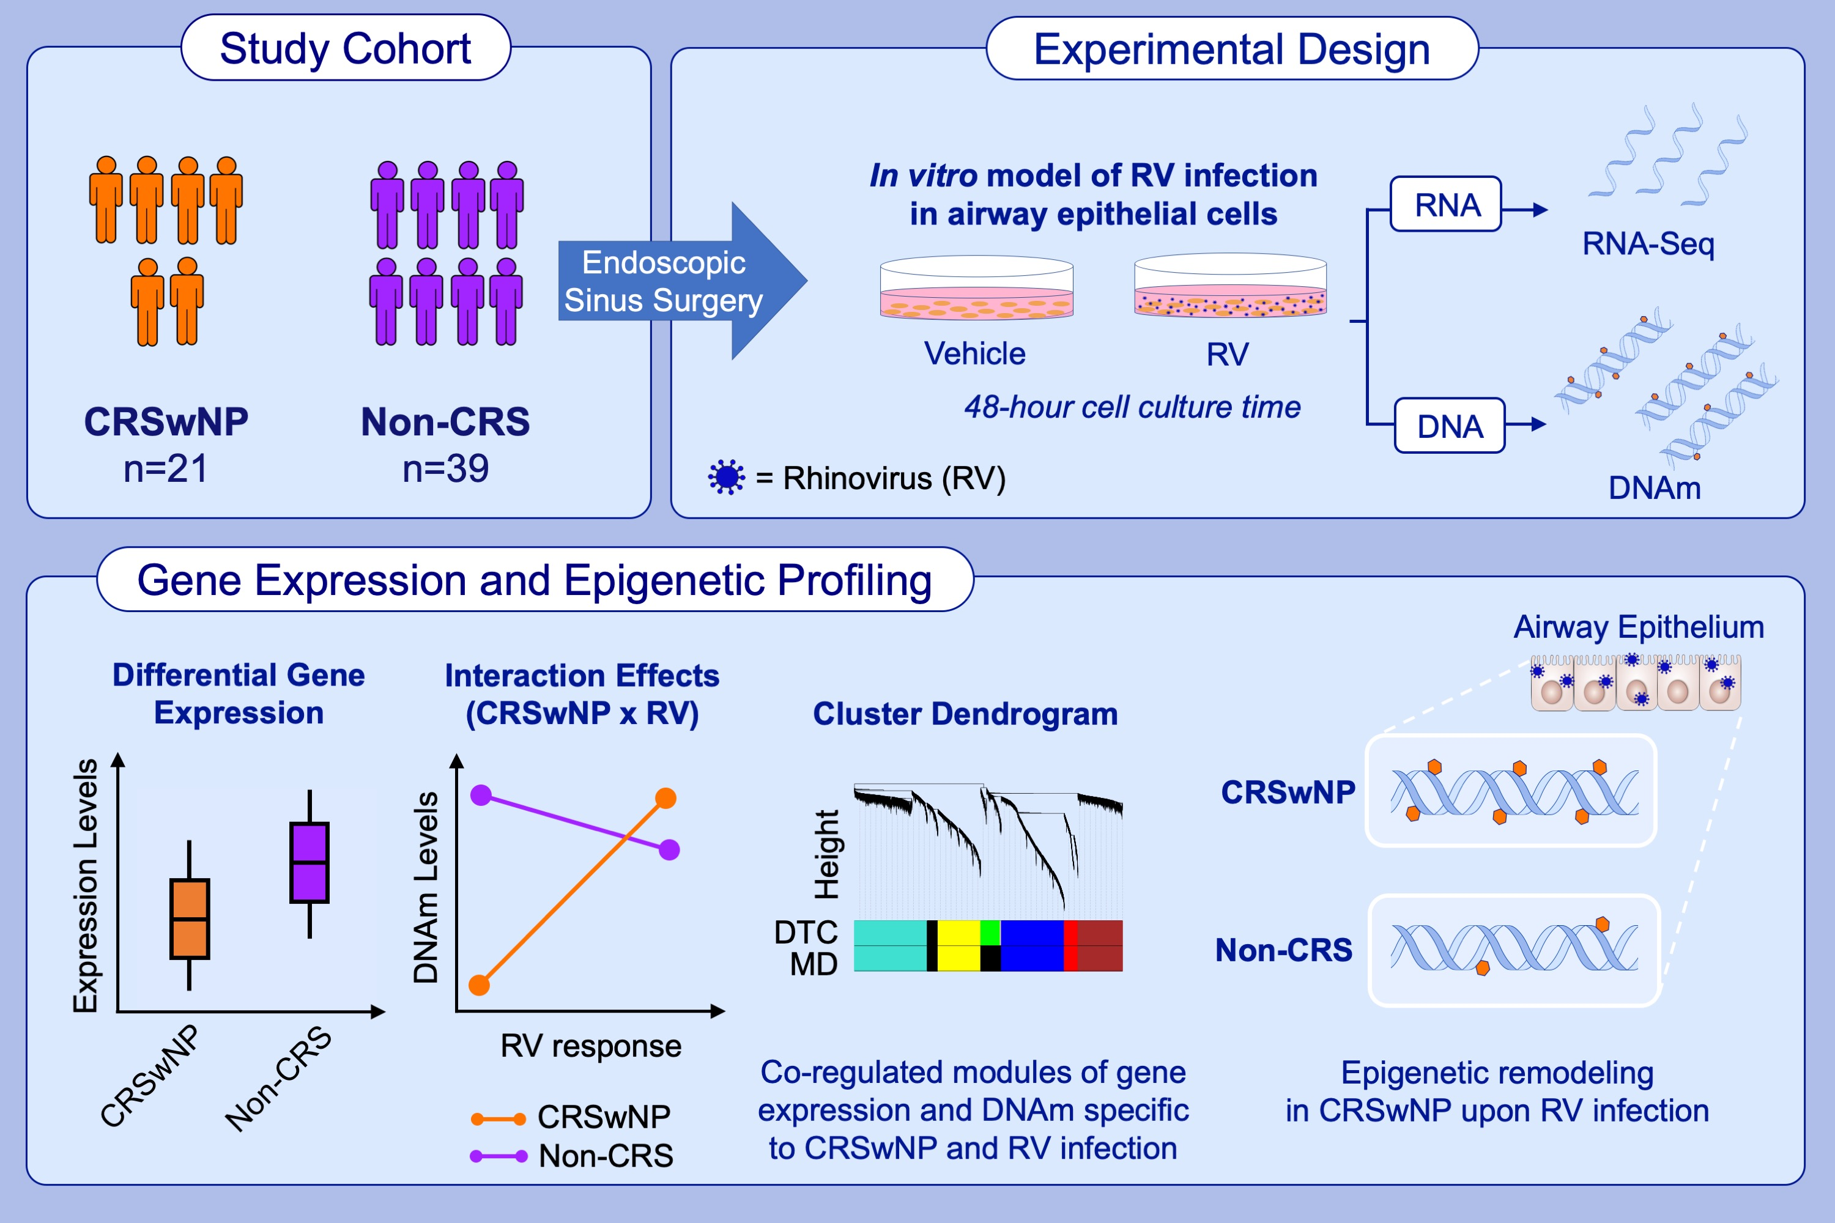
Epigenetic responses to rhinovirus exposure in airway epithelial cells are correlated with key transcriptional pathways in chronic rhinosinusitis
Marcus M. Soliai, Atsushi Kato, Katherine A. Naughton, James E. Norton, Aiko I. Klinger, et al.
Allergy. 2023; pages: 26982711
https://doi.org/10.1111/all.15837
© 2019 EAACI and John Wiley and Sons A/S. Published by John Wiley and Sons Ltd.
Notes:
HIGHLIGHTS
This study identified differential gene expression and epigenetic profiles of the airway epithelium between CRSwNP cases and non-CRS controls in an in vitro cell model.
Interaction effects indicated that the epigenetic response to RV infection significantly differed between cases and controls. Distinct co-regulated gene expression and DNAm modules were specific to CRSwNP and to RV infection.
These data suggest that intrinsic epigenetic features in the airway epithelium of CRSwNP influence the response to RV infection and increase susceptibility to CRS.
Abbreviations: CRSwNP, chronic rhinosinusitis with nasal polyps; DNAm, DNA methylation; DTC, dynamic tree cut; MD, merged dynamic; RNA-Seq, RNA sequencing; RV, rhinovirus

