Slide 1
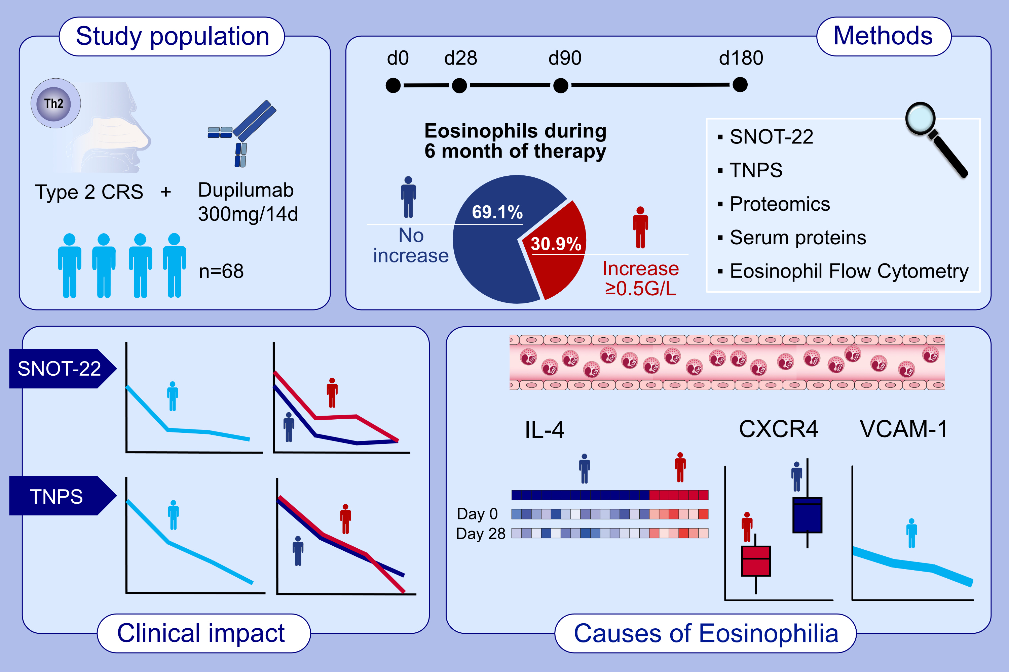
Dupilumab-induced eosinophilia in patients with Diffuse Type 2 Chronic Rhinosinusitis
Fabio S. Ryser, Ayla Yalamanoglu, Alan Valaperti, Catrin Brühlmann, Tina Mauthe, Stephan Traidl, et al.
Allergy. 2023; pages: 2712-2723
https://doi.org/10.1111/all.15844
© 2019 EAACI and John Wiley and Sons A/S. Published by John Wiley and Sons Ltd.
Notes:
HIGHLIGHTS
Transient blood eosinophilia seems to have no clinical impact in patients with type 2 CRS treated with dupilumab.
High IL-4 levels at baseline induce dysregulation of migration, chemotaxis, and homing of eosinophils by decreased CXCR4 on eosinophils and VCAM-1.
CXCR4 might be a useful marker to predict blood eosinophilia in patients with type 2 CRS under dupilumab.
Abbreviations: CRS, chronic rhinosinusitis; CXCR4, CXC chemokine receptor 4 (stromal cell-derived factor 1 receptor); IL-4, interleukin 4; SNOT-22, sino-nasal outcome test 22 questionnaire; TNPS, total nasal polyp score; VCAM-1, vascular adhesion molecule 1

