Slide 1
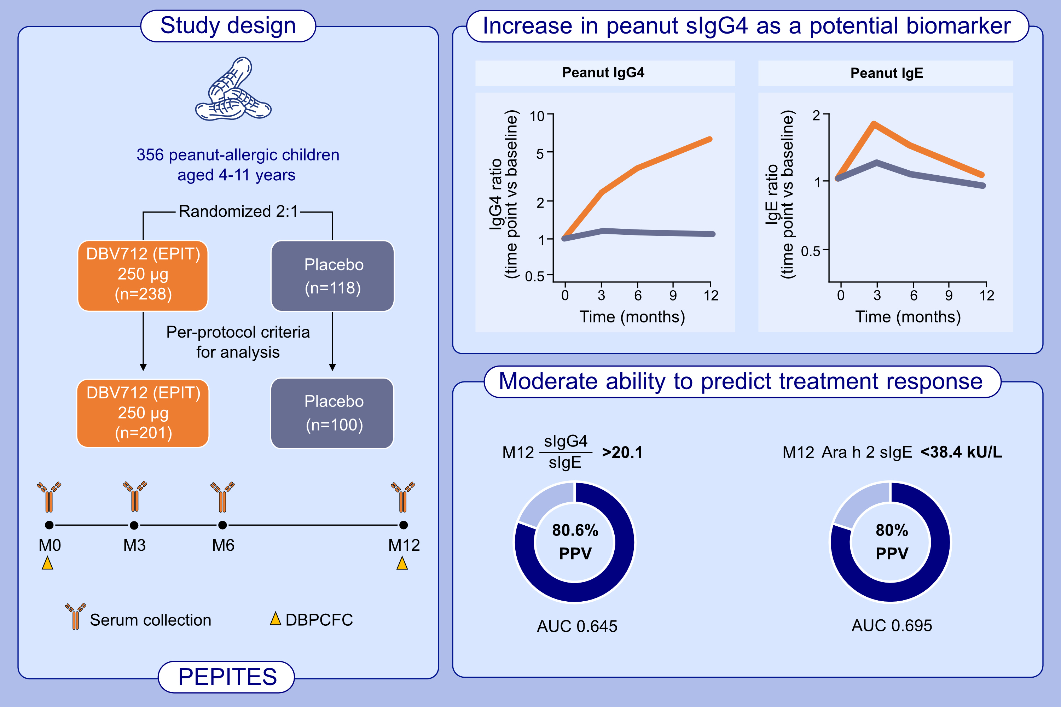
Immune Response Evolution in Peanut Epicutaneous Immunotherapy
for Peanut-Allergic Children
Marie Bastin, Warner W. Carr, Carla M. Davis, David M. Fleischer, Jay A. Lieberman, et al.
Allergy. 2023; pages: 2467-2476
https://doi.org/10.1111/all.15709
© 2019 EAACI and John Wiley and Sons A/S. Published by John Wiley and Sons Ltd.
Notes:
HIGHLIGHTS
This phase 3 DBPCFC examined serum-specific IgG4 and IgE (whole peanut and components) in the subjects enrolled in PEPITES study.
Among 4-11 years old participants, peanut specific IgG4 levels could distinguish DBV712-treated subjects from placebo-treated subjects.
Month 12 peanut-specific IgG4/IgE ratio as well as month 12 peanut-specific Ara h 2 levels had moderate predictability for an eliciting dose >300mg peanut protein.
Abbreviations: AUC, area under the curve; DBPCFC, double-blind placebo-controlled food challenge; DBV712, investigational peanut EPIT; EPIT, epicutaneous immunotherapy;
Ig, immunoglobulin; M, month; PEPITES, Efficacy and Safety of Viaskin Peanut in Children With IgE-Mediated Peanut Allergy

