Slide 1
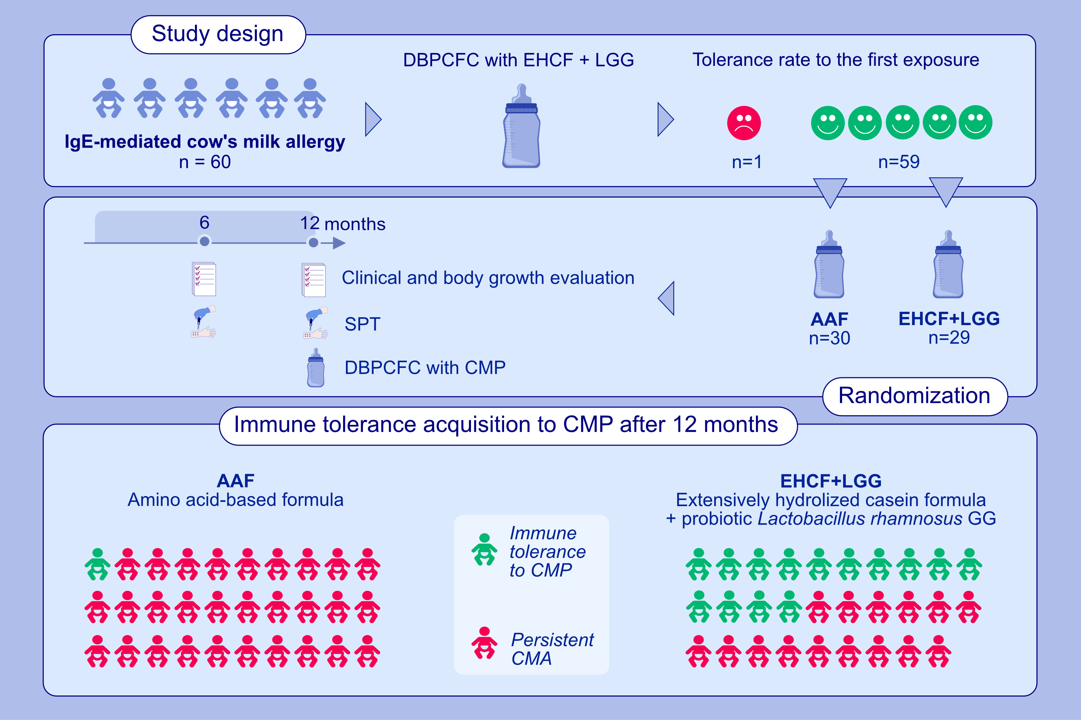
The Step-Down approach in children with Cow’s Milk Allergy: results of a randomized controlled trial
Rita Nocerino, Serena Coppola, Laura Carucci, Anna Fiorenza de Giovanni di Santa Severina, Franca Oglio, et al.
Allergy. 2023; pages: 2477-2486
https://doi.org/10.1111/all.15750
© 2019 EAACI and John Wiley and Sons A/S. Published by John Wiley and Sons Ltd.
Notes:
HIGHLIGHTS
The SDACMA trial evaluated the tolerability and the rate of immune tolerance acquisition in CMA children starting dietary AAF treatment and then switching to EHCF+LGG.
Subjects tolerating EHCF+LGG were randomly allocated to remain on AAF, or to switch to EHCF+LGG.
In IgE-mediated CMA children the step-down from AAF to EHCF+LGG is well tolerated and could facilitate the immune tolerance acquisition.
Abbreviations: AAF, amino acid-based formula; CMP: cow’s milk protein; DBPCFC, double-blind placebo-controlled food challenge; EHCF+LGG, extensively hydrolyzed casein formula plus Lactobacillus rhamnosus GG; IgE, immunoglobulin E; SDACMA, Step-Down Approach in children with Cow’s Milk Allergy; SPT, skin prick test

