Slide 1
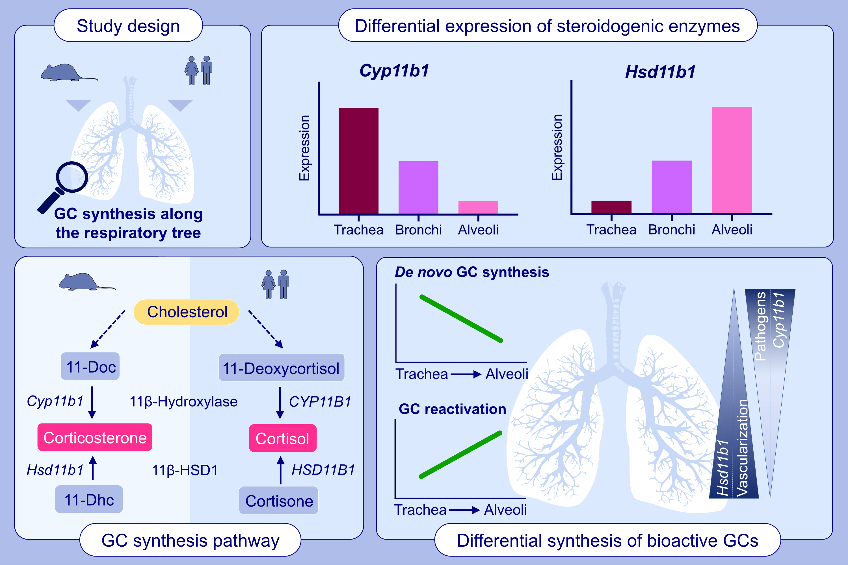
Glucocorticoids are differentially synthesized along the human and murine respiratory tree
Verena M. Merk, Pietro Renzulli, Bart Vrugt, Achim Fleischmann, Thomas Brunner
Allergy. 2023; pages: 2428-2440
https://doi.org/10.1111/all.15765
© 2019 EAACI and John Wiley and Sons A/S. Published by John Wiley and Sons Ltd.
Notes:
HIGHLIGHTS
The lung epithelium expresses steroidogenic enzymes and synthesizes GCs de novo from cholesterol as well as via reactivation from 11-dehydrocorticosterone/cortisone.
GC reactivation via 11β-hydroxysteroid dehydrogenase 1 occurs mostly in the alveoli, whereas de novo GC synthesis via 11β-hydroxylase predominantly in the large conducting airways.
The concept of differential GC synthesis could be confirmed in murine as well as human lung tissue.
Abbreviations: Cyp11b1, 11β-hydroxylase; GC, glucocorticoids; Hsd11b1, 11β-hydroxysteroid dehydrogenase; 11-Doc, 11-deoxycorticosterone; 11-Dhc, 11-dehydrocorticosterone.

