Slide 1
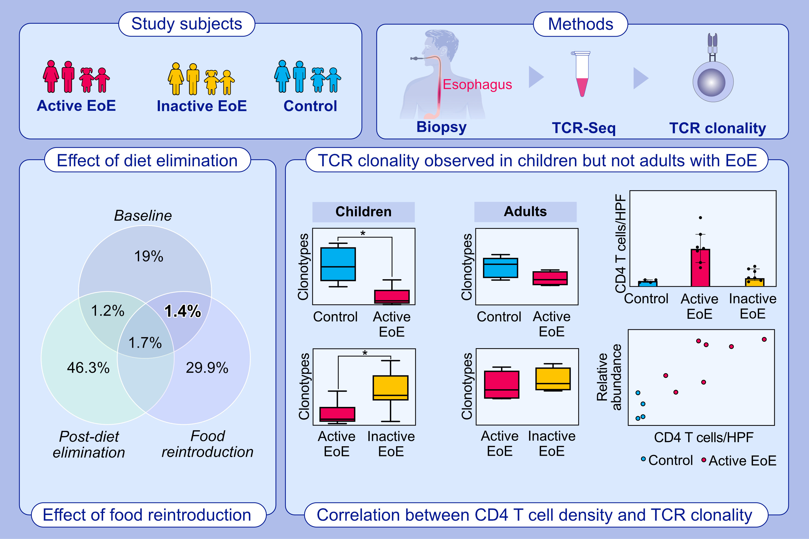
Bulk T-Cell Receptor Sequencing Confirms Clonality in Pediatric EoE and Identifies a Food-Specific Repertoire
Rethavathi Janarthanam, Fei Li Kuang, Angelika Zalewski, Katie Amsden, Ming-Yu Wang, Lorena Ostilla,, et al.
Allergy. 2023; pages: 2487-2496
https://doi.org/10.1111/all.15773
© 2019 EAACI and John Wiley and Sons A/S. Published by John Wiley and Sons Ltd.
Notes:
HIGHLIGHTS
TCR Sequencing was performed on total RNA from esophageal biopsies from children and adults with EoE and non-EoE controls. TCR clonality was identified in children but not adults with EoE.
TCRs disappear with food elimination and recur with reintroduction.
The relative abundance of TCR clones occupying more than 1% of total correlated with intraepithelial peak CD4 T-cells/hpf in pediatric esophageal biopsies.
Abbreviations: EoE, eosinophilic esophagitis; hpf, high power field; TCR, T cell receptor

