Slide 1
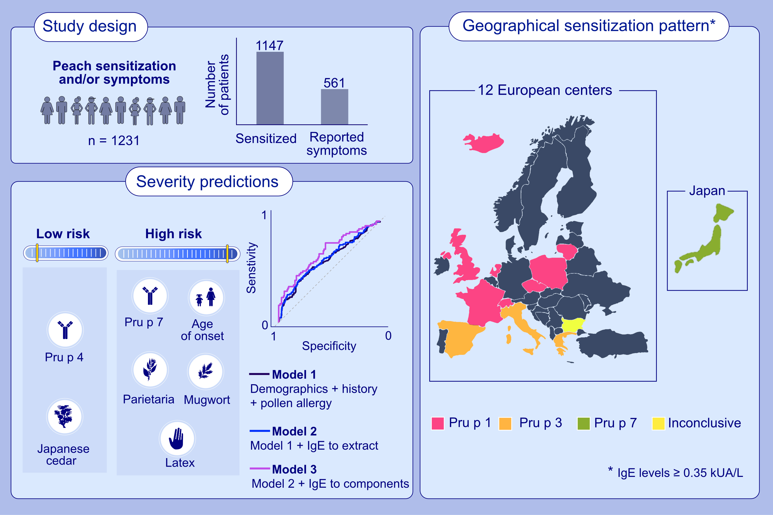
A European-Japanese study on peach allergy: IgE to Pru p 7 associates with severity
E. J. J. Kallen, A. Revers, M. Fernández-Rivas, R. Asero, B. Ballmer-Weber, L. Barreales, , et al.
Allergy. 2023; pages: 2497-2509
https://doi.org/10.1111/all.15783
© 2019 EAACI and John Wiley and Sons A/S. Published by John Wiley and Sons Ltd.
Notes:
HIGHLIGHTS
This study analyzed sensitization patterns to five peach components across Europe and in Japan, to explore their relation to pollen and foods and to predict symptom severity.
A severity prediction model combining clinical and demographic outcomes with CRD performs better than CRD alone.
Geographic differences were identified, confirming and extending earlier reports: PR-10 (Pru p 1) dominant in Northern/Central Europe, LTP (Pru p 3) in Southern Europe and GRP (Pru p 7) in Japan. Pru p 7 is associated with severe reactions.
Abbreviations: CRD, component-resolved diagnostic; IgE, immunoglobulin E; kUA/L, kilounits of allergen-specific IgE per liter; LTP, lipid transfer protein.

