Slide 1
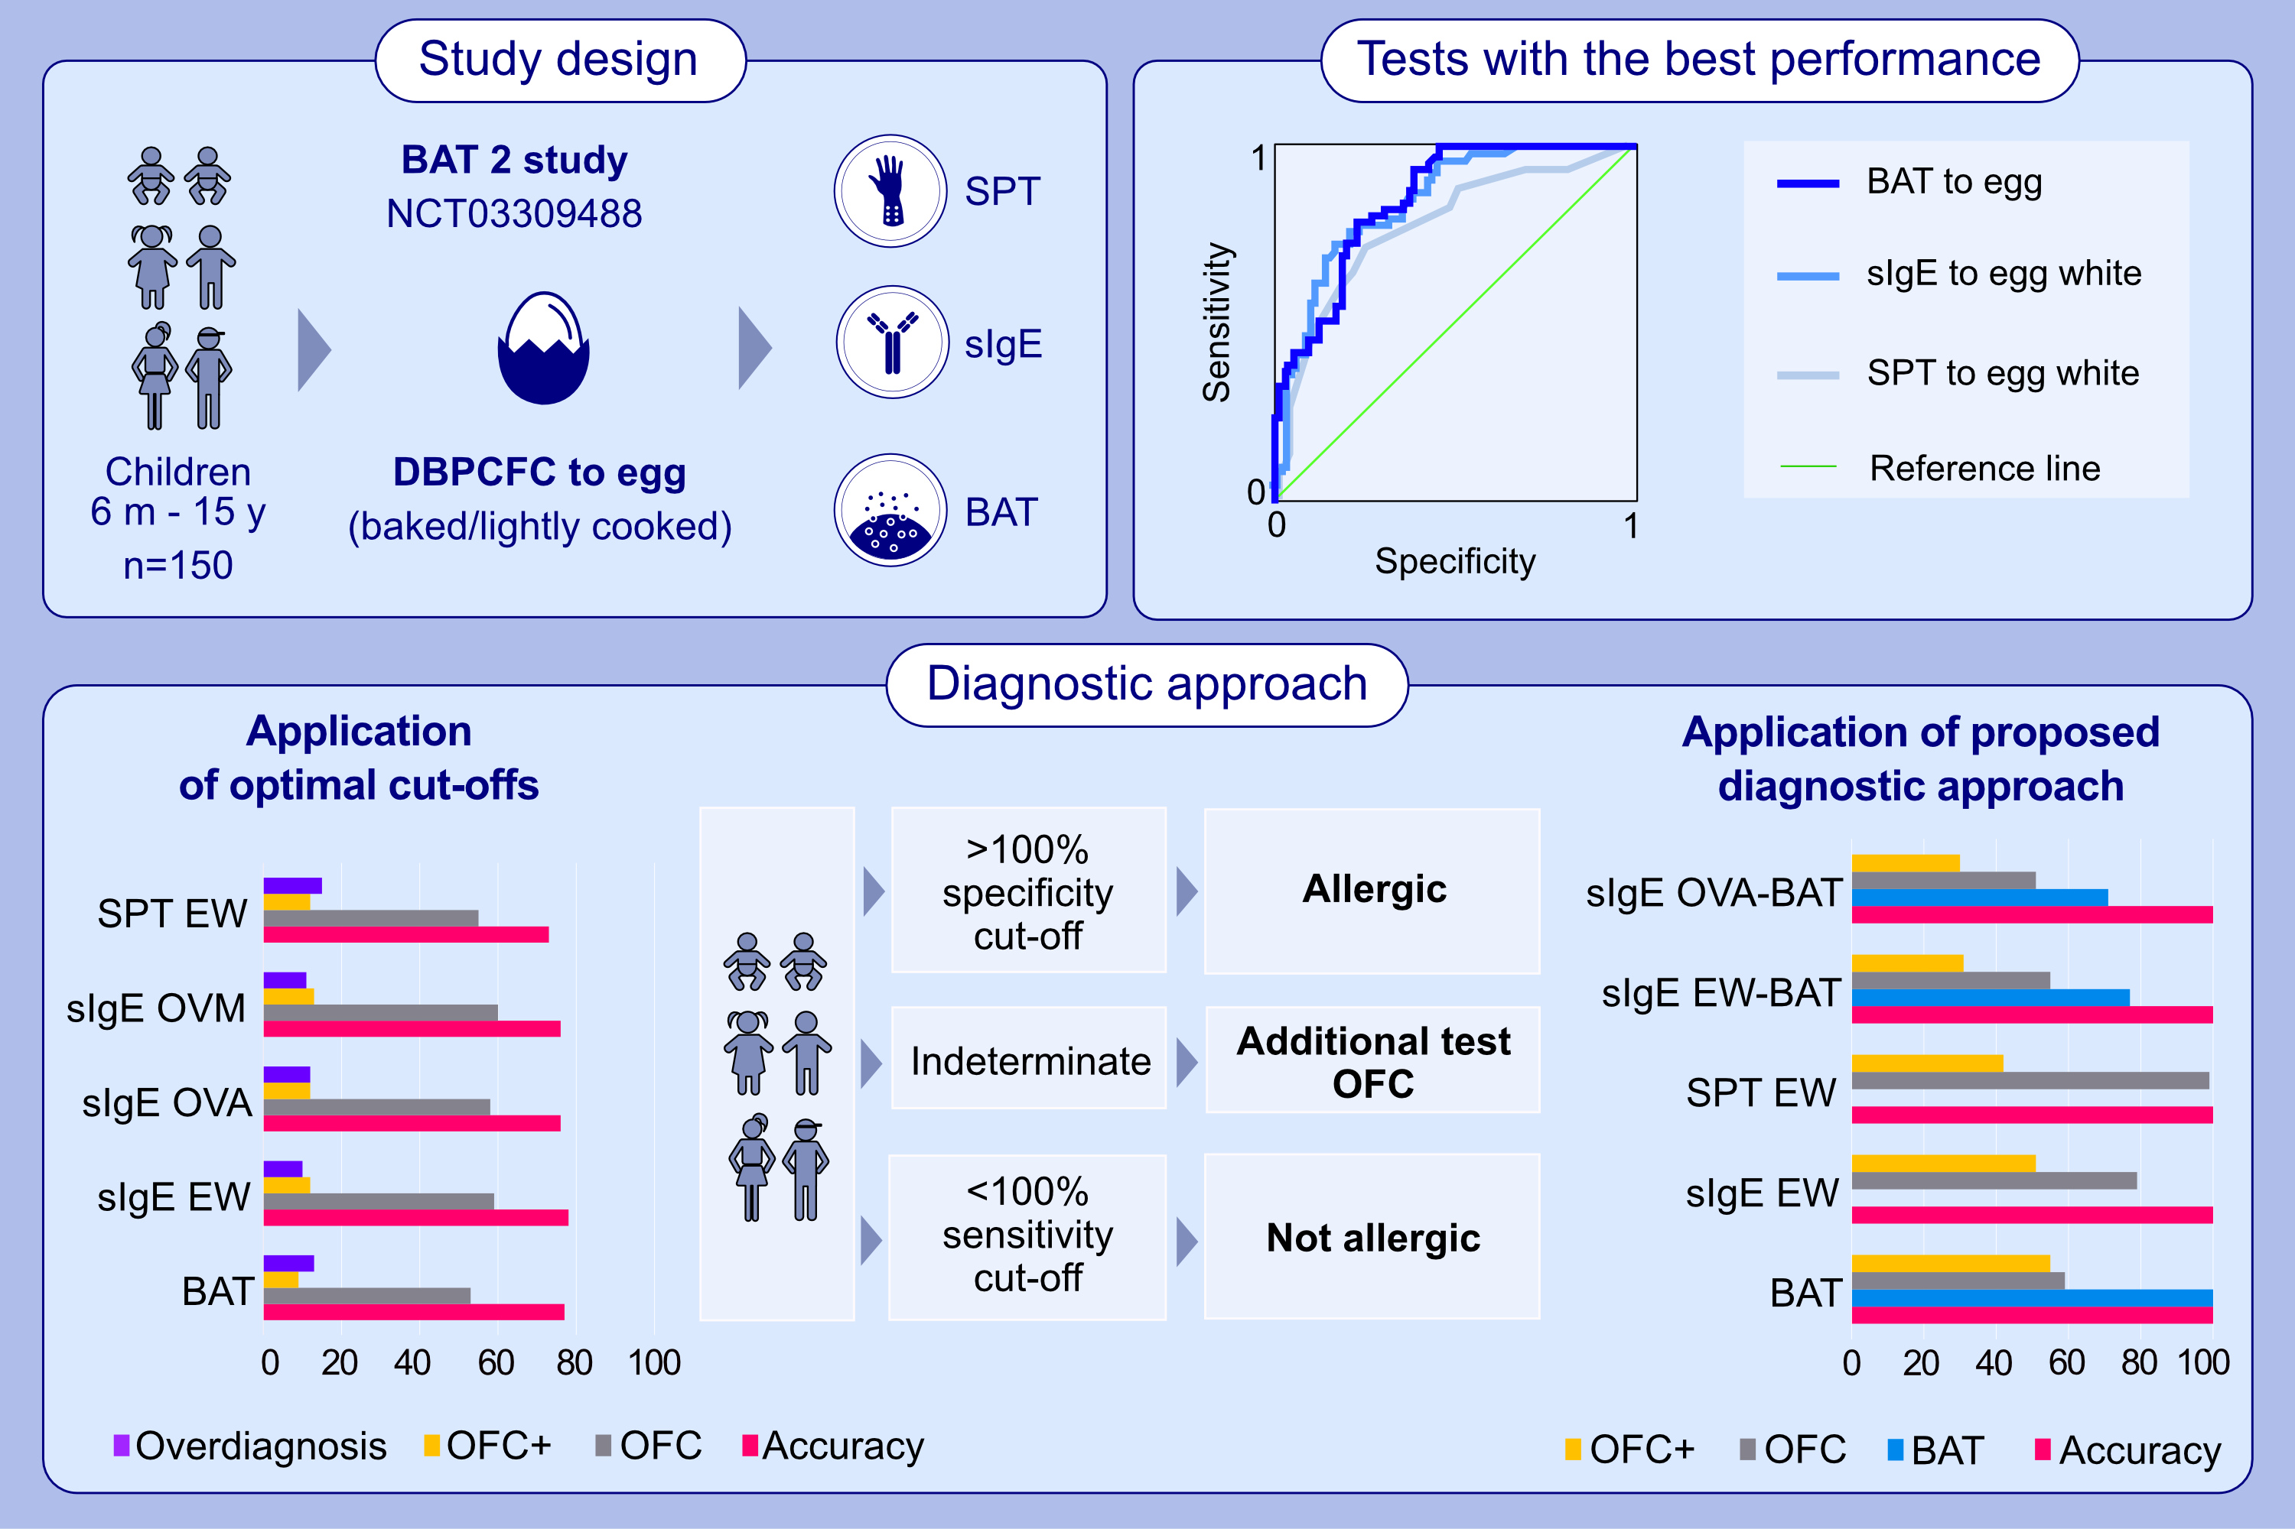
Diagnostic utility of allergy tests to predict baked egg and lightly cooked egg allergies compared to double-blind placebo-controlled food challenges
Marta Krawiec, Suzana Radulovic, Ru-Xin Foong, Andreina Marques-Mejias, Irene Bartha, et al.
Allergy. 2023; pages:
https://doi.org/10.1111/all.15797
© 2019 EAACI and John Wiley and Sons A/S. Published by John Wiley and Sons Ltd.
Notes:
HIGHLIGHTS
All participants had DBPCFC to baked egg and, if this was negative, also DBPCFC to loosely cooked egg; SPT, sIgE and BAT were performed in parallel.
The test with the best diagnostic performance was BAT, followed by sIgE and SPT.
Applying 100% sensitivity and 100% specificity cut-offs allowed 100% accuracy. Using tests sequentially reduced the number of OFCs (and BATs).
Abbreviations: BAT, basophil activation test; DBPCFC, double-blind placebo-controlled food challenge; EW, egg white; NCT, national clinical trial; OVA, ovalbumin; OVM, ovomucoid; OFC, oral food challenge; OFC+, positive oral food challenge; SPT, skin prick test; sIgE, specific IgE

