Slide 1
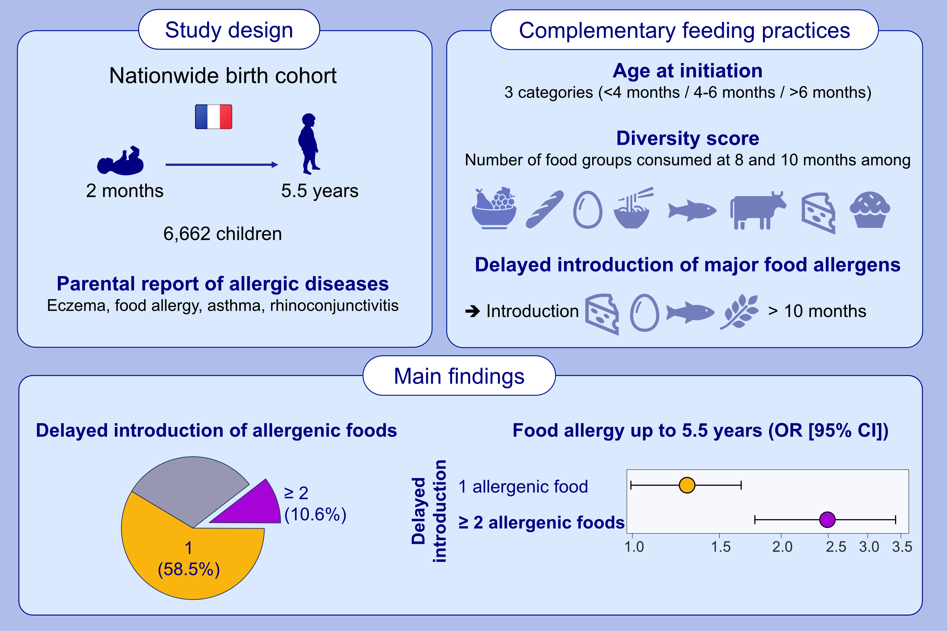
Complementary feeding practices are related to the risk of food allergy in the ELFE cohort
T. Adam, A. Divaret-Chauveau, C. Roduit, K. Adel-Patient, A. Deschildre, C. Raherison, M.-A. , et al.
Allergy. 2023; pages: 2456-2466
https://doi.org/10.1111/all.15828
© 2019 EAACI and John Wiley and Sons A/S. Published by John Wiley and Sons Ltd.
Notes:
HIGHLIGHTS
The study aimed to explore the association between complementary feeding practices (age, food diversity and allergenic food) and the risk of food allergy, eczema, asthma, and rhinoconjunctivitis in early childhood.
More than 50% children were not introduced with at least one major allergenic food (egg, wheat, fish, dairy products) at 10 months.
This delayed introduction (after 10 months) of major allergenic food is associated with a higher risk of food allergy up to the age of 5.5 years.
Abbrevations: CI, confidence interval; ELFE, Étude Longitudinale Française depuis l’Enfance; OR, odds ratio.

