Slide 1
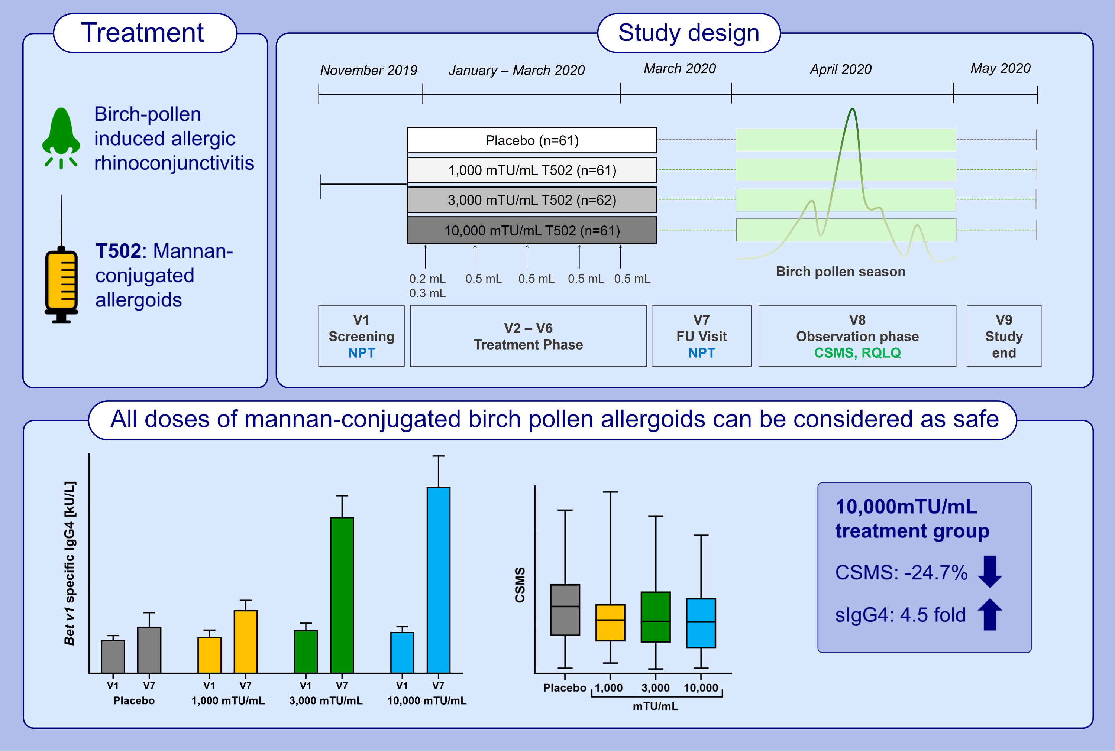
A randomized, double-blind, placebo-controlled trial with mannan-conjugated birch pollen allergoids
Ralph Mösges, Christoph Zeyen, Esther Raskopf, Cengizhan Acikel, Hacer Sahin, et al.
Allergy. 2024; 990-1000
https://doi.org/10.1111/all.15910
© 2019 EAACI and John Wiley and Sons A/S. Published by John Wiley and Sons Ltd.
Notes:
HIGHLIGHTS
• This dose finding study investigated subcutaneous immunotherapy with T502 in birch pollen-induced allergic rhinoconjunctivitis.
• 246 birch-pollen allergic adults received short-course treatment of placebo or different doses of T502.
• The 10,000 mTU/mL dose resulted in the highest efficacy with reduction of CSMS by 24.7% (median) and a 4.5-fold increased production of Bet v1 specific IgG4 compared to placebo.
.

