Slide 1
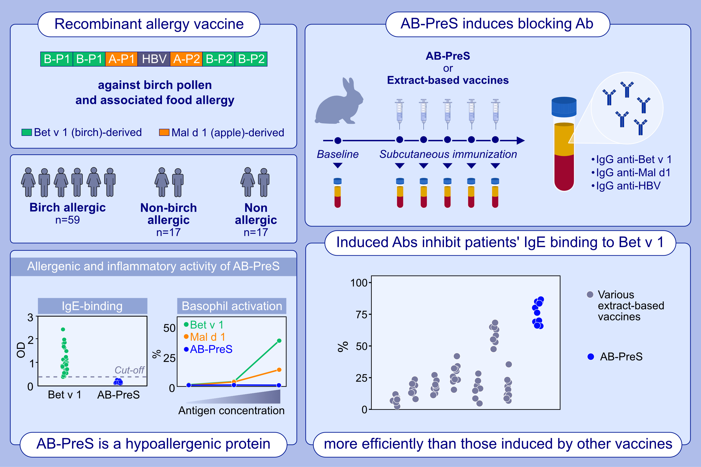
Recombinant PreS-fusion protein vaccine for birch pollen and apple allergy
Musa Khaitov, Igor Shilovskiy, Rudolf Valenta, Milena Weber, Artem Korneev, et al.
Allergy. 2024; 1001-1017
https://doi.org/10.1111/all.15919
© 2019 EAACI and John Wiley and Sons A/S. Published by John Wiley and Sons Ltd.
Notes:
HIGHLIGHTS
• We designed a vaccine consisting of peptides mimicking IgE-epitopes of birch and apple allergens fused with HBV-derived PreS.
• Aluminum hydroxide-adsorbed AB-PreS induces IgG antibodies specific for Bet v 1, Mal d 1 and HBV.
• IgG antibodies induced by AB-PreS inhibit IgE binding of allergic patients IgE to Bet v 1 and Mal d 1 better than extract-based vaccines.
• Anti-PreS IgG may protect against HBV infection. .

