Slide 1
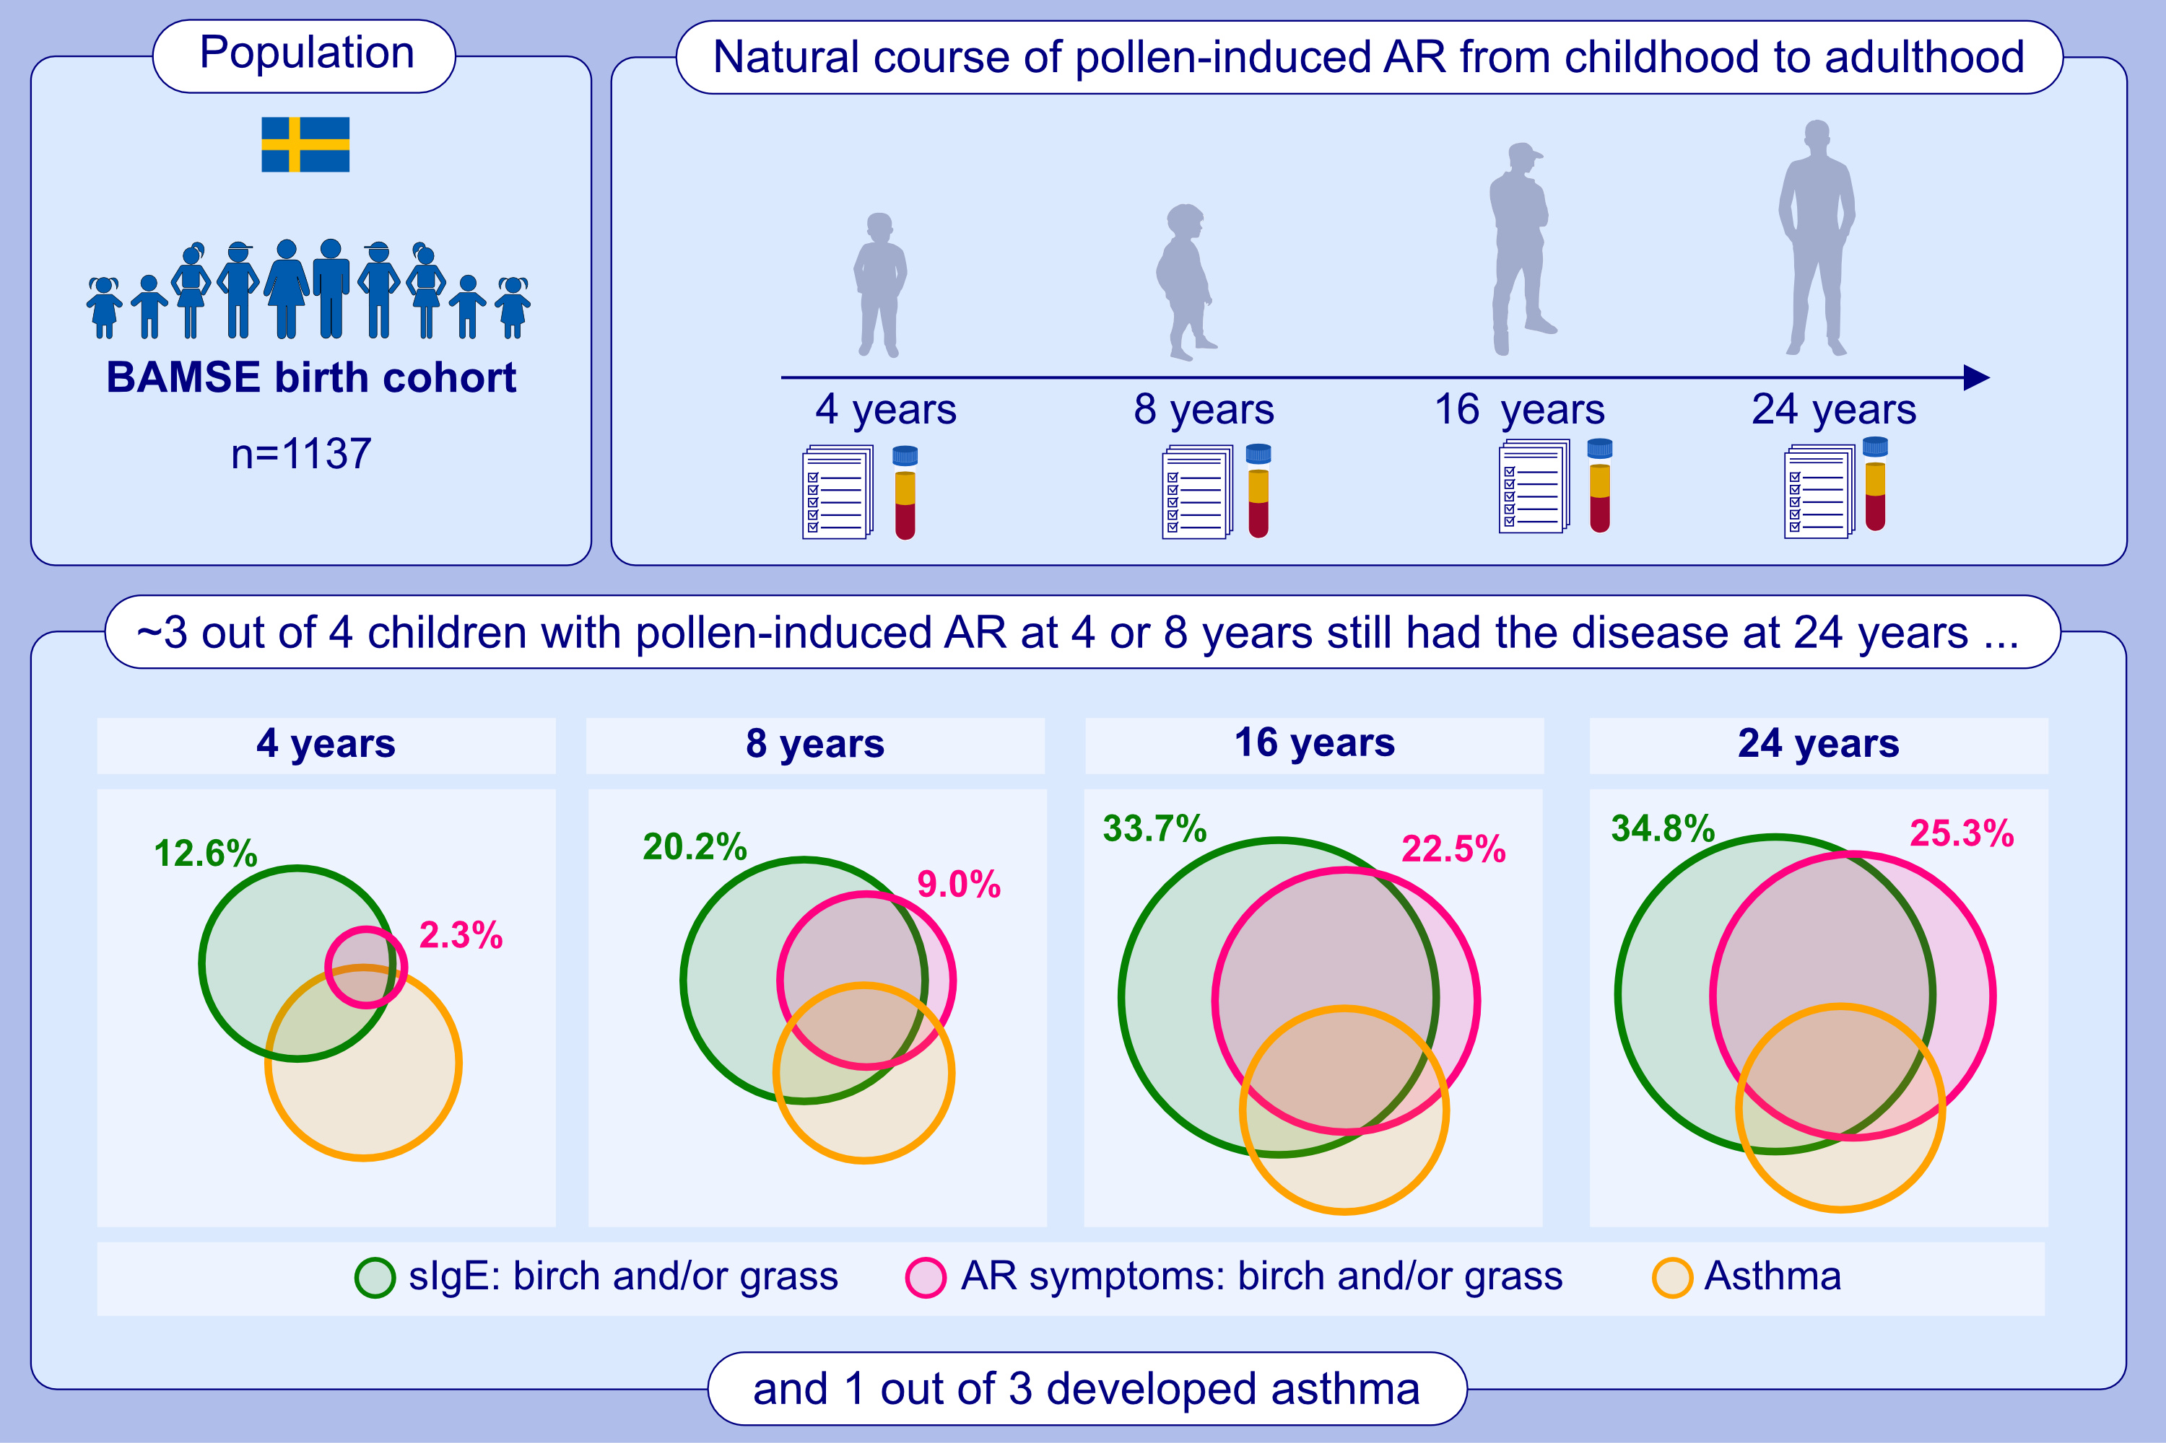
Natural course of pollen-induced allergic rhinitis from childhood to adulthood: A 20-year follow up
Magnus Lindqvist, Katja Biering Leth-Møller, Allan Linneberg, Inger Kull, Anna Bergström, et al.
Allergy. 2024; 884-893
https://doi.org/10.1111/all.15927
© 2019 EAACI and John Wiley and Sons A/S. Published by John Wiley and Sons Ltd.
Notes:
HIGHLIGHTS
• 1137 subjects in the BAMSE birth cohort were followed prospectively over 20 years.
• Children with pollen induced allergic rhinitis are at high risk of persistent disease for at least 20 years.
• Childhood up to adolescence seems to be the most dynamic period of AR progression. .

