Slide 1
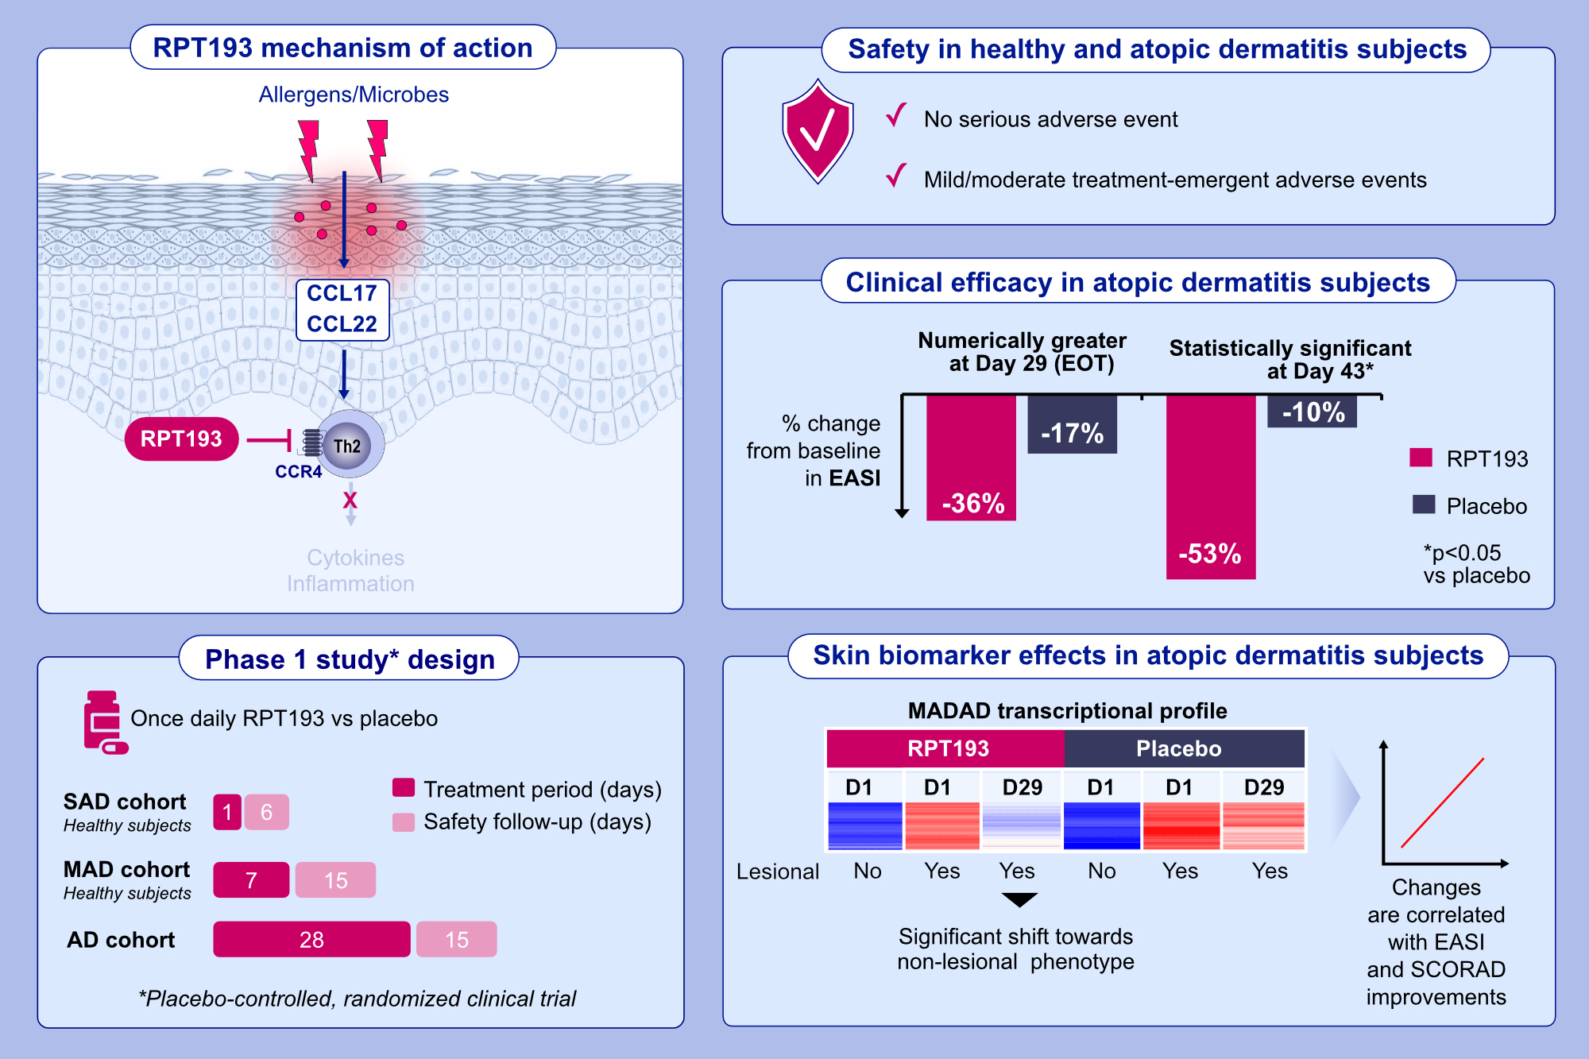
Clinical and molecular effects of oral CCR4 antagonist RPT193 in atopic dermatitis: A Phase 1 study
Robert Bissonnette, Janet DuBois, Paola Facheris, Ester Del Duca, Madeline Kim, et al.
Allergy. 2024; Early view https://doi.org/10.1111/all.15949
© 2019 EAACI and John Wiley and Sons A/S. Published by John Wiley and Sons Ltd.
Notes:
HIGHLIGHTS
• RPT193, a small molecule human CCR4 antagonist, inhibits the migration and downstream function of Th2 cells.
• In this first-in-human, randomized, placebo-controlled Phase 1 study, RPT193 was well tolerated in healthy subjects and subjects with atopic dermatitis.
• RPT193 improved clinical signs and symptoms of atopic dermatitis and normalized transcriptional profile in lesional skin. .

