Slide 1
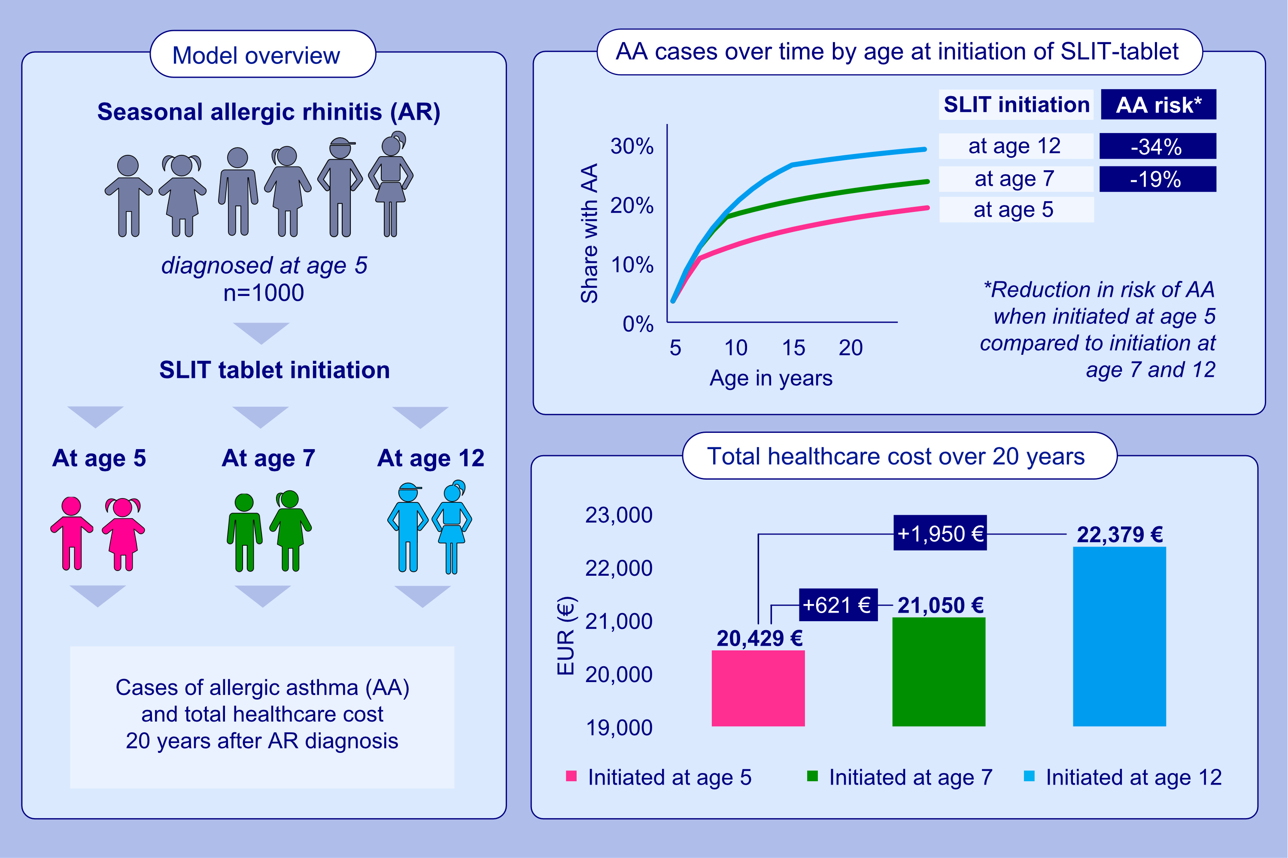
Quantifying the benefits of early sublingual allergen immunotherapy tablet initiation in children
Eckard Hamelmann, Eva Hammerby, Katrine Skaarup Scharling, Mikkel Pedersen, Anna Okkels, et al.
Allergy. 2024; 1018-1027
https://doi.org/10.1111/all.15985
© 2019 EAACI and John Wiley and Sons A/S. Published by John Wiley and Sons Ltd.
Notes:
HIGHLIGHTS
• The BEAT model evaluates clinical and economic effects of SLIT initiated at different ages.
• Initiation of SLIT at age 5 vs 12 results in a 34% reduction in the risk of AA and reduces the total healthcare costs by EUR 1,950 within 20 years.
• Early initiation has the potential to halt progression from AR into AA and reduce healthcare costs.
.

