Slide 1
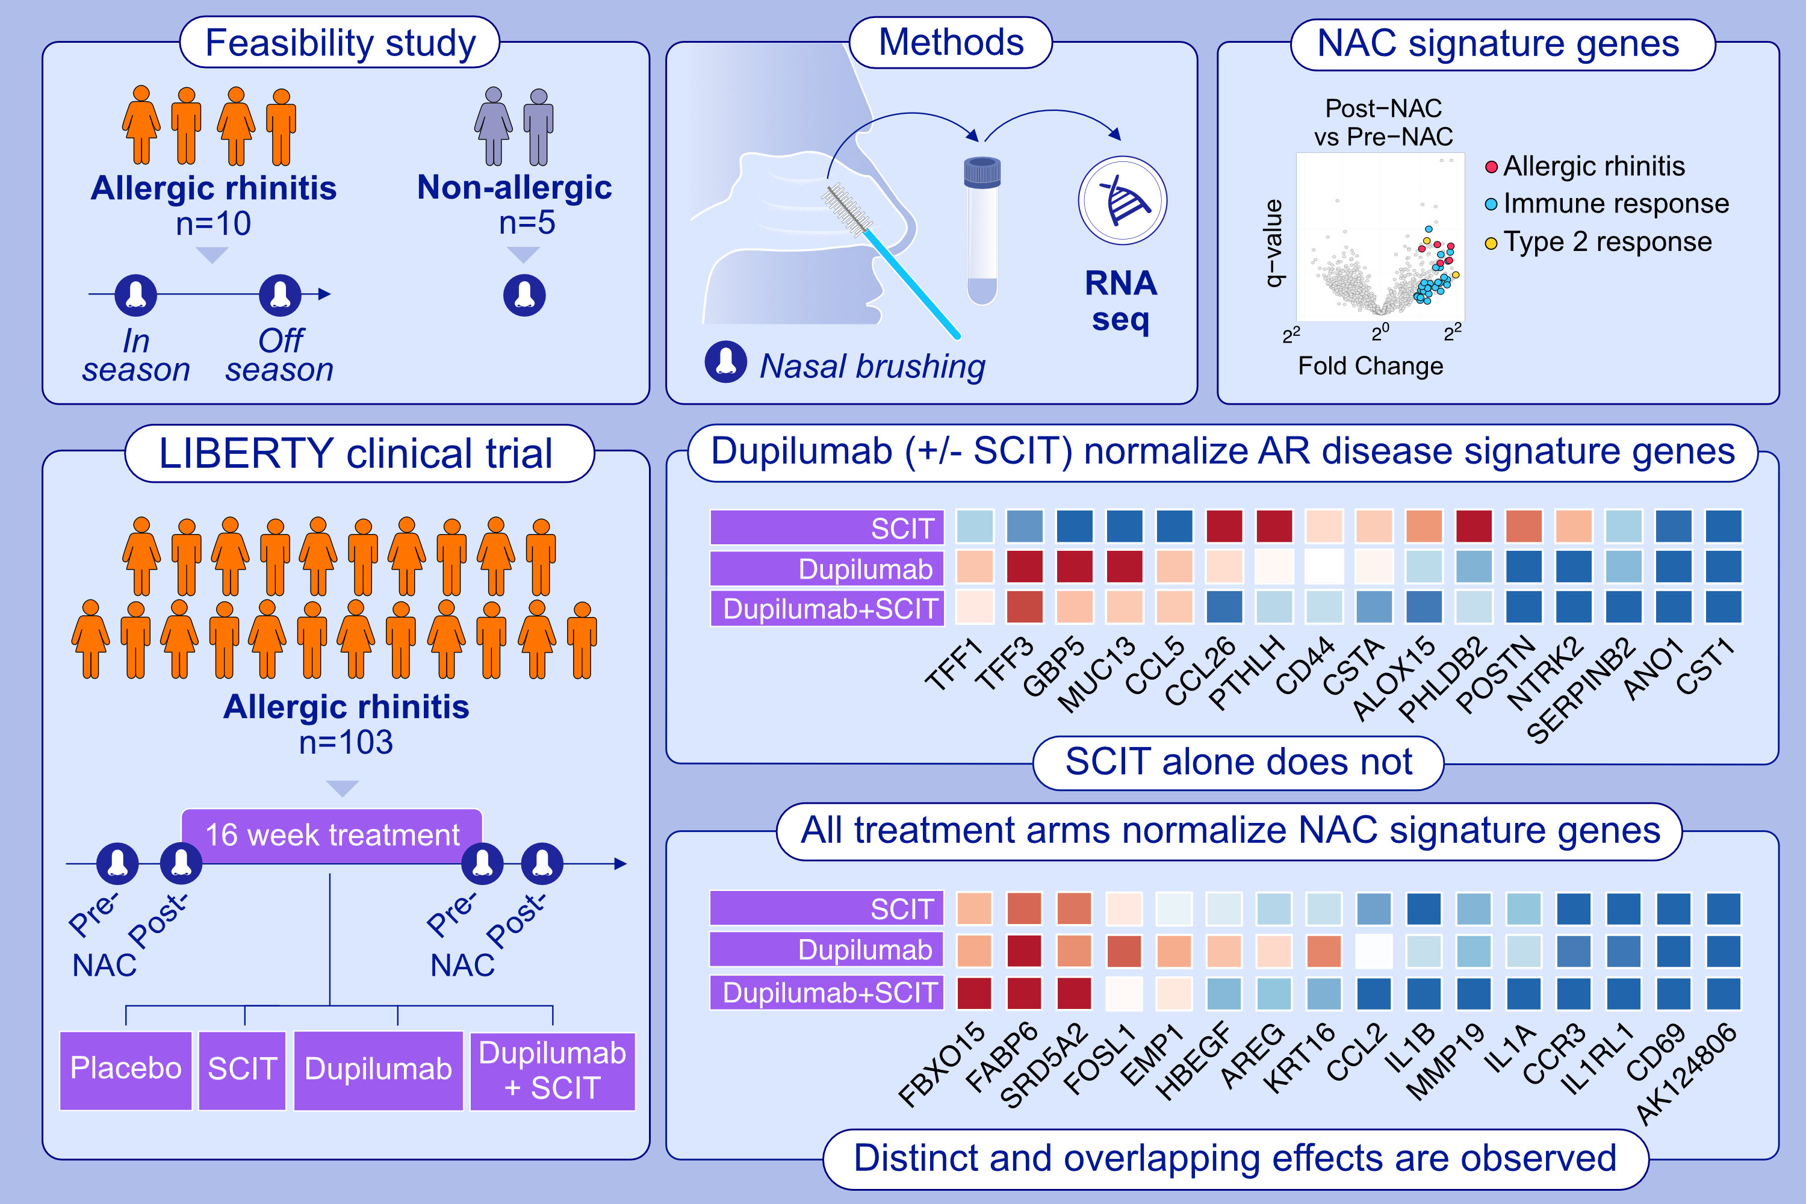
Differential modulation of allergic rhinitis nasal transcriptome by dupilumab and allergy immunotherapy
Matthew F. Wipperman, Kaitlyn M. Gayvert, Amanda Atanasio, Claire Q. Wang, Jonathan Corren, et al.
Allergy. 2024; 894-907
https://doi.org/10.1111/all.16001
© 2019 EAACI and John Wiley and Sons A/S. Published by John Wiley and Sons Ltd.
Notes:
HIGHLIGHTS
• The study aimed to understand the pathobiology of allergic rhinitis (AR) by analysing transcriptome data from nasal brushing samples of individuals with and without AR, and those undergoing different treatments.
• The study evaluated how treatments, including dupilumab, SCIT, a combination of both, vs placebo, influenced AR and allergen challenge specific gene signatures in nasal tissue.
• Results showed that while both dupilumab and SCIT+dupilumab significantly repressed the AR disease signature, and all three treatments repressed the nasal allergen challenge (NAC) gene signature.

