Slide 1
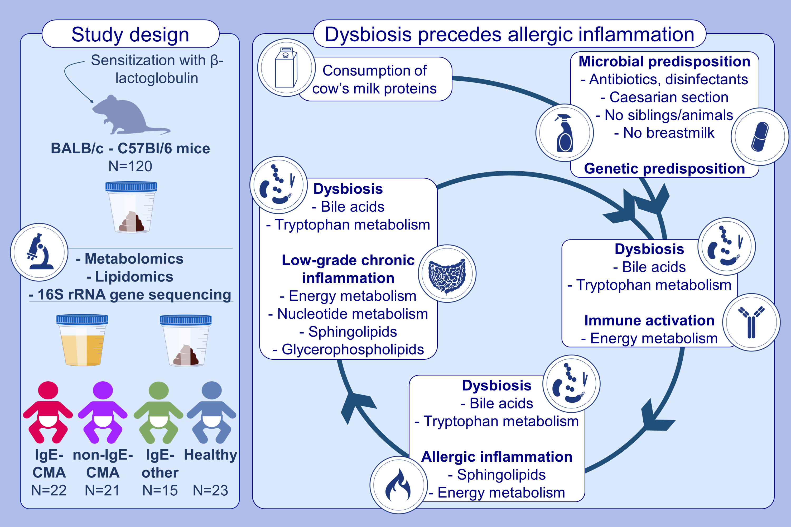
Integrated gut metabolome and microbiome fingerprinting reveals that dysbiosis precedes allergic inflammation in IgE-mediated pediatric cow's milk allergy
Ellen De Paepe, Vera Plekhova, Pablo Vangeenderhuysen, Nele Baeck, Dominique Bullens, et al.
Allergy. 2024; 946-963
https://doi.org/10.1111/all.16005
© 2019 EAACI and John Wiley and Sons A/S. Published by John Wiley and Sons Ltd.
Notes:
HIGHLIGHTS
• Early-stage microbial metabolites, reflective of gut dysbiosis steer the development of the immune system toward food allergies.
• Allergic inflammation appears at the end of the sensitization through a dysregulation in sphingolipid and energy metabolism.
• Allergic children on an elimination diet suffer from subacute chronic inflammation, as a consequence of concurrent dysbiosis. .

