Slide 1
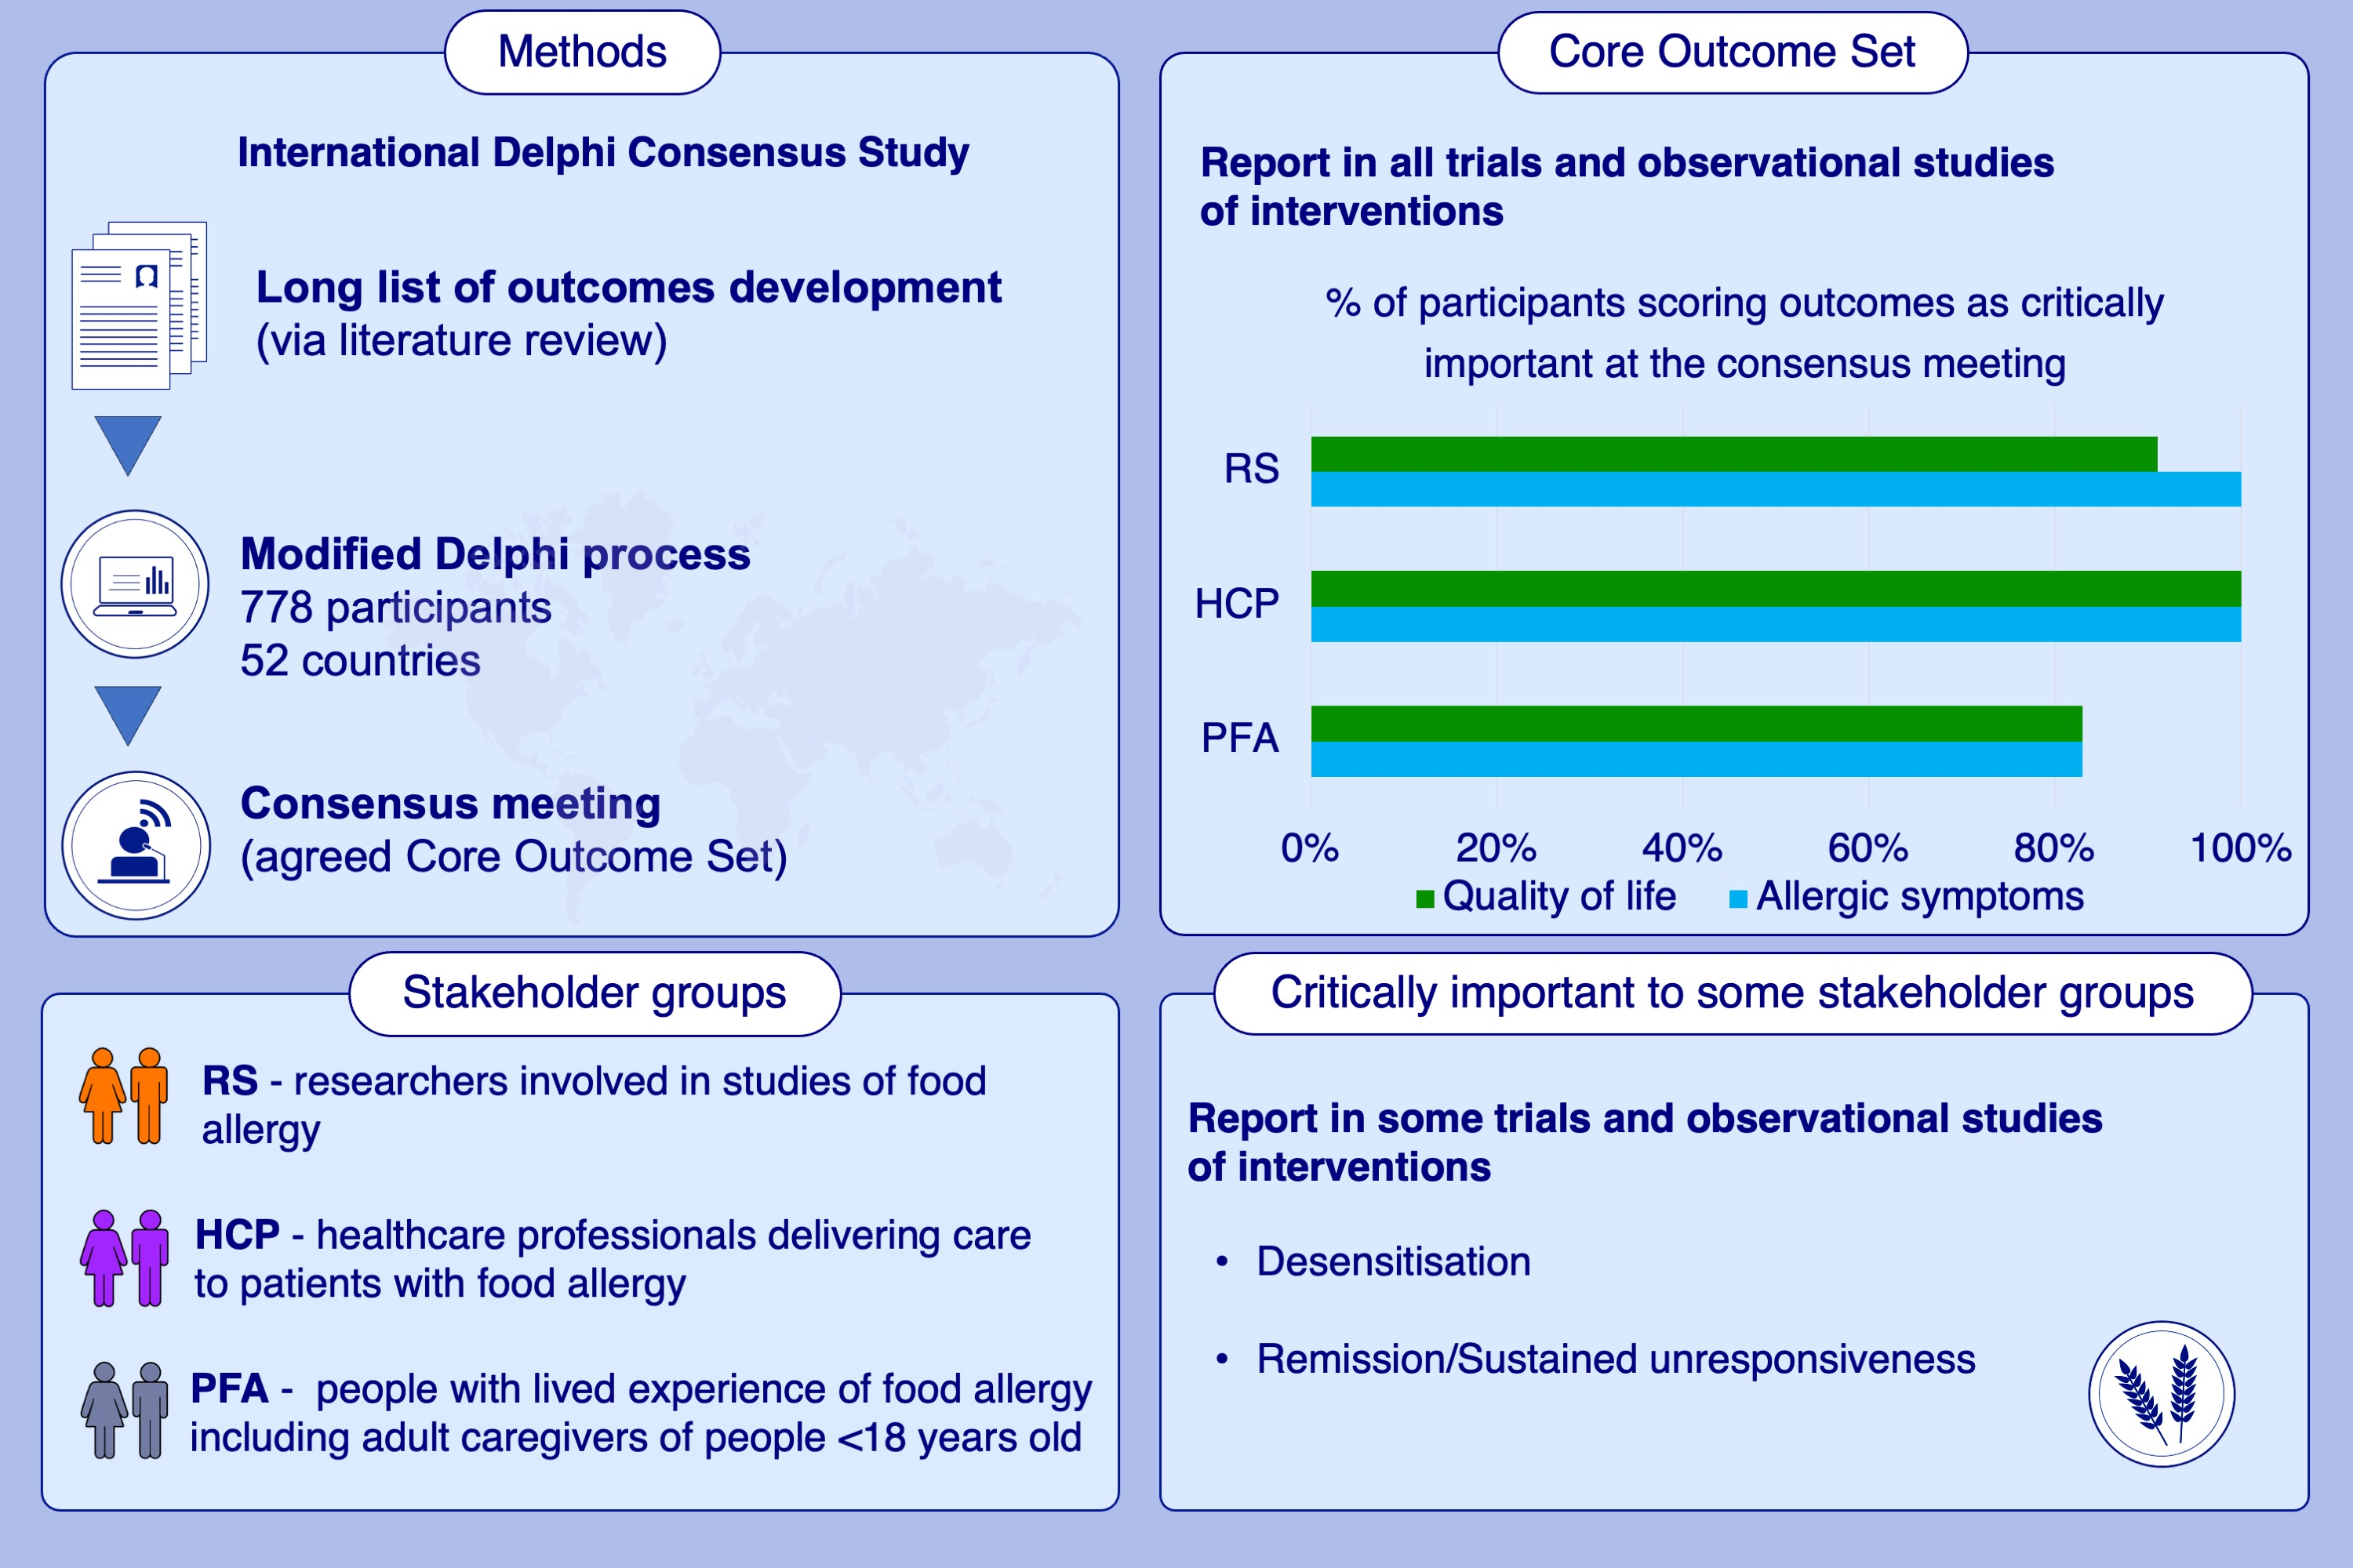
Core Outcome Set for IgE-mediated food allergy clinical trials and observational studies of interventions: International Delphi consensus study ‘COMFA’
Anastasia Demidova, Karl Philipp Drewitz, Parisut Kimkool, Nikolina Banjanin, Vladyslava Barzylovich, et al.
Allergy. 2024;977-989
https://doi.org/10.1111/all.16023
© 2019 EAACI and John Wiley and Sons A/S. Published by John Wiley and Sons Ltd.
Notes:
HIGHLIGHTS
• Core Outcome Measures for Food Allergy (COMFA) initiative, through international modified Delphi consensus process, has established a Core Outcome Set (COS) for IgE-mediated food allergy measured in clinical trials and observational studies of interventions.
• ‘Allergic symptoms’ and ‘quality of life’ achieved consensus for inclusion in the final COS.
• ‘Desensitisation’ and ‘remission/sustained unresponsiveness’ were considered important but did not reach a predefined threshold for inclusion in all three stakeholder groups. .

