Slide 1
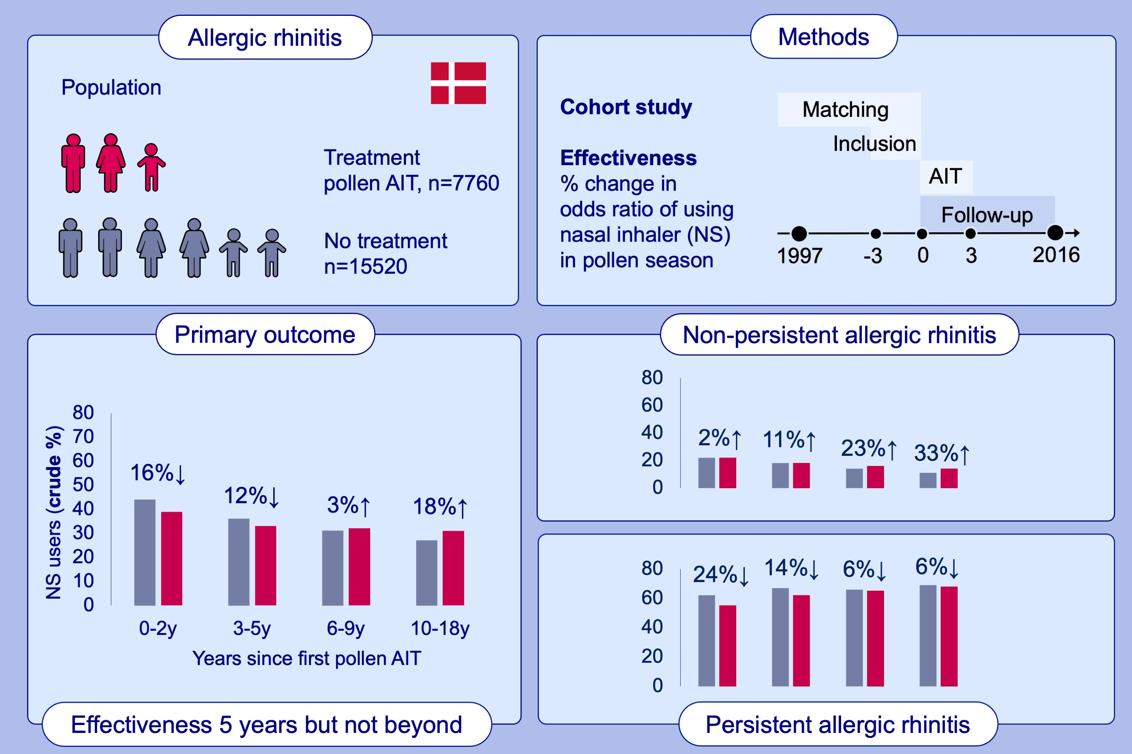
The effectiveness of pollen allergen immunotherapy on allergic rhinitis over 18 years: A national cohort study in Denmark
Peter Bager, Gry Poulsen, Jan Wohlfahrt, Mads Melbye
Allergy. 2024; 1028-1041
https://doi.org/10.1111/all.16026
© 2019 EAACI and John Wiley and Sons A/S. Published by John Wiley and Sons Ltd.
Notes:
HIGHLIGHTS
• This analysis of Danish national prescription data over 18 years shows that pollen allergen immunotherapy reduces allergic rhinitis medication users up to 5 years after start of the standard 3 years of therapy, but not beyond 5 years.
• Post-hoc analyses suggests this effectiveness is more consistent among patients with persistent allergic rhinitis.
.

