Slide 1
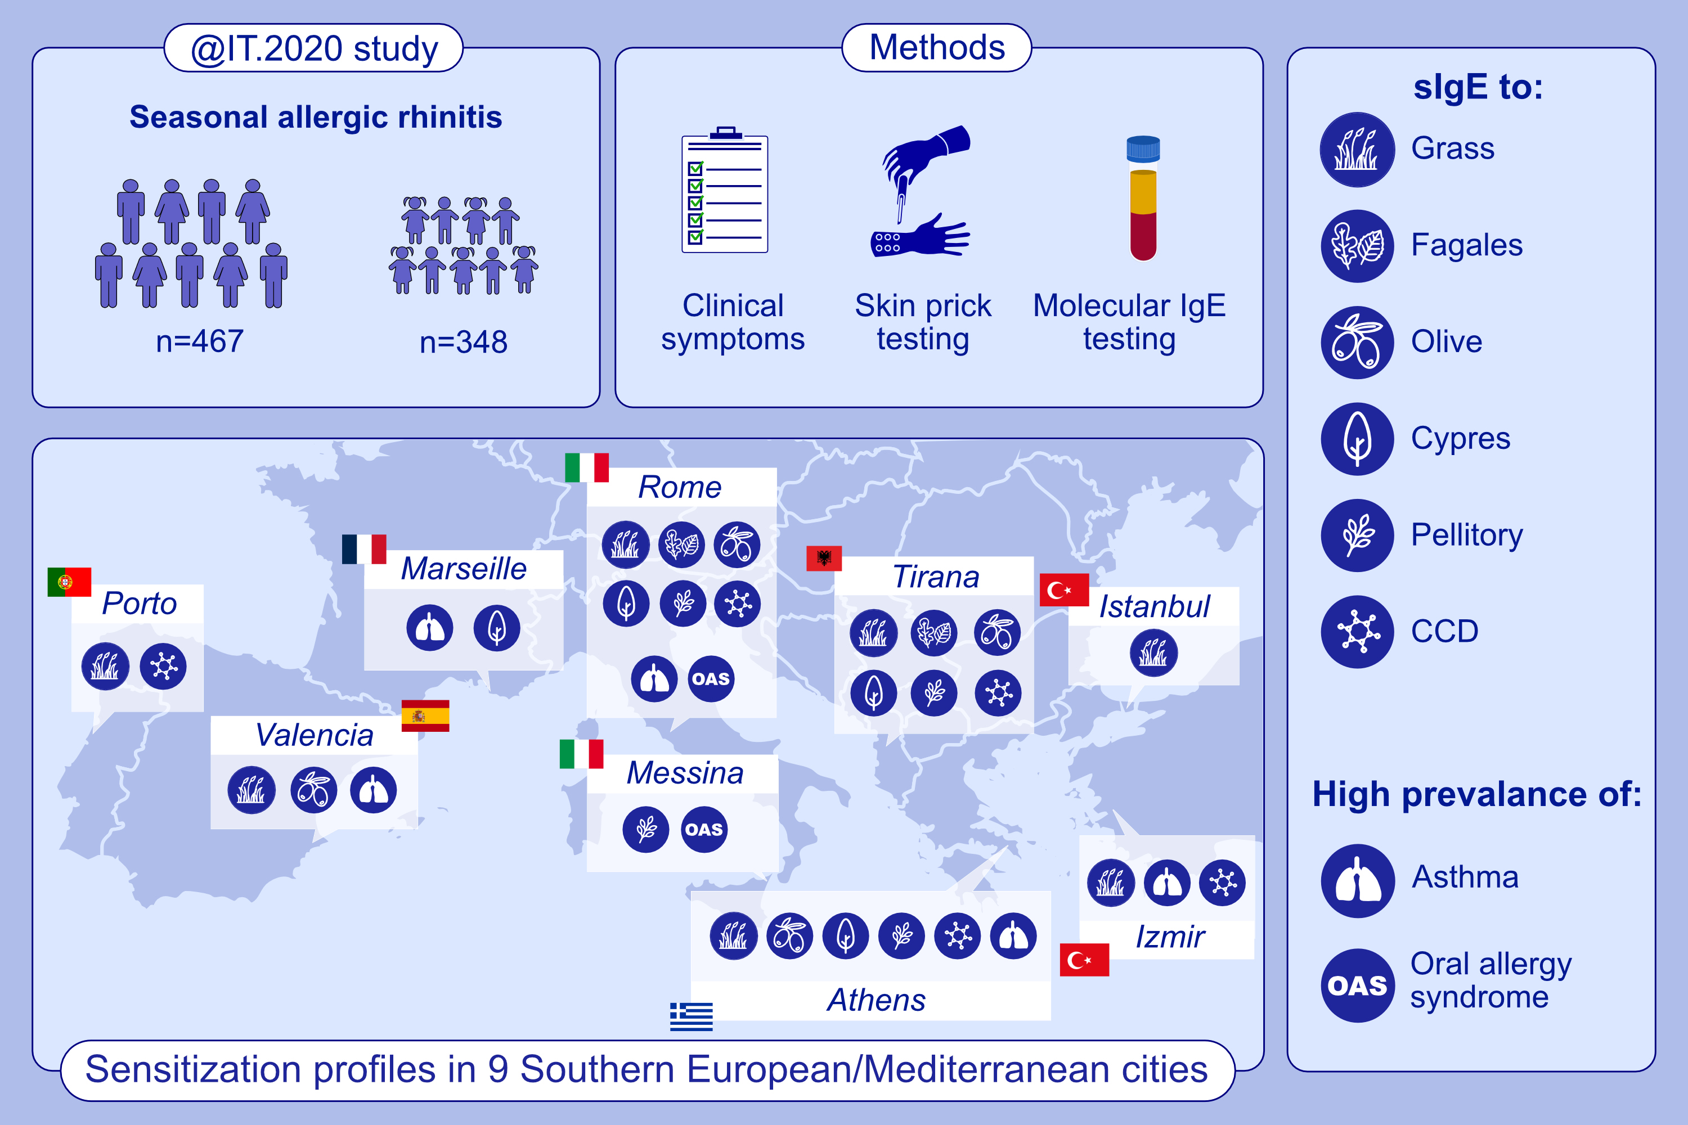
Heterogeneity of sensitization profiles and clinical phenotypes among patients with seasonal allergic rhinitis in Southern European countries—The @IT.2020 multicenter study
S. Dramburg, U. Grittner, E. Potapova, A. Travaglini, S. Tripodi, et al.
Allergy. 2024; 908-923
https://doi.org/10.1111/all.16029
© 2019 EAACI and John Wiley and Sons A/S. Published by John Wiley and Sons Ltd.
Notes:
HIGHLIGHTS
• Dupilumab therapy affects the expression of inflammatory markers in tear fluids and the microbiome of ocular surfaces of AD patients.
• A high expression of Th2/Th17 inflammatory markers in tear fluids at baseline is characteristic for AD patients later developing DAOSD.
• In patients developing DAOSD, a shift from a Th2/Th17 toward a Th1/Th17 inflammation pattern at ocular surfaces is observed. .

