Slide 1
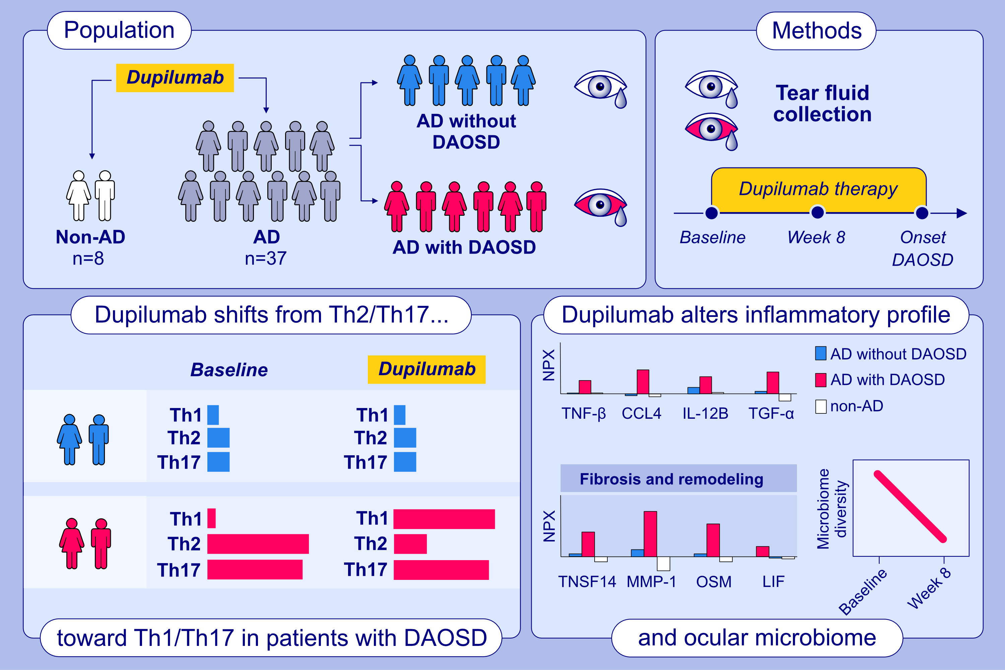
Dupilumab-associated ocular surface disease is characterized by a shift from Th2/Th17 toward Th1/Th17 inflammation
Kathrin Thormann, Anne-Sophie Lüthi, Felix Deniau, Anja Heider, Simone Cazzaniga, et al.
Allergy. 2024; 937-948
https://doi.org/10.1111/all.16045
© 2019 EAACI and John Wiley and Sons A/S. Published by John Wiley and Sons Ltd.
Notes:
HIGHLIGHTS
Dupilumab therapy affects the expression of inflammatory markers in tear fluids and the microbiome of ocular surfaces of AD patients.
A high expression of Th2/Th17 inflammatory markers in tear fluids at baseline is characteristic for AD patients later developing DAOSD.
In patients developing DAOSD, a shift from a Th2/Th17 toward a Th1/Th17 inflammation pattern at ocular surfaces is observed.

