Slide 1
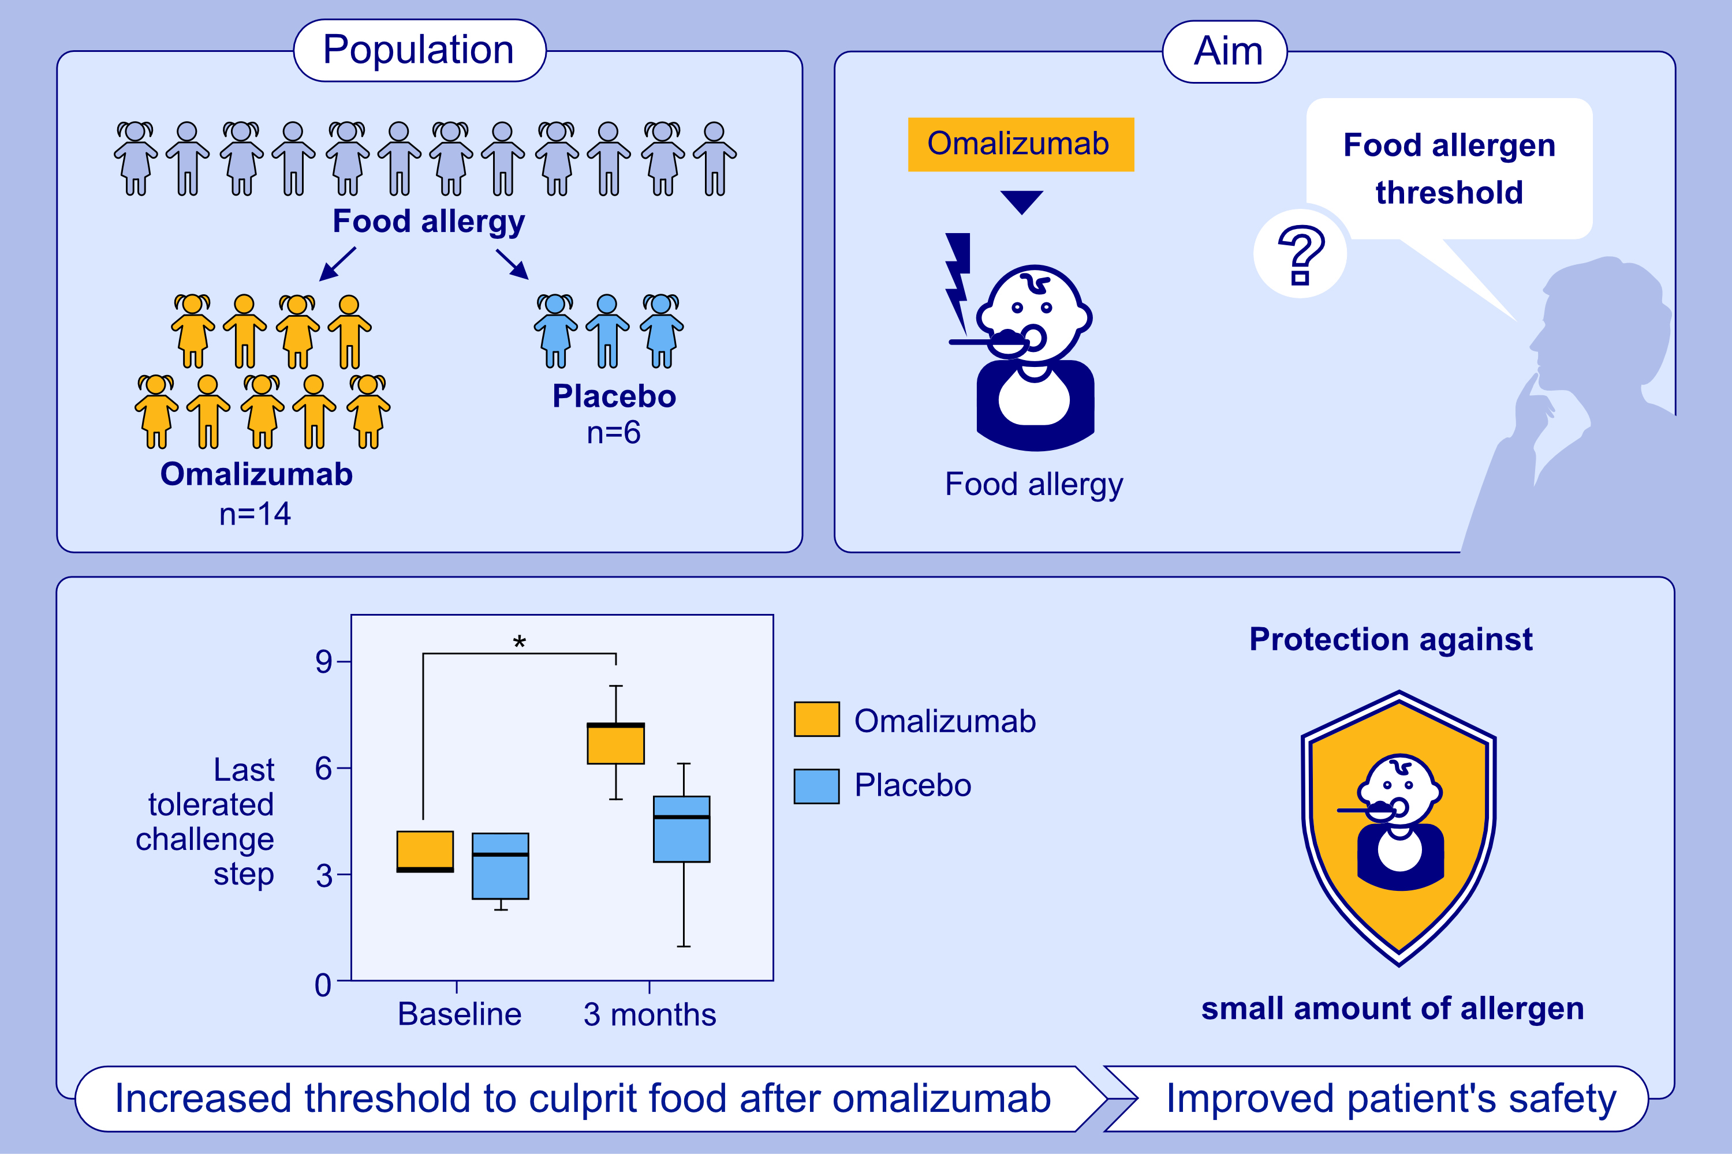
A randomized, double-blind placebo-controlled study on the efficacy of Omalizumab on food allergy threshold in children with severe food allergy
Charlotte G. Mortz, Louise Parke, Helene M. Rasmussen, Henrik Fomsgaard Kjaer, Carsten Bindslev-Jensen et al.
Allergy. 2024; 964-976
https://doi.org/10.1111/all.16046
© 2019 EAACI and John Wiley and Sons A/S. Published by John Wiley and Sons Ltd.
Notes:
HIGHLIGHTS
• This study evaluates the efficacy of Omalizumab in children with food allergy.
• Omalizumab increased food allergy threshold significant compared to placebo (p=0.003).
• The threshold before Omalizumab treatment was 0.013-0.443 gram food protein while the last tolerated dose after 3 months of treatment increased up to 44 gram food protein (1.143-44).
• An increased threshold level during Omalizumab treatment significantly improves patient safety and protects children against traces of allergen. .

