Slide 1
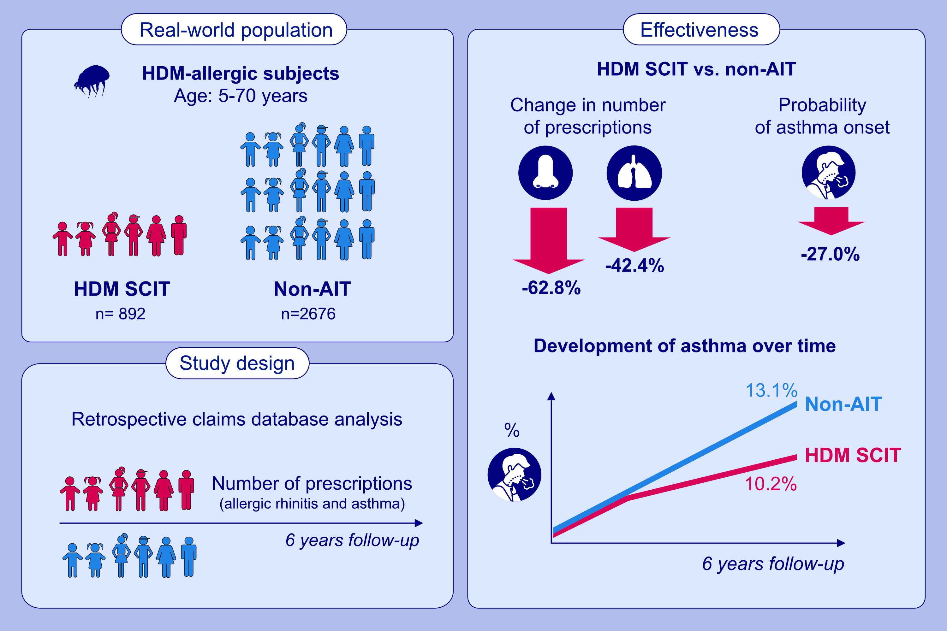
House dust mite SCIT reduces asthma risk and significantly improves long-term rhinitis and asthma control—A RWE study
Marek Jutel, Ludger Klimek, Hartmut Richter, Bernd Brüggenjürgen, Christian Vogelberg et al.
Allergy. 2024; 1042-1051
https://doi.org/10.1111/all.16052
© 2019 EAACI and John Wiley and Sons A/S. Published by John Wiley and Sons Ltd.
Notes:
HIGHLIGHTS
• This study presents 6-years follow-up results for real-world effectiveness of HDM SCIT compared to non-AIT in Germany based on a retrospective claims database analysis.
• During the follow-up period after at least two years of SCIT, the number of prescriptions in the SCIT group reduces by 62.8% for allergic rhinitis medication and by 42.4% for asthma medication.

