Slide 1
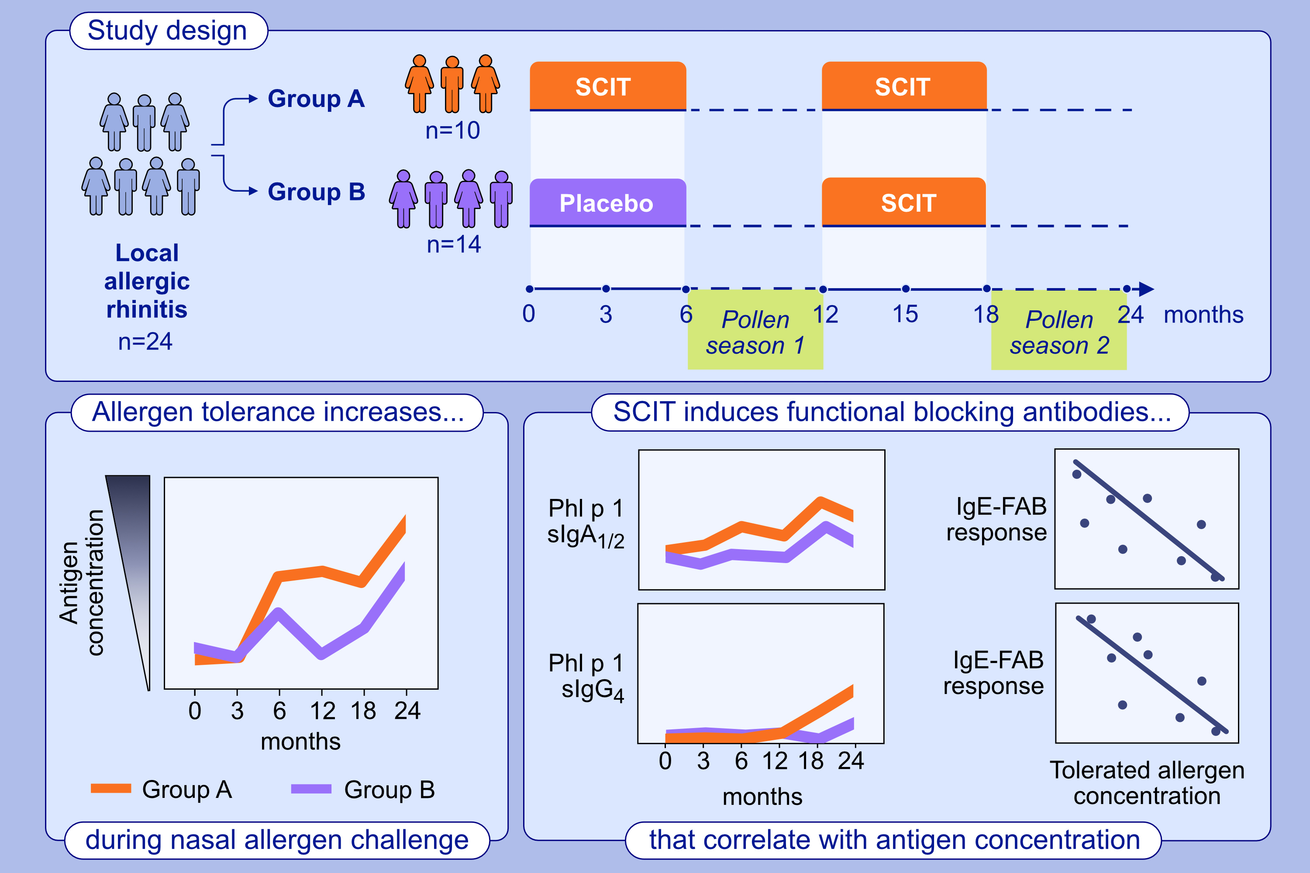
Nasal allergen-neutralizing antibodies correlate closely with tolerated intranasal allergen challenge dose following grass pollen subcutaneous immunotherapy in patients with local allergic rhinitis
Ibon Eguiluz-Gracia, Rebecca V. Parkin, Janice A. Layhadi, Elizabeth Palmer, Xun Meng, et al.
Allergy. 2024. Pages; 2197-2206
https://doi.org/10.1111/all.16083
© 2019 EAACI and John Wiley and Sons A/S. Published by John Wiley and Sons Ltd.
Notes:
HIGHLIGHTS
• This study investigates SCIT capacity to induce local and systemic blocking antibodies in patients with local allergic rhinitis.
• Grass pollen SCIT induces functional systemic blocking antibodies.
• Grass pollen SCIT is associated with induction of functional Phl p specific IgA1/2 and IgG4 which can inhibit IgE-facilitated allergen binding to CD23 on B cells and correlate with reduced allergen tolerated dose.
.

