Slide 1
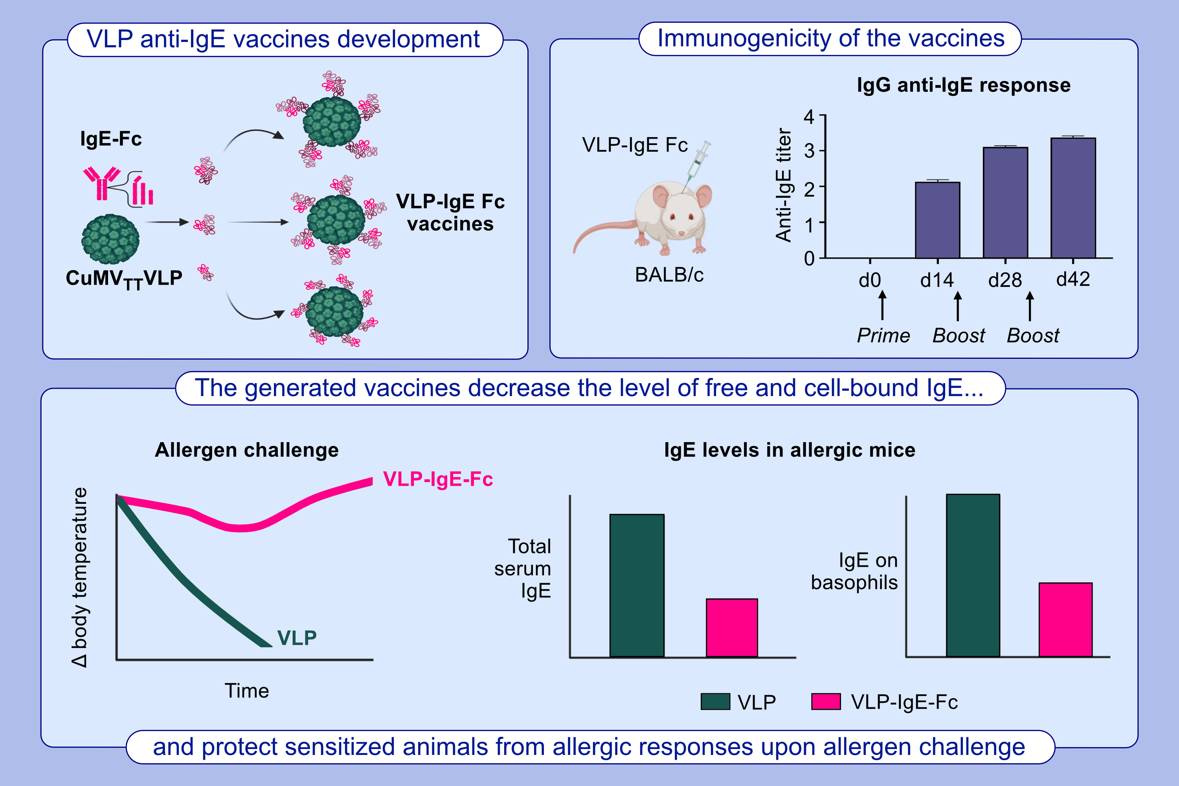
Generation of a virus-like particles based vaccine against IgE
Zahra Gharailoo, Kevin Plattner, Gilles Augusto, Paul Engeroff, Monique Vogel, et al.
Allergy. 2024. Pages: 2207-2221
https://doi.org/10.1111/all.16090
© 2019 EAACI and John Wiley and Sons A/S. Published by John Wiley and Sons Ltd.
Notes:
HIGHLIGHTS
• This study aimed to develop an anti-IgE vaccine based on VLPs which can induce long-lasting neutralizing IgG anti-IgE antibodies reducing allergic responses without causing intrinsic mast cell activation due to IgE cross-linking.
• VLP-based anti-IgE vaccine candidates were produced by chemically coupling synthetic mouse IgE-Fc fragments to plant-virus derived CuMVTT VLPs.
• These vaccine candidates were highly immunogenic and induced protection upon allergen challenge by decreasing the level of free and cell bound IgE.
• .

