Slide 1
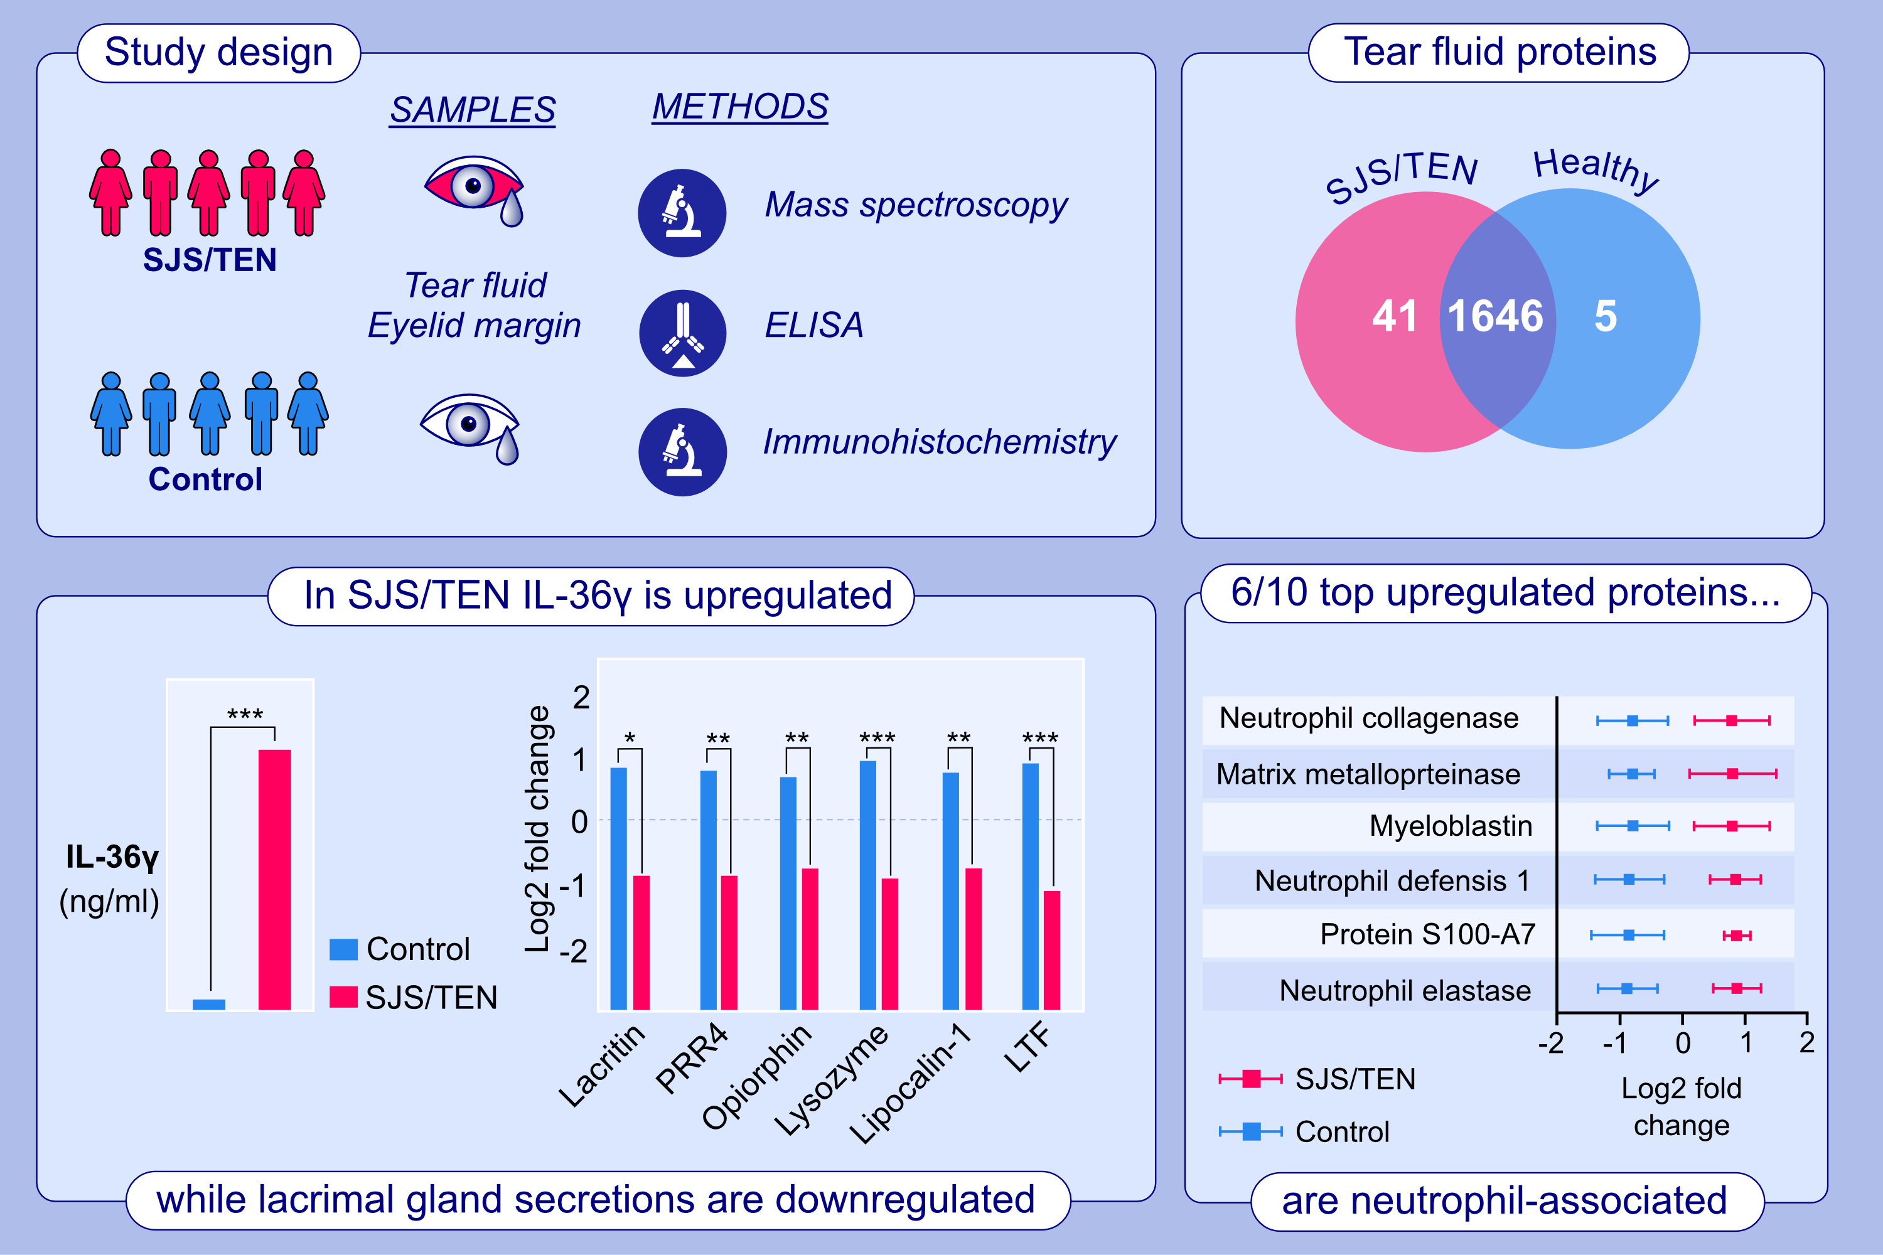
Neutrophil-driven and interleukin-36γ-associated ocular surface inflammation in chronic Stevens–Johnson syndrome
Madhuri Amulya Koduri, Tejaswini Pingali, Deeksha Prasad, Vijay Singh, Swati Singh, et al.
Allergy. 2024;. Pages: 2128-2143
https://doi.org/10.1111/all.16126
© 2019 EAACI and John Wiley and Sons A/S. Published by John Wiley and Sons Ltd.
Notes:
HIGHLIGHTS
• This study investigates the tear proteome and specific factors involved in the ocular complications in SJS/TEN.
• We identify 1692 tear fluid proteins.
• In patients with SJS/TEN, several of the top upregulated proteins are associated with neutrophil secretions.
• IL-36γ is significantly upregulated in tear fluid of patients with SJS/TEN, while lacrimal gland secretions are downregulated.

