Slide 1
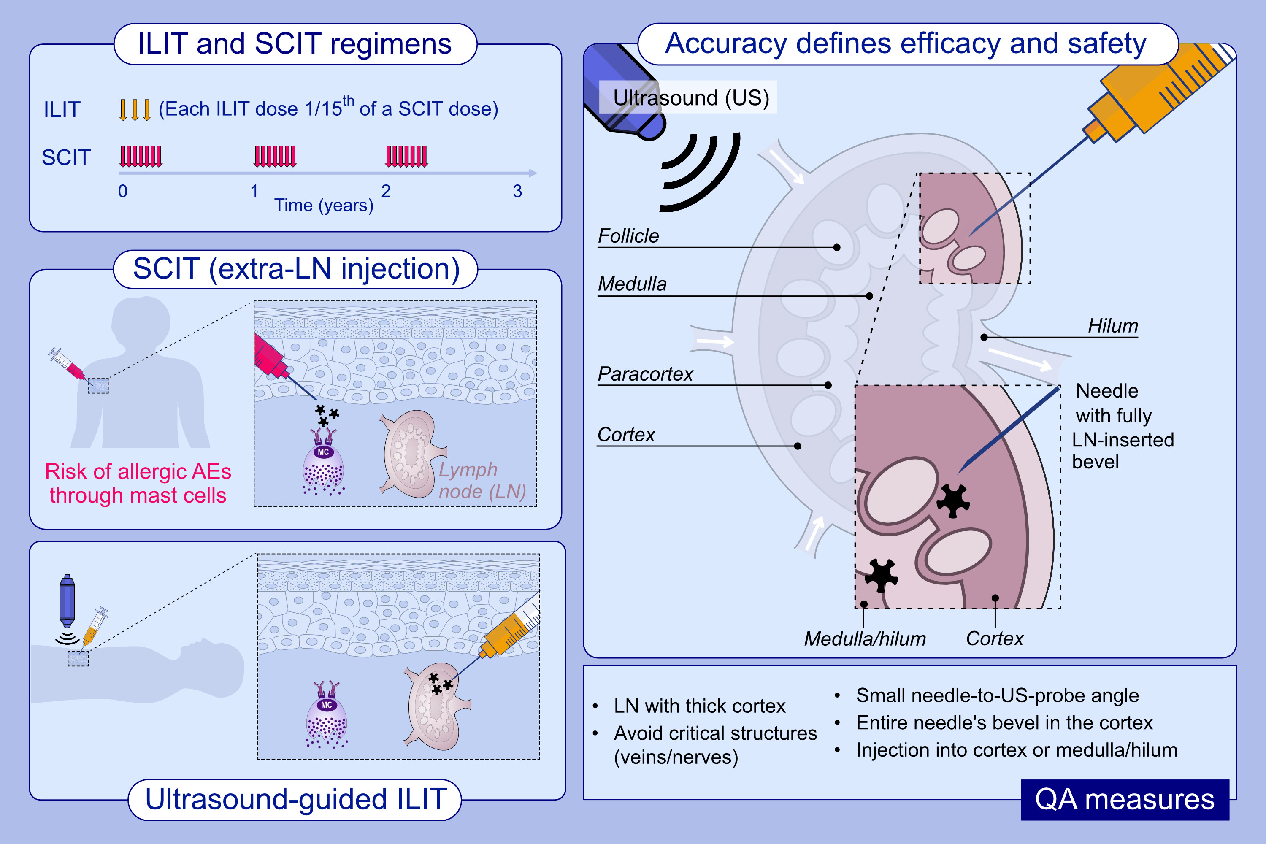
How to hit the allergy target: A critical appraisal of intralymphatic immunotherapy with practical recommendations on ultrasound-guided injections
Stephan Flory, Bjarke Hviid-Vyff, Lara Šošić, Johannes M. Schmid, Lars Ahlbeck, et al.
Allergy. 2024; pages: 2222-2234 https://doi.org/10.1111/all.16138
© 2019 EAACI and John Wiley and Sons A/S. Published by John Wiley and Sons Ltd.
Notes:
HIGHLIGHTS
• Ultrasound-guided ILIT holds promise for treatment of allergy.
• Correct positioning of the needle within the lymph node is critical for efficacy and safety, and practice correlate with improved needle visibility and more accurate ILIT injections.

