Slide 1
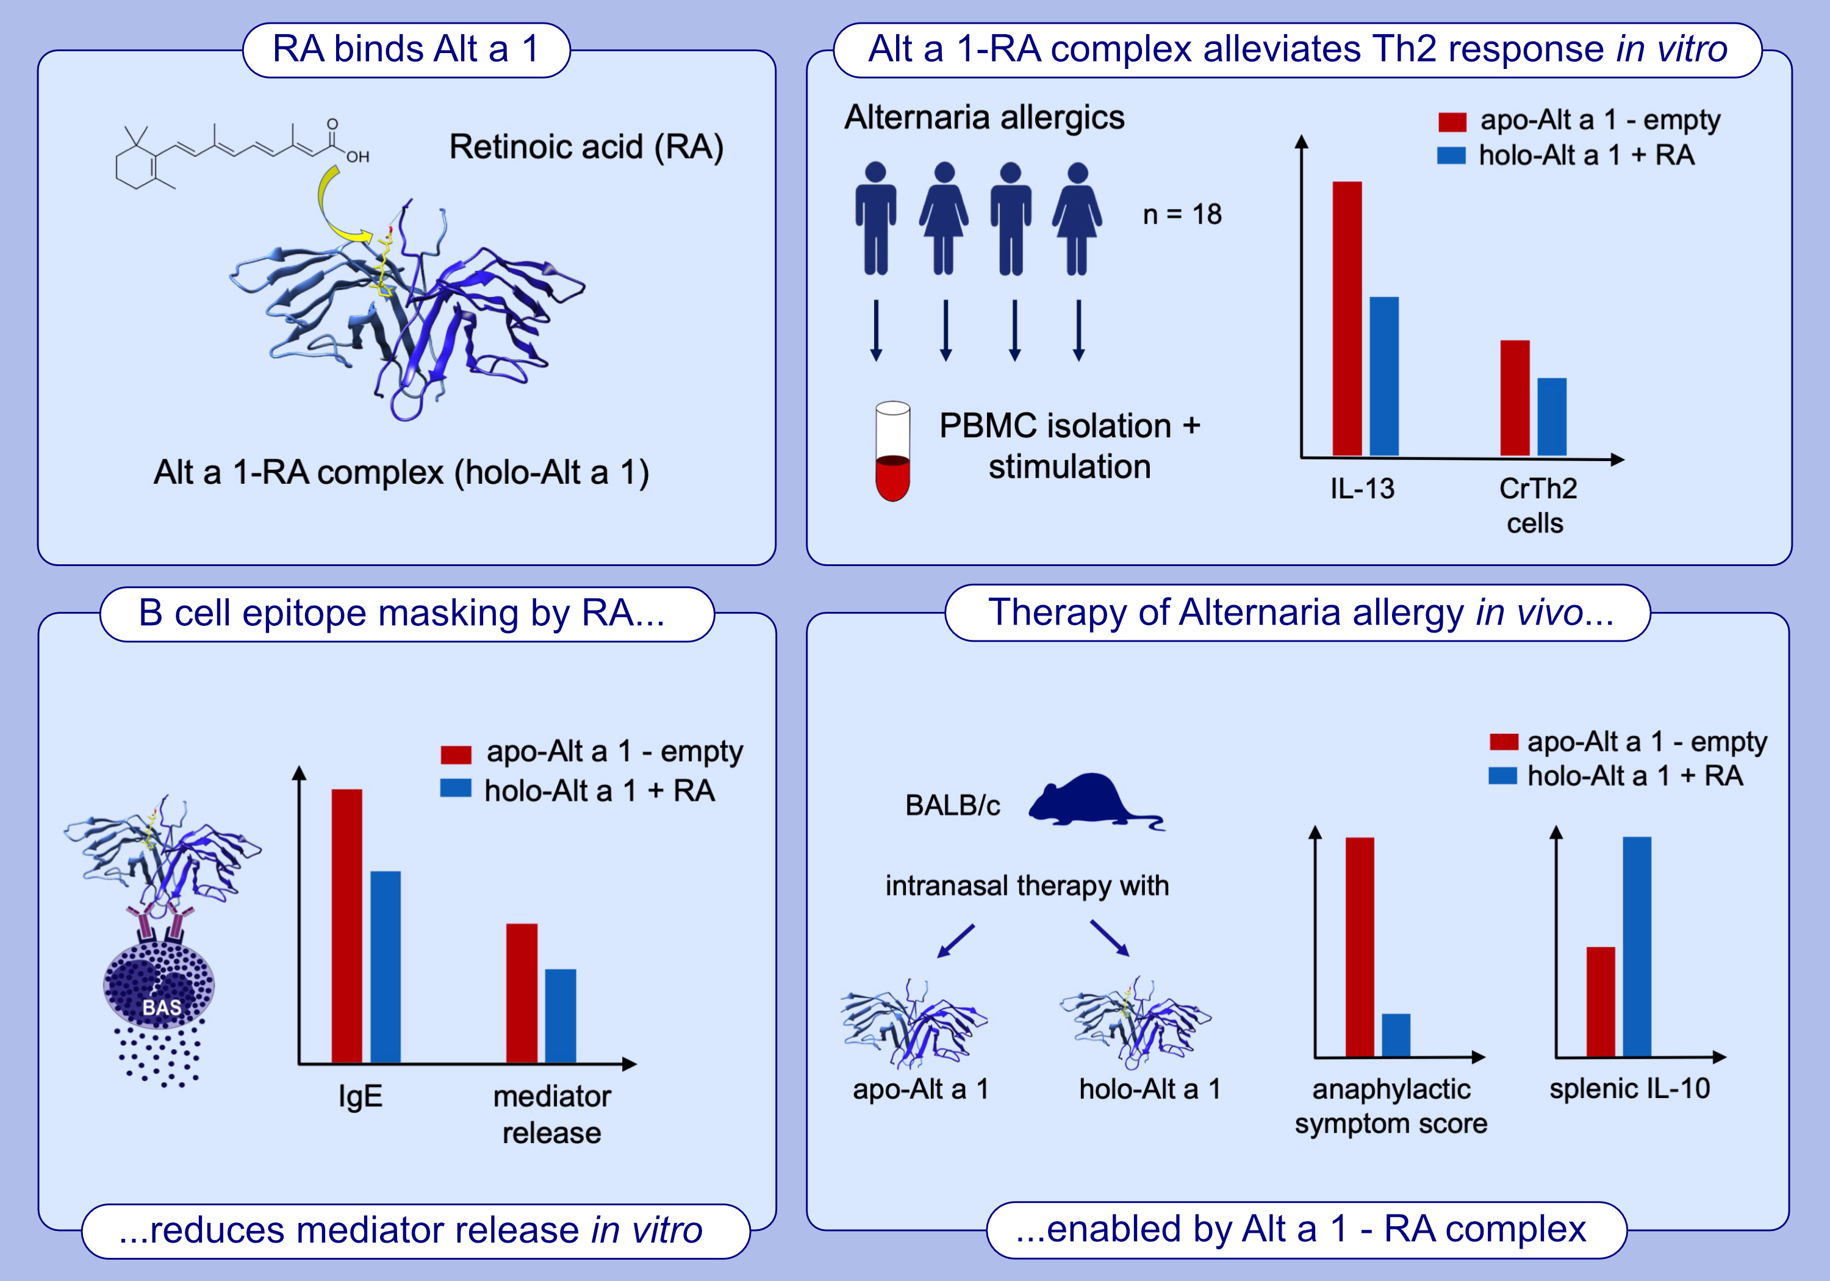
Mould allergen Alt a 1 spiked with the micronutrient retinoic acid reduces Th2 response and ameliorates Alternaria allergy in BALB/c mice
Aila Fakhimahmadi, Franziska Roth-Walter, Gerlinde Hofstetter, Markus Wiederstein, Sebastian A. Jensen, et al.
Allergy. 2024; pages: 2144-2156
https://doi.org/10.1111/all.16181
© 2019 EAACI and John Wiley and Sons A/S. Published by John Wiley and Sons Ltd.
Notes:
HIGHLIGHTS
• Complexing Alt a 1 from Alternaria alternata to RA masks IgE B-cell epitopes and reduces the IgE-binding capacity of the allergen.
• Alt a 1 complexed to RA leads to reduced Th2 response in vitro.
• Alt a 1 complexed to RA is able to modulate an ongoing Th2 immune response and to prevent anaphylactic symptoms in vivo.
.

