Slide 1
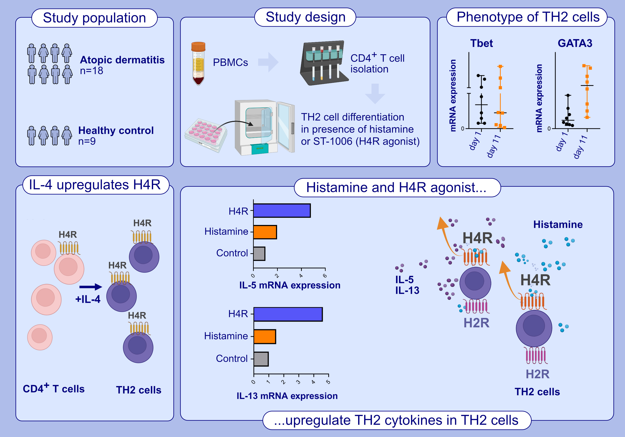
The stimulation of TH2 cells results in increased IL-5 and IL-13 production via the H4 receptor
Eirini Nikolouli, Susanne Mommert, Damilola Modupe Dawodu, Katrin Schaper-Gerhardt, Holger Stark, et al.
Allergy. 2024; pages: 2144-2156
https://doi.org/10.1111/all.16182
© 2019 EAACI and John Wiley and Sons A/S. Published by John Wiley and Sons Ltd.
Notes:
HIGHLIGHTS
• In the present study we differentiated CD4+ T cells from atopic dermatitis patients and from healthy control individuals in the presence of histamine or of the H4 receptor -selective agonist ST-1006 to TH2 cells.
• Transcriptomic analysis and quantitative PCR revealed an upregulation of the H4 receptor in response to IL-4 in TH2 cells when compared to TH1 and naive CD4+ T cells.
• Increased expressions of IL-5 and IL-13 were observed in in vitro differentiated TH2 cells in the presence of histamine or of the H4 receptor-selective-agonist when compared to the untreated control. .

