Slide 1
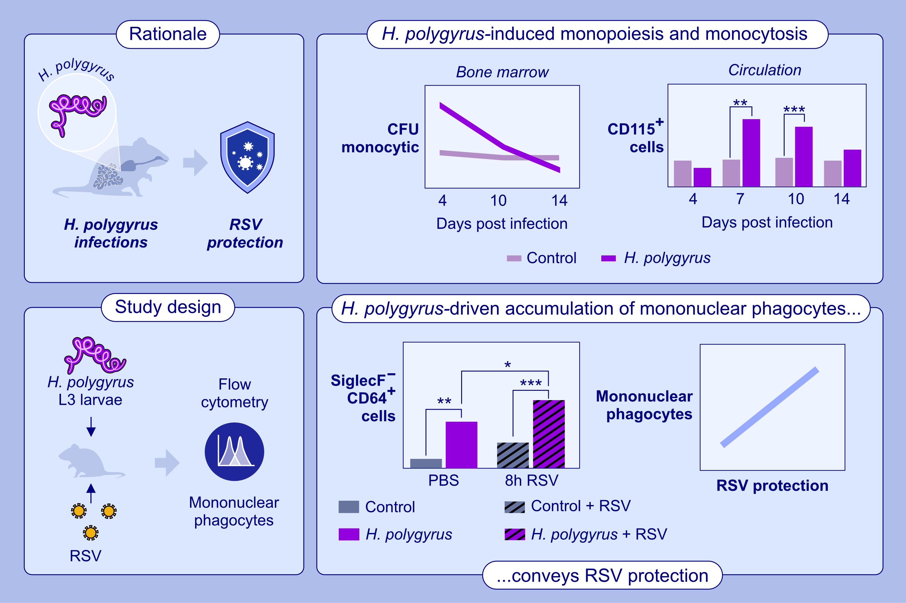
Helminth induced monocytosis conveys protection from respiratory syncytial virus infection in mice
Matthew O. Burgess, Piotr Janas, Karla Berry, Hannah Mayr, Matthias Mack, et al.
Allergy. 2024; pages: 2157-2172
https://doi.org/10.1111/all.16206
© 2019 EAACI and John Wiley and Sons A/S. Published by John Wiley and Sons Ltd.
Notes:
HIGHLIGHTS
• Ongoing H.
• polygyrus infection in mice induces bone marrow monopoiesis, circulatory monocytosis, and increased lung mononuclear phagocytes.
• H.
• polygyrus infection increases the accumulation of lung mononuclear phagocytes in the early immune response to RSV.

