Slide 1
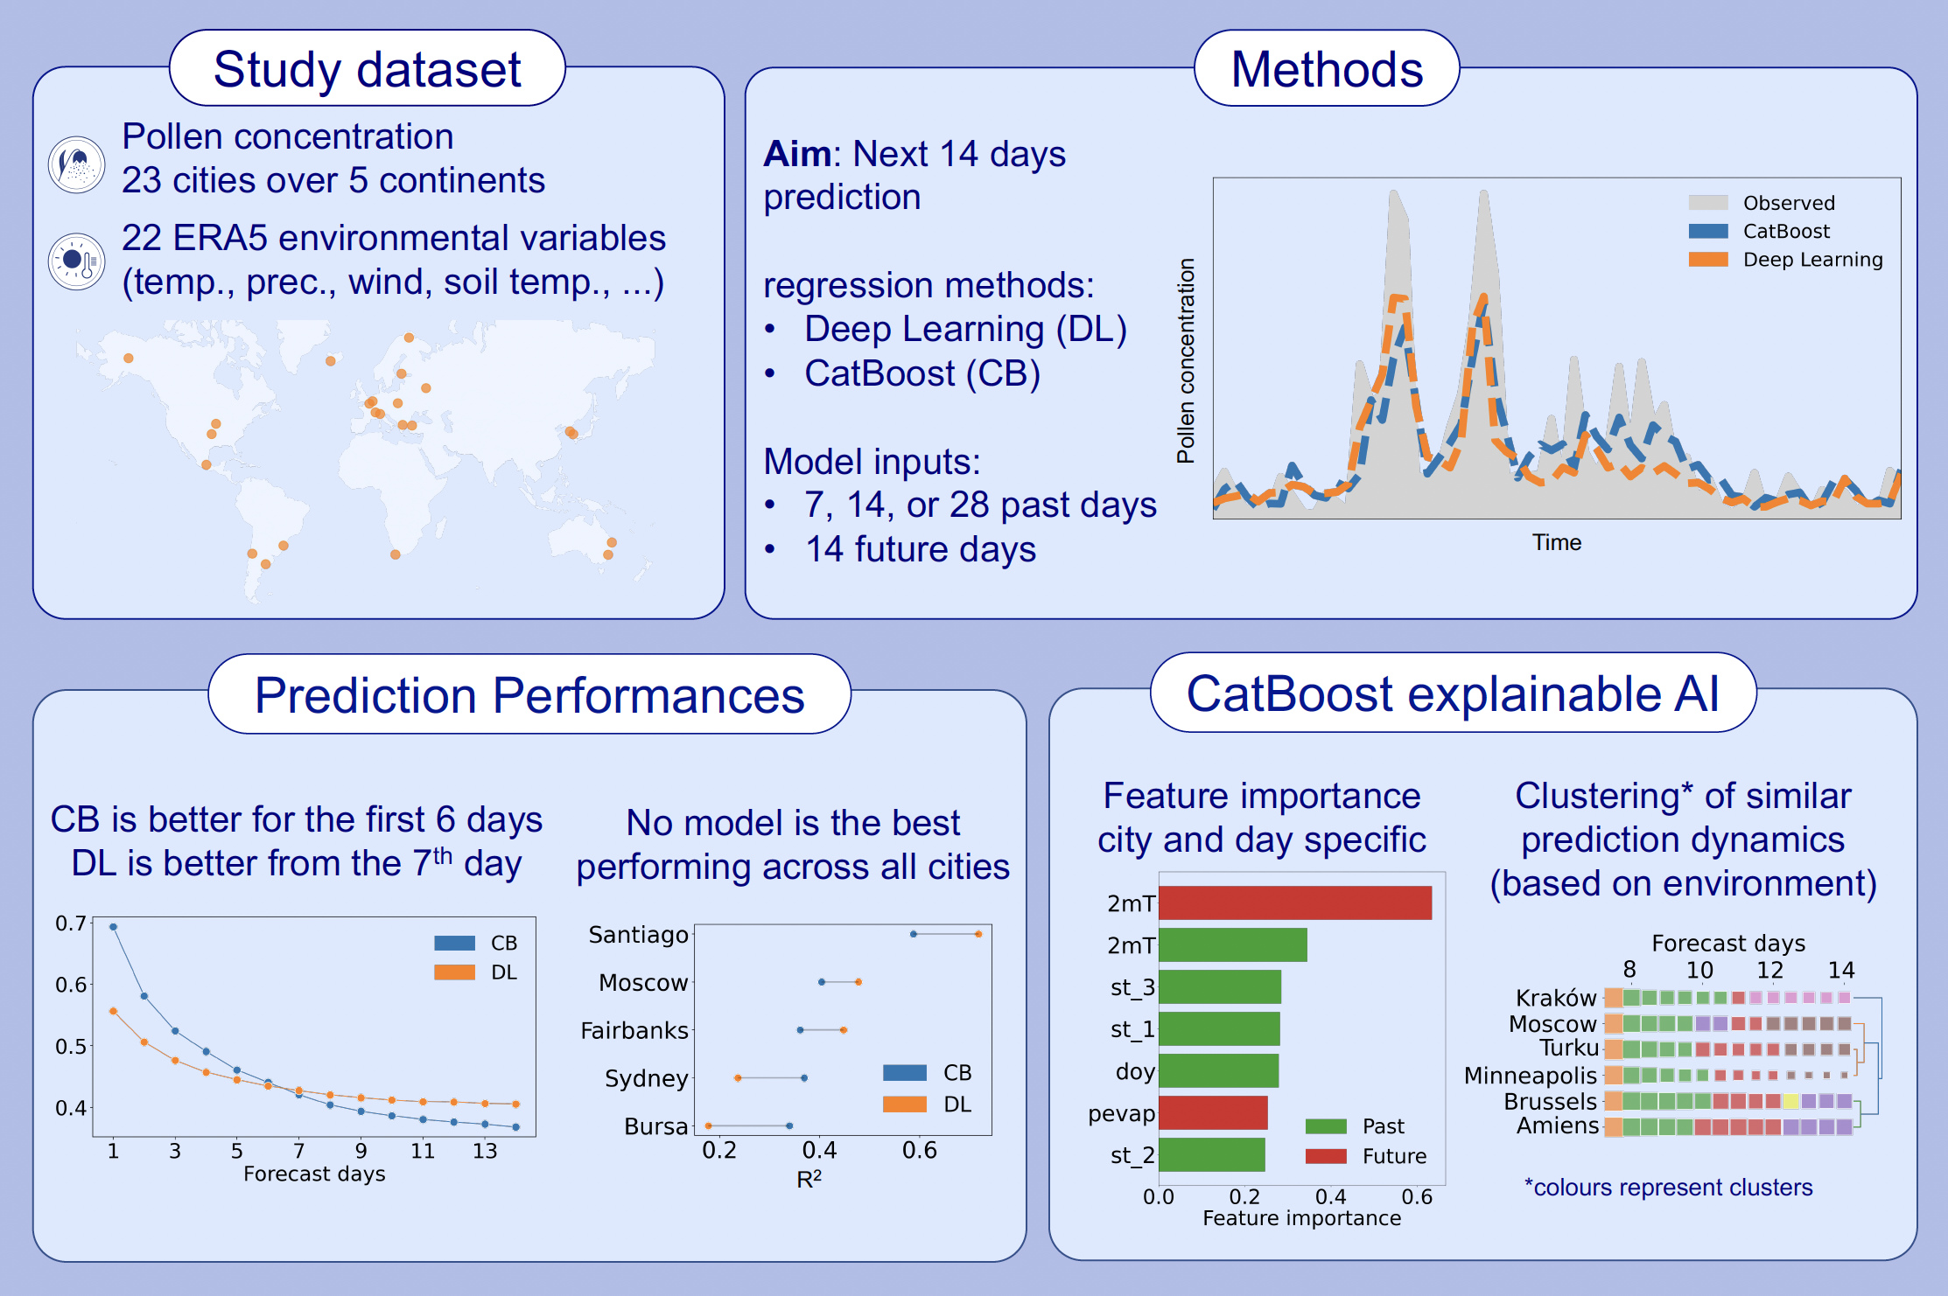
Forecasting daily total pollen concentrations on a global scale
László Makra, Luca Coviello, Andrea Gobbi, Giuseppe Jurman, Cesare Furlanello, et al.
Allergy. 2024; pages: 2173-2185
https://doi.org/10.1111/all.16227
© 2019 EAACI and John Wiley and Sons A/S. Published by John Wiley and Sons Ltd.
Notes:
HIGHLIGHTS
• CatBoost is a preferable model for short-term forecasts, while Deep Learning is for longer ones, but there is no definite answer to what the better model is for every day or city.
• Past pollen trends are strong indicators of future pollen concentrations.
• CatBoost can be used to determine the importance of environmental variables in forecasting daily total pollen concentration.
• .

