Slide 1
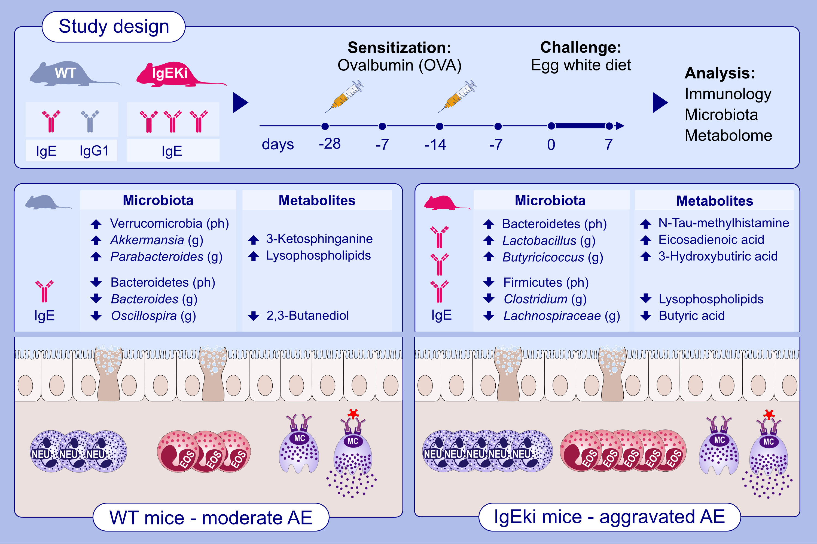
The impact of high-IgE levels on metabolome and microbiome in experimental allergic enteritis
Elisa Zubeldia-Varela, Frank Blanco-Pérez, Tomás Clive Barker-Tejeda, David Rojo, Alma Villaseñor, et al.
Allergy. 2024; pages:3430-3447
https://doi.org/10.1111/all.16202
© 2019 EAACI and John Wiley and Sons A/S. Published by John Wiley and Sons Ltd.
Notes:
HIGHLIGHTS
• Distinctive metabolome and microbiome signatures were detected among different degrees of AE in WT mice and IgEki mice expressing high levels of IgE.
• IgEki mice exacerbated AE development with altered levels of lipids including sphingolipids, glycerophospholipids and fatty acids, and histamine derivative.
• The exacerbated AE was accompanied with reduced Clostridium and increased Lactobacillus.
• These findings contribute to establishing AE diagnostics and therapies. .

