Slide 1
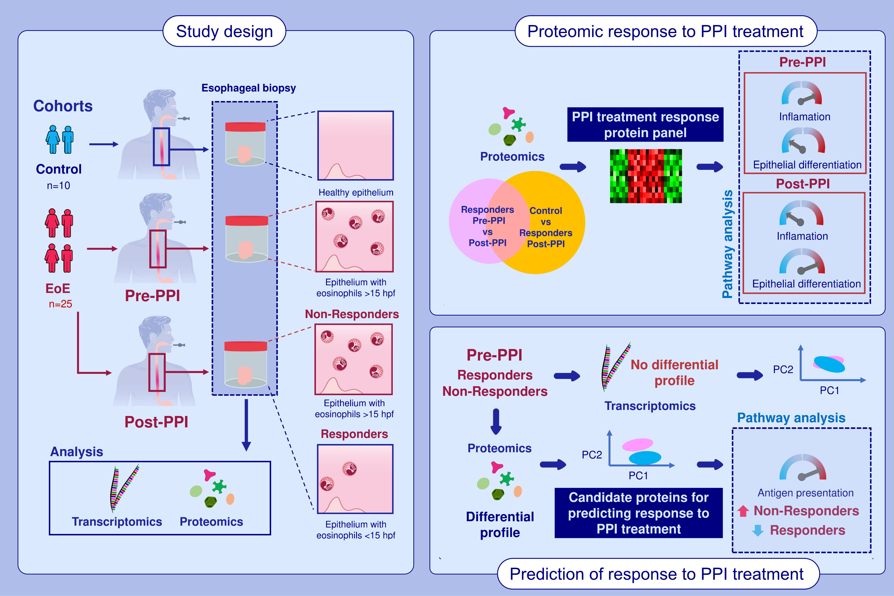
Proton pump inhibitor effect on esophageal protein signature of eosinophilic esophagitis, prediction, and evaluation of treatment response
Francisca Molina-Jiménez, Lola Ugalde-Triviño, Laura Arias-González, Elisa Armenteros, Carlos Relaño-Rupérez, et al.
Allergy. 2024; pages:3448-3463
https://doi.org/10.1111/all.16261
© 2019 EAACI and John Wiley and Sons A/S. Published by John Wiley and Sons Ltd.
Notes:
HIGHLIGHTS
• Proteomics and transcriptomics were used to investigate changes in esophageal epithelium from EoE responder and non-responder patients prior and after PPI treatment.
• A set of proteins, mainly related with inflammatory and epithelial differentiation processes, were detected as differentially expressed in PPI responders after treatment.
• Proteins related to antigen presentation were differentially expressed between responders and non-responders at baseline.
• .

