Slide 1
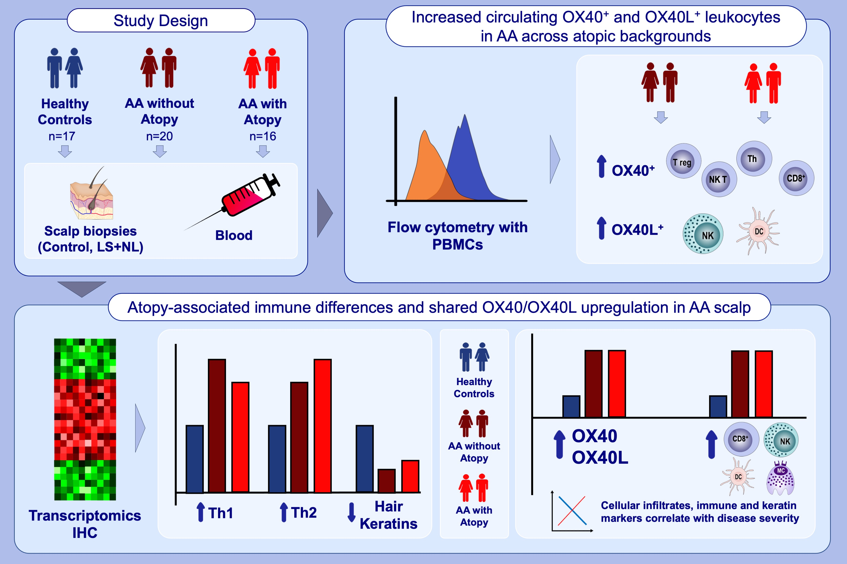
Alopecia areata exhibits cutaneous and systemic OX40 activation across atopic backgrounds
Madeline Kim, Ester Del Duca, Dante Dahabreh, Daniel Lozano-Ojalvo, Britta Carroll, et al.
Allergy. 2024; pages:3401-3414
https://doi.org/10.1111/all.16268
© 2019 EAACI and John Wiley and Sons A/S. Published by John Wiley and Sons Ltd.
Notes:
HIGHLIGHTS
• This study evaluated the molecular and cellular profiles of the scalp and blood of patients with alopecia areata (AA), stratified by atopic background.
• AA scalp was characterized by strong upregulation of OX40/OX40L and Th1 and Th2 with greater inflammatory tone and Th2-skewing in the setting of atopy.
• Circulating OX40+ and OX40L+ leukocytes were increased in AA, regardless of atopy.
• .

