Slide 1
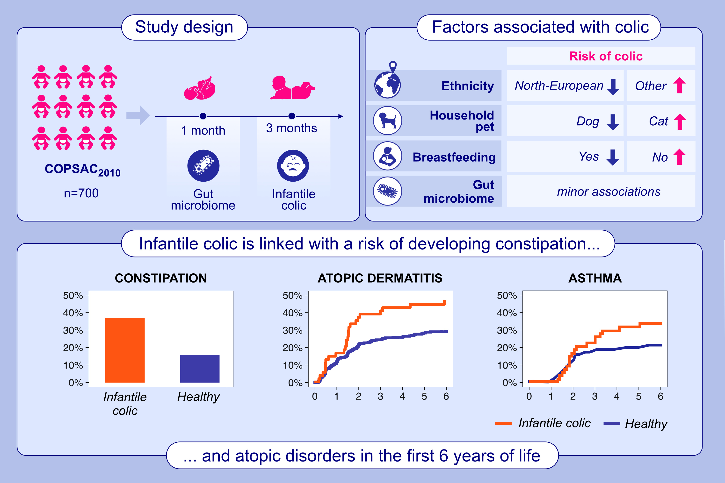
Infantile colic is associated with development of later constipation and atopic disorders
Jakob Stokholm, Jonathan Thorsen, Ann-Marie Malby Schoos, Morten Arendt Rasmussen, Sarah Brandt, et al.
Allergy. 2024; pages: 3360-3372
https://doi.org/10.1111/all.16274
© 2019 EAACI and John Wiley and Sons A/S. Published by John Wiley and Sons Ltd.
Notes:
HIGHLIGHTS
• In a deeply phenotyped COPSAC2010 population, we evaluated early life factors and gut microbiota in relation to the development of infantile colic and the risk of developing later gastrointestinal and atopic manifestations.
• We link several factors including race, breastfeeding and pets with infantile colic, which is in turn associated with a higher risk of developing constipation, asthma, atopic dermatitis, and allergic sensitization in the first 6 years of life.
• The one-month gut microbiome composition was associated with colic but did not mediate the risks of long-term outcomes.
•
.

