Slide 1
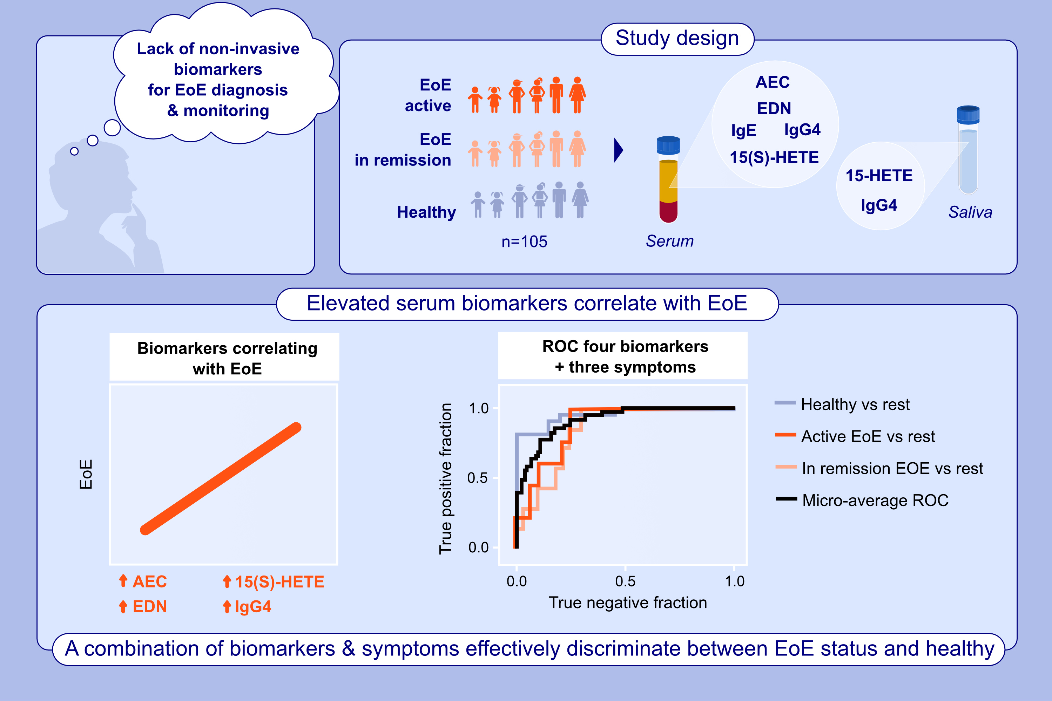
Biomarkers for a less invasive strategy to predict children with eosinophilic esophagitis
Helena Thulin, Ladan Mansouri, Maria Altman, Simon Kebede Merid, Joachim Lundahl, et al.
Allergy. 2024; pages:3464-3474
https://doi.org/10.1111/all.16275
© 2019 EAACI and John Wiley and Sons A/S. Published by John Wiley and Sons Ltd.
Notes:
HIGHLIGHTS
• This study evaluates 20 biomarkers in serum and saliva, aiming to assess their diagnostic potential in pediatric EoE patients and healthy individuals.
• We identified serum biomarkers associated with EoE: AEC, EDN, 15(S)-HETE, sIgG4, and sIgE.
• Symptoms along with elevated levels of AEC, sIgE to egg white/wheat, differentiate between EoE status and healthy. .

