Slide 1
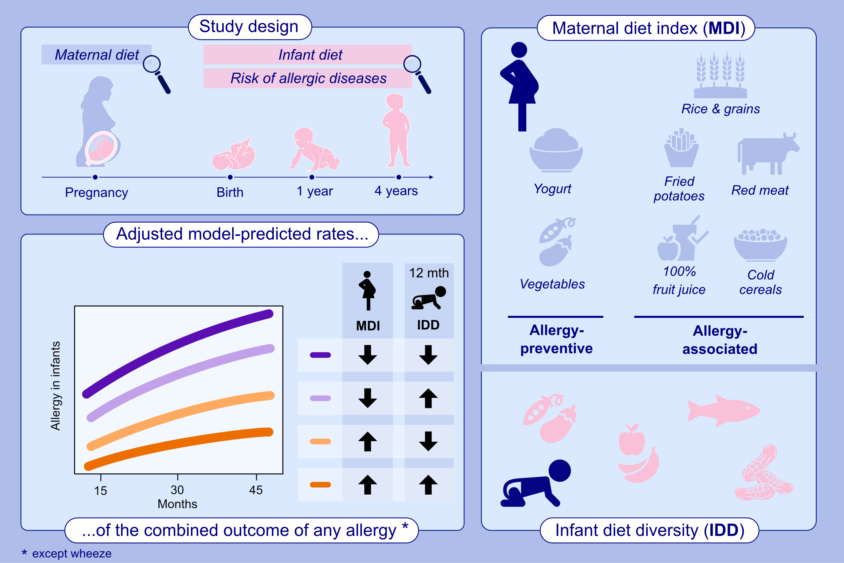
Maternal allergy-preventive diet index, offspring infant diet diversity, and childhood allergic diseases
Carina Venter, Kaci Pickett-Nairne, Donald Leung, David Fleischer, Liam O'Mahony, et al.
Allergy. 2024; pages:3475-3488
https://doi.org/10.1111/all.16292
© 2019 EAACI and John Wiley and Sons A/S. Published by John Wiley and Sons Ltd.
Notes:
HIGHLIGHTS
• This study investigated associations between diet and allergic disease outcomes.
• Maternal and infant diet were self-reported.
• Adjusted parametric Weibull time-to-event models assessed associations between maternal diet index, infant diet diversity and time to development of allergic rhinitis, atopic dermatitis, asthma, wheeze, IgE-mediated food allergy, and a combined outcome of any allergic disease except for wheeze.
• The lowest risk of all infant allergy outcomes which included allergic rhinitis, atopic dermatitis, asthma, and IgE-mediated food allergy, was seen when both pregnant women had a higher maternal diet index score and infants had a more diverse diet.

