Slide 1
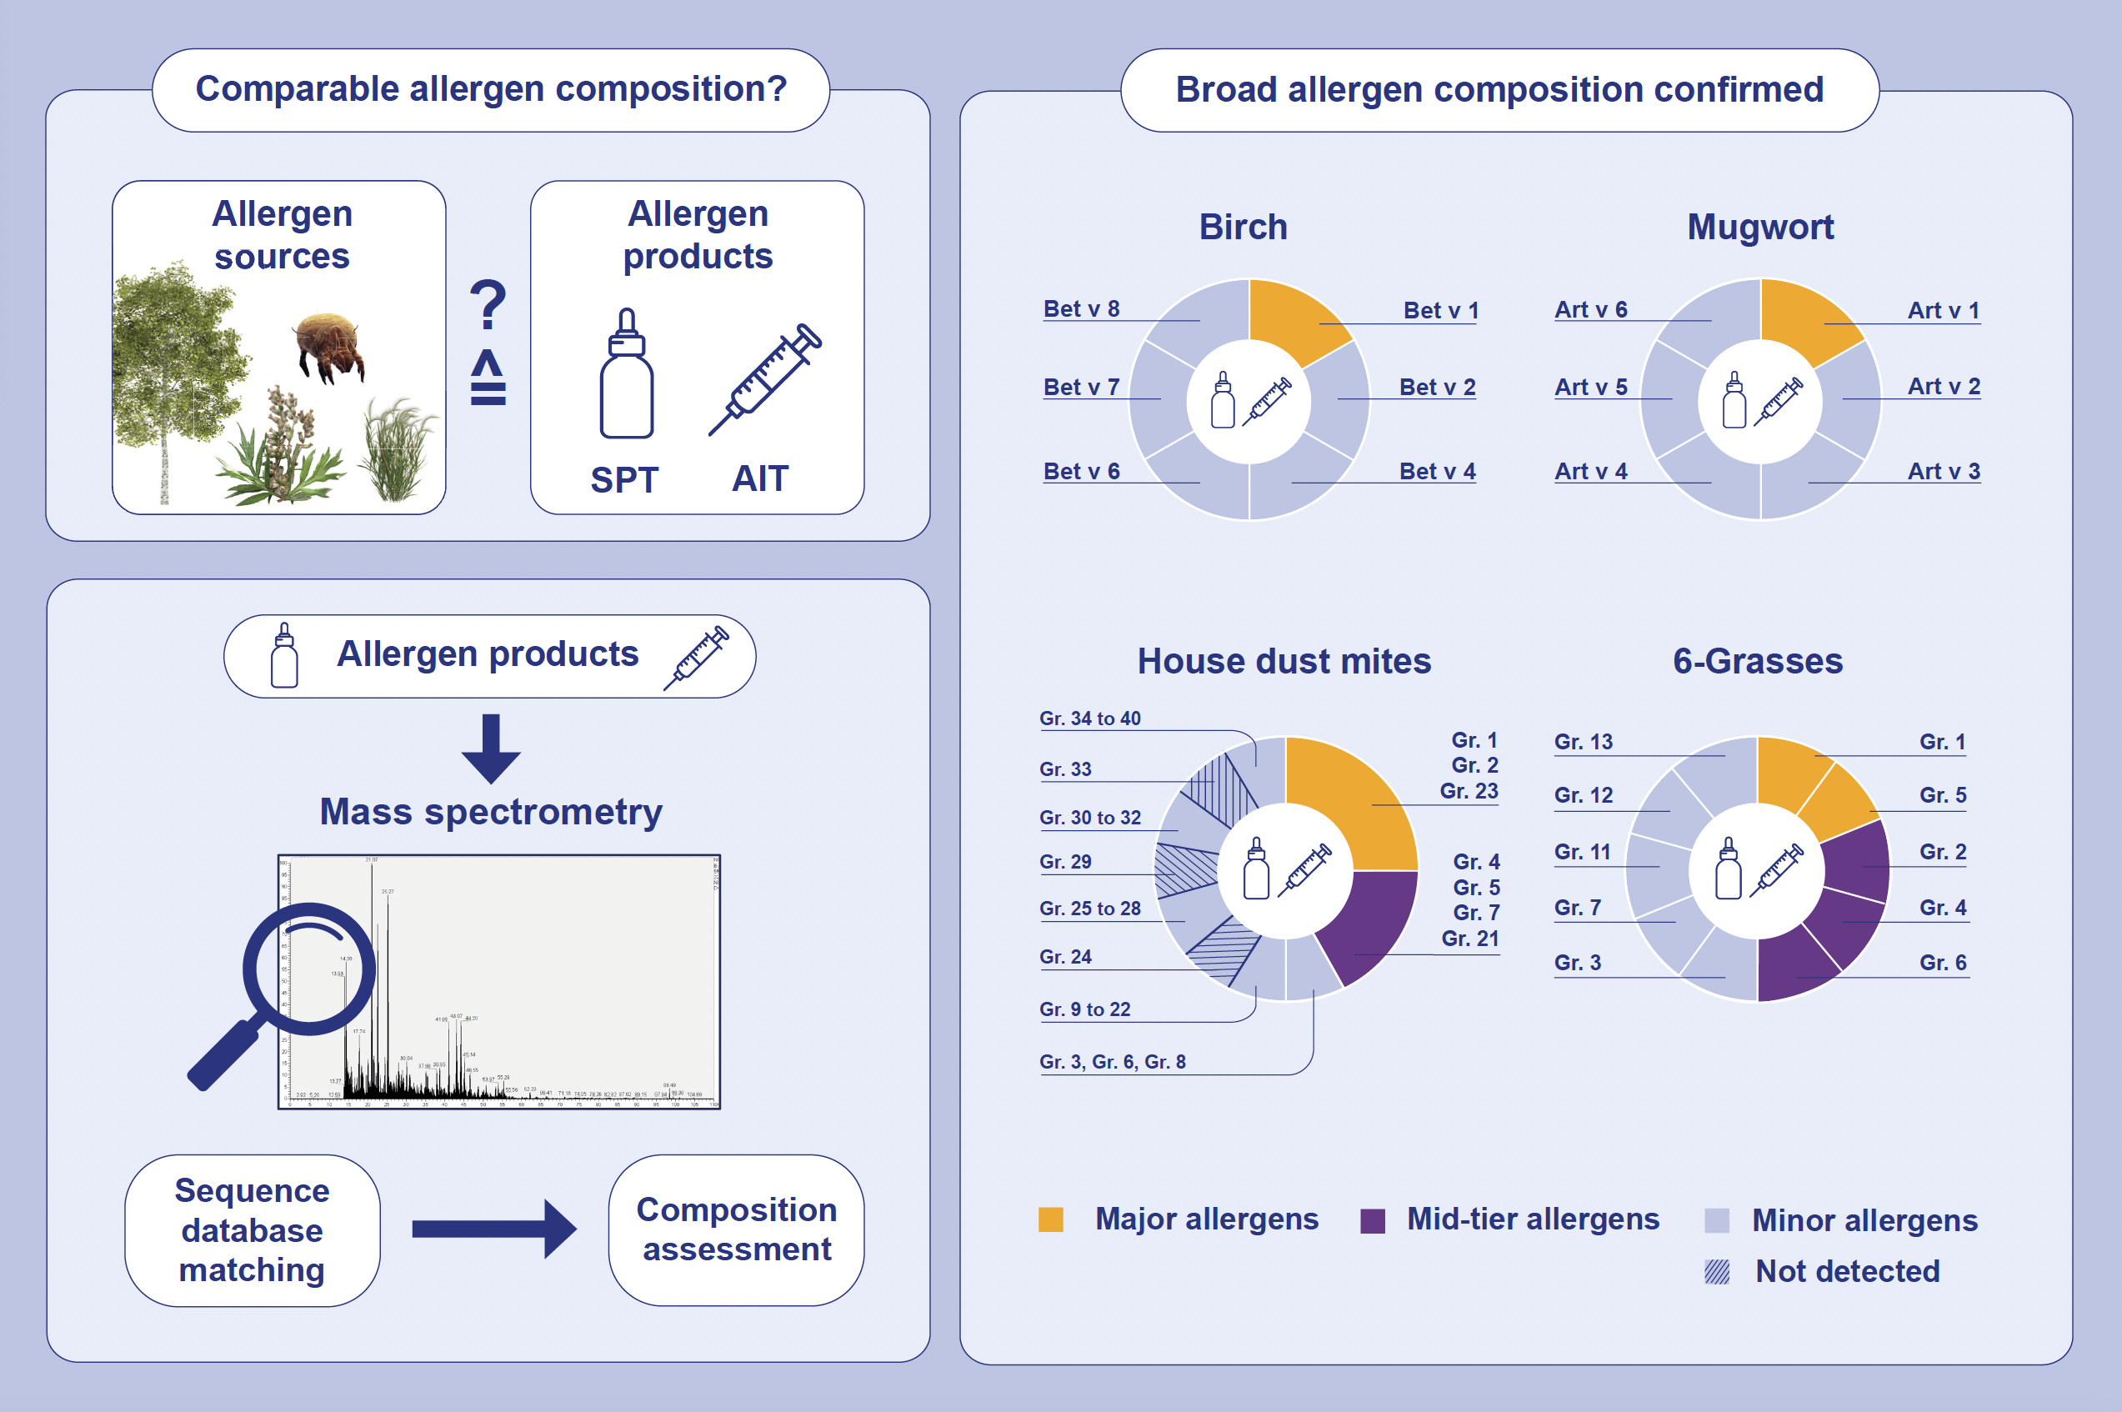
Improved quality control of allergen products: Assessing the molecular allergen composition by mass spectrometry
Steffen Augustin, Thomas Eichhorn, Martin Wald, Frank Fischer, Marek Jutel, et al.
Allergy. 2024; pages: 3489-3500
https://doi.org/10.1111/all.16339
© 2019 EAACI and John Wiley and Sons A/S. Published by John Wiley and Sons Ltd.
Notes:
HIGHLIGHTS
• To investigate the completeness of the qualitative allergen composition of diagnostic (SPT) and therapeutic (AIT) allergen products manufactured from various allergen sources, a consistent high-resolution mass spectrometry method was applied.
• Allergens were identified by publicly accessible protein sequence databases.
• The presence of all major, all mid-tier and most minor allergens was confirmed in the analysed allergen products. .

