Slide 1
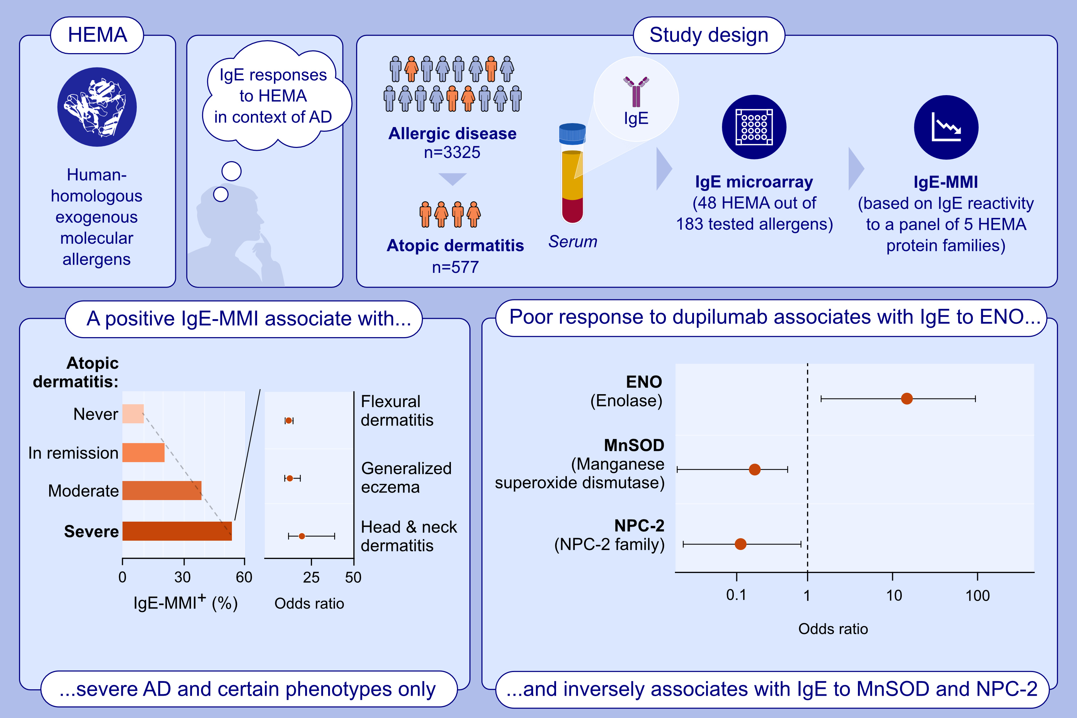
A microarray-based IgE-molecular mimicry index (IgE-MMI): A biomarker for disease severity, clinical phenotypes, and therapeutic response in atopic dermatitis?
Enrico Scala, Stefania Madonna, Damiano Abeni, Lorenzo Cecchi, Barbara Cocuroccia, et al.
Allergy. 2024; pages:3415-3429
https://doi.org/10.1111/all.16377
© 2019 EAACI and John Wiley and Sons A/S. Published by John Wiley and Sons Ltd.
Notes:
HIGHLIGHTS
• This study investigates whether IgE antibody responses to HEMA are associated with AD, its severity and response to dupilumab.
• IgE-MMI is associated with severe AD, particularly in flexural dermatitis, head and neck dermatitis, and generalized eczema.
• Poor response to dupilumab is associated with IgE antibodies to ENO, but inversely associated with IgE antibodies to MnSOD and NPC-2 from dust mites. .

