Slide 1
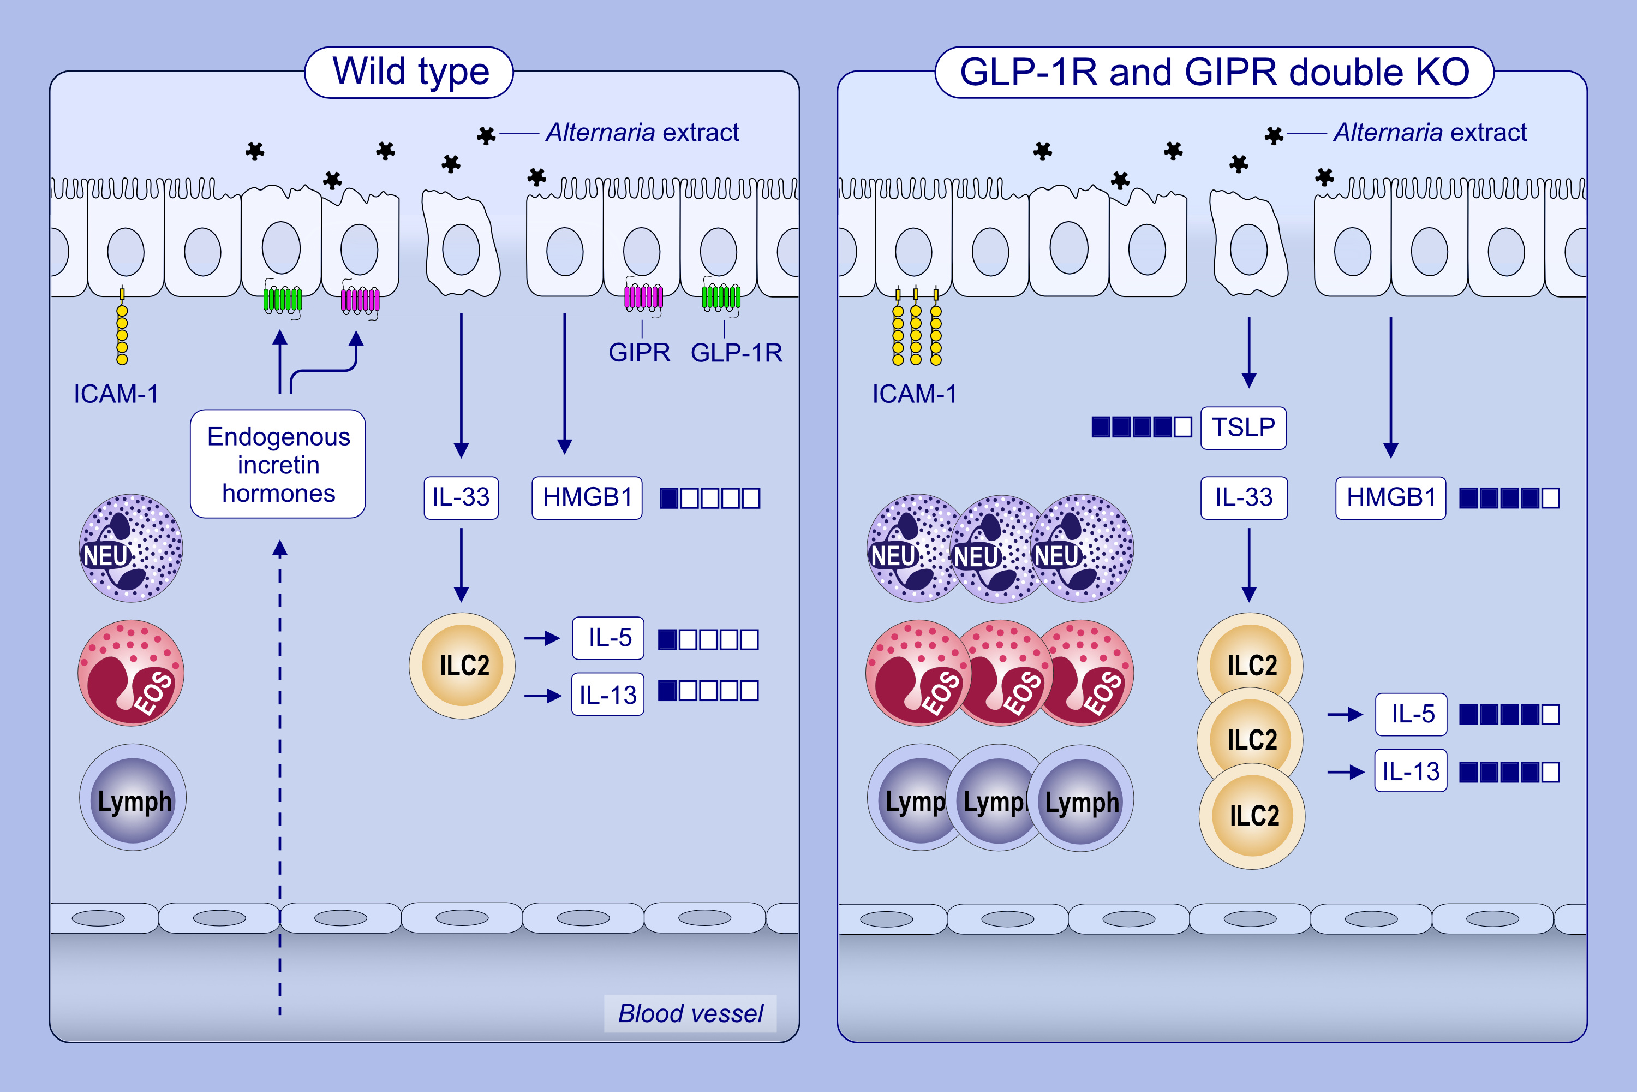
Endogenous Glucagon-Like Peptide-1 Receptor and Glucose-Dependent Insulinotropic Polypeptide Receptor Signaling Inhibits Aeroallergen-Induced Innate Airway Inflammation
Shinji Toki, Masako Abney, Jian Zhang, Mark Rusznak, Christian M. Warren, et al.
Allergy. 2024; pages:3373-3384
https://doi.org/10.1111/all.16402
© 2019 EAACI and John Wiley and Sons A/S. Published by John Wiley and Sons Ltd.
Notes:
HIGHLIGHTS
• This study investigates the role of endogenous signaling through either one, or both, of the GLP-1R and GIPR in regulating allergic airway inflammation.
• The simultaneous loss of GLP-1R and GIPR signaling leads to increased TSLP release, a higher number of lung ILC2 cells, eosinophils, lymphocytes, and neutrophils in the airway, as well as elevated expression of type 2 cytokines (IL-5 and IL-13), HMGB1, and ICAM-1 in lung epithelial cells, compared to other mouse strains following exposure to Alternaria extract.
• These data suggest that basal incretin signaling has a role of anti-allergic inflammation in the lung.
• .

