Slide 1
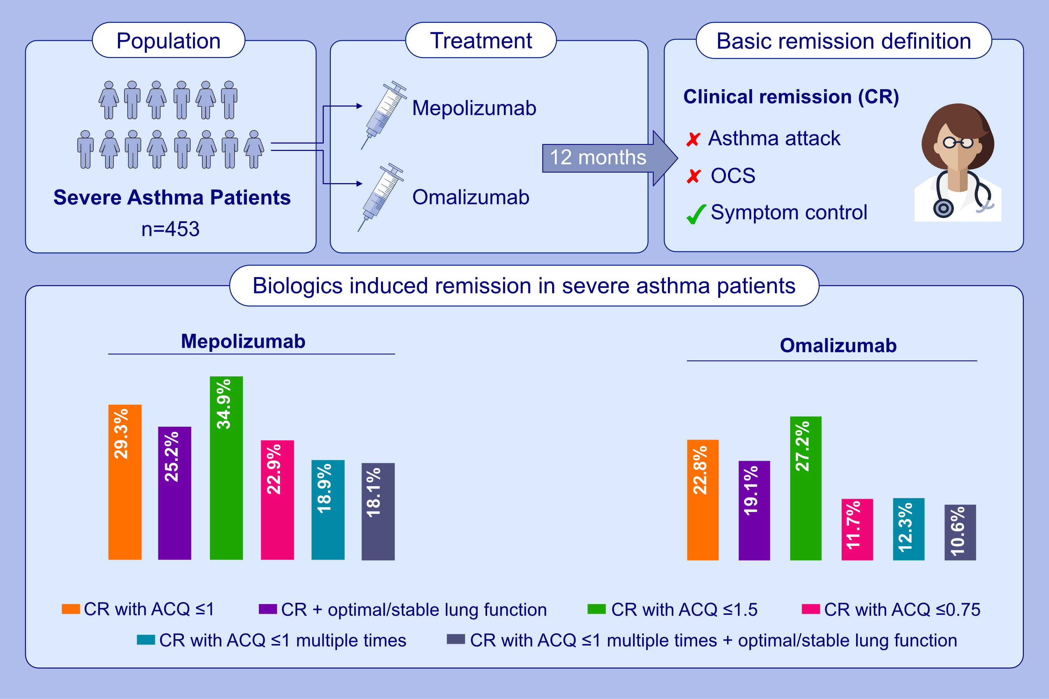
Biologics (mepolizumab and omalizumab) induced remission
in severe asthma patients
Dennis Thomas, Vanessa M. McDonald, Sean Stevens, Erin S. Harvey, Melissa Baraket, , et al.
Allergy. 2024; pages: 384-392
https://doi.org/10.1111/all.15867
© 2024 EAACI and John Wiley and Sons A/S. Published by John Wiley and Sons Ltd.
Notes:
HIGHLIGHTS
The effectiveness of mepolizumab and omalizumab in achieving asthma remission was evaluated in an observational study.
The basic definition consists of no asthma attack, no OCS use and ACQ5≤1 at 12-months. We also evaluated various definitions and ACQ cut-offs in sensitivity analyses.
The observed remission rate ranged between 18.1% and 34.9% in mepolizumab and 10.6% and 27.2% in omalizumab cohorts.
Abbreviations: CR, clinical remission; ACQ, asthma control questionnaire; OCS, oral corticosteroids; LF, lung function.

