Slide 1
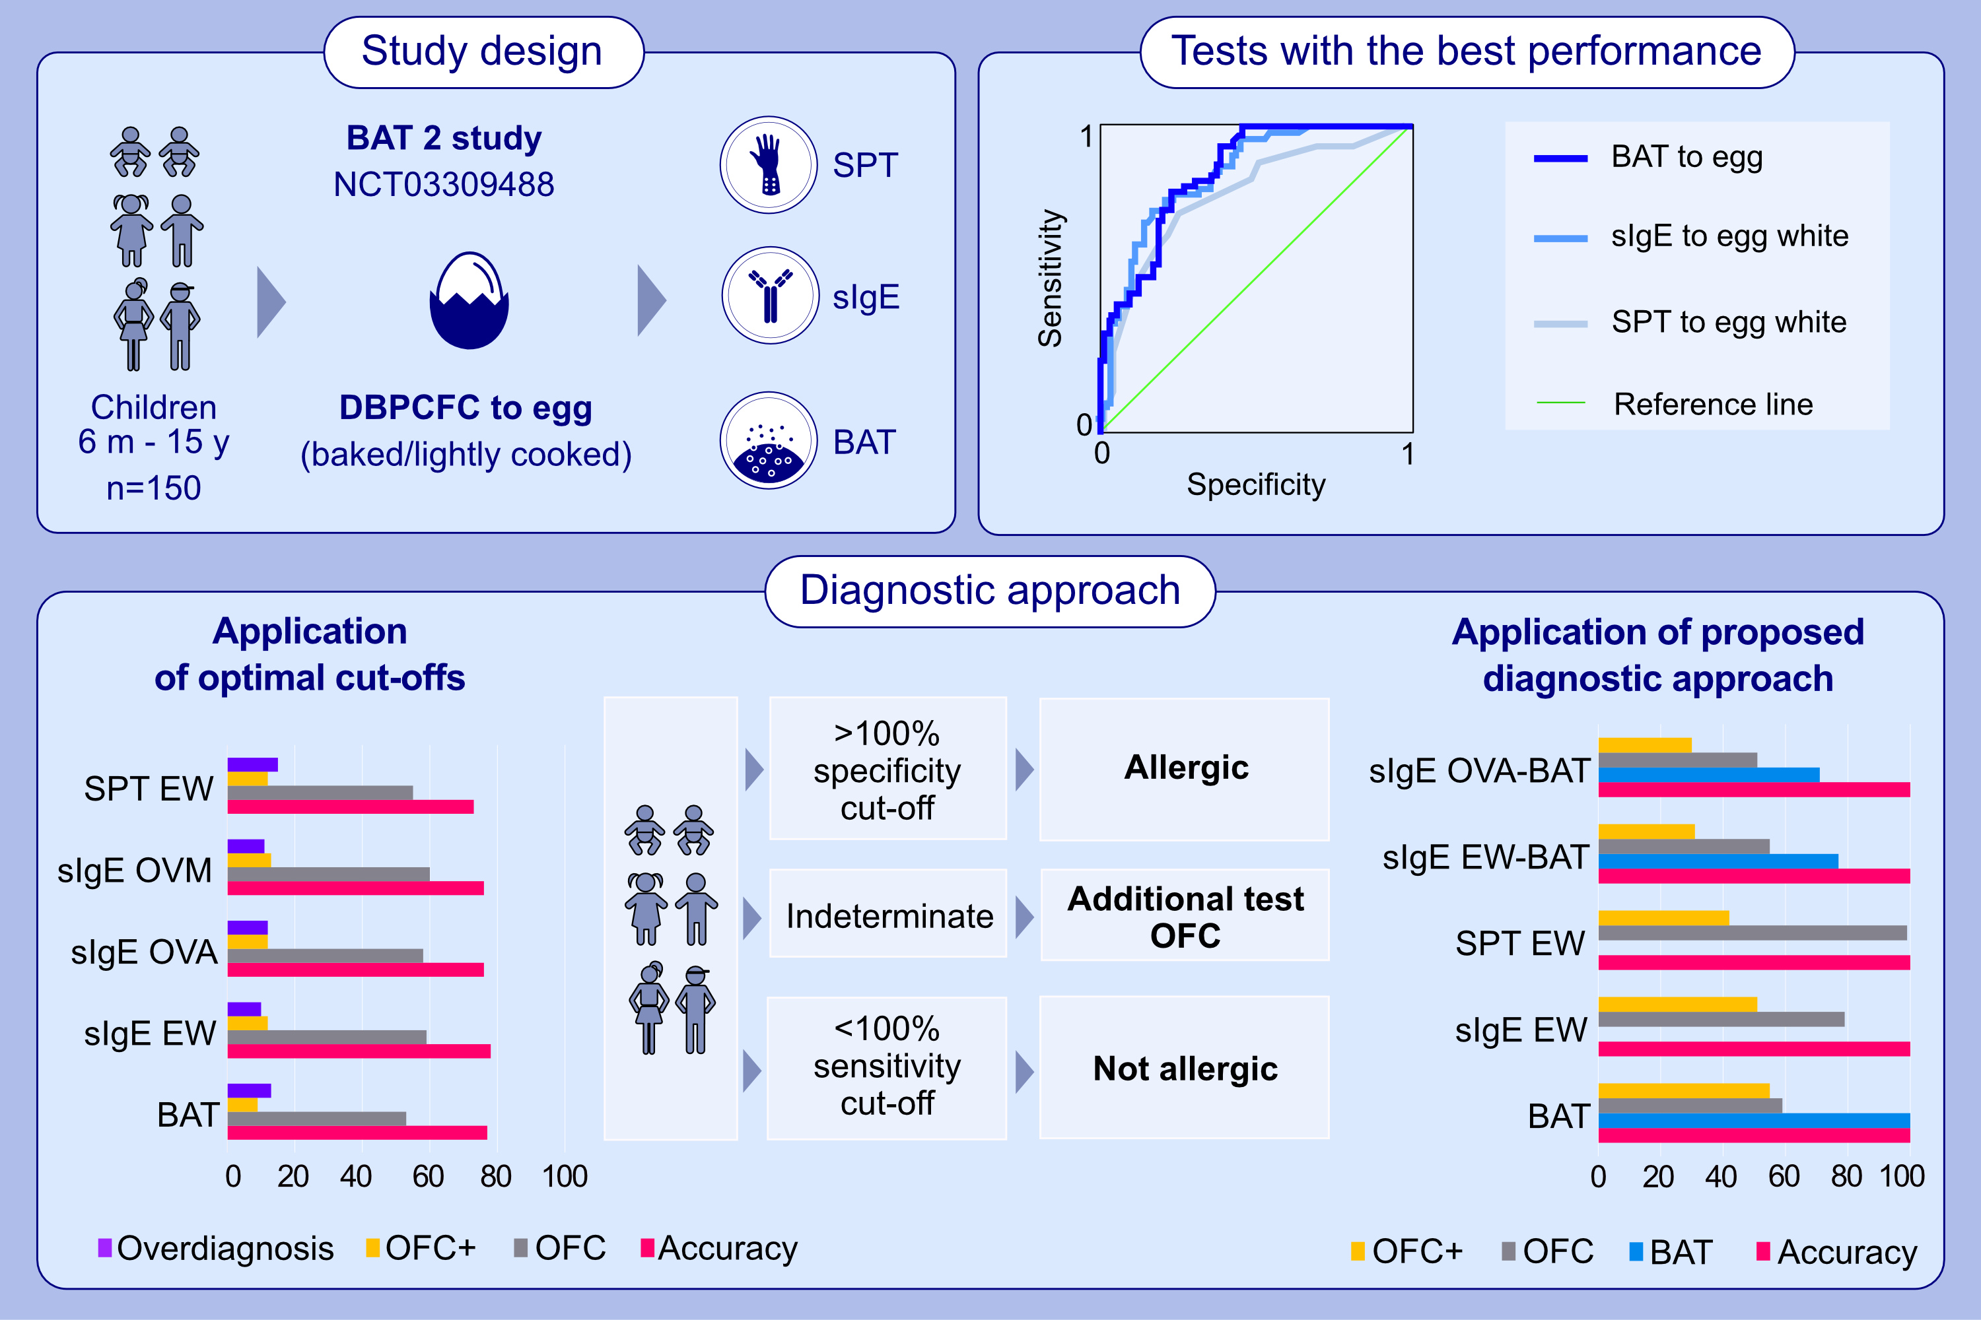
Basophil activation test as predictor of severity and threshold of allergic reactions to egg
Suzana Radulovic, Ru-Xin Foong, Irene Bartha, Andreina Marques-Mejias, Marta Krawiec, , et al.
Allergy. 2024; pages: 419-431
https://doi.org/10.1111/all.15875
© 2024 EAACI and John Wiley and Sons A/S. Published by John Wiley and Sons Ltd.
Notes:
HIGHLIGHTS
Study participants had DBPCFC to baked egg and, if this was negative, also DBPCFC to loosely cooked egg – patients who developed allergic reactions during DBPCFC were included for analyses.
No demographic or clinical features were statistically significantly different between severity or threshold groups.
BAT was the best biomarker to identify patients who developed severe reactions or reacted to less than 0.13g of egg protein.
Abbreviations: AUC, area under the curve; BAT, basophil activation test; BAS, basophil; DBPCFC, double-blind placebo-controlled food challenge; KU/L, kilounits per liter; OVM, ovomucin; SI, stimulation index; sIgE, specific IgE; sens, sensitivity; spec, specificity; tIgE, total IgE.

