Slide 1
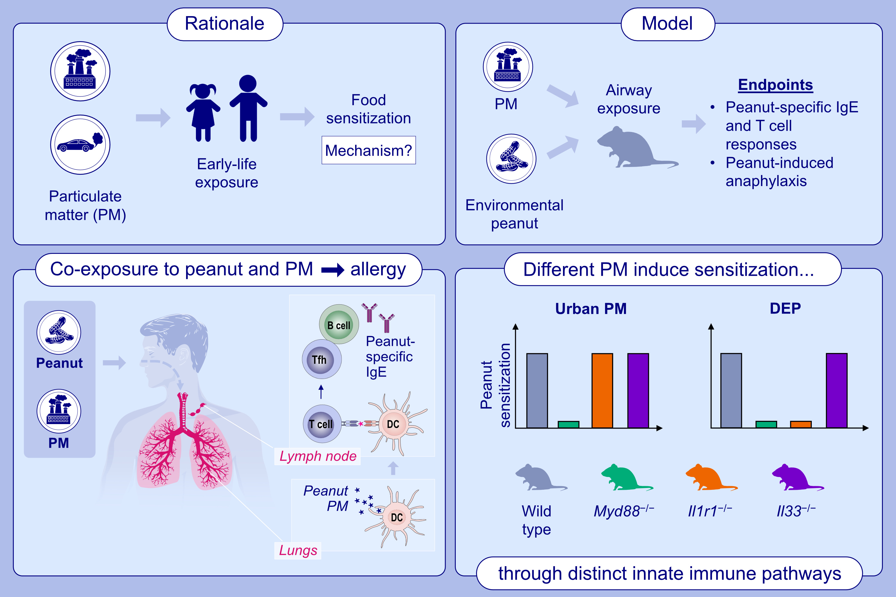
Different airborne particulates trigger distinct immune pathways leading to peanut allergy in a mouse model
Robert M. Immormino, Johanna M. Smeekens, Priscilla I. Mathai, Katelyn M. Clough, Jackqueline T. Nguyen, et al.
Allergy. 2024; pages:432-444
https://doi.org/10.1111/all.15908
© 2024 EAACI and John Wiley and Sons A/S. Published by John Wiley and Sons Ltd.
Notes:
HIGHLIGHTS
We used an animal model to explore the mechanisms by which PM exposure promotes food sensitization.
Environmental co-exposure to peanut and PM induced peanut-specific Tfh cells, leading to peanut sensitization and allergy in mice.
Different types of PM induced peanut sensitization through distinct innate immune pathways.
Abbreviations: DEP, disel exhaust particles; IgE, immunoglobulin E; Myd88, myeloid differentiation primary response 88; PM, particulate matter; Tfh, T follicular helper

