Slide 1
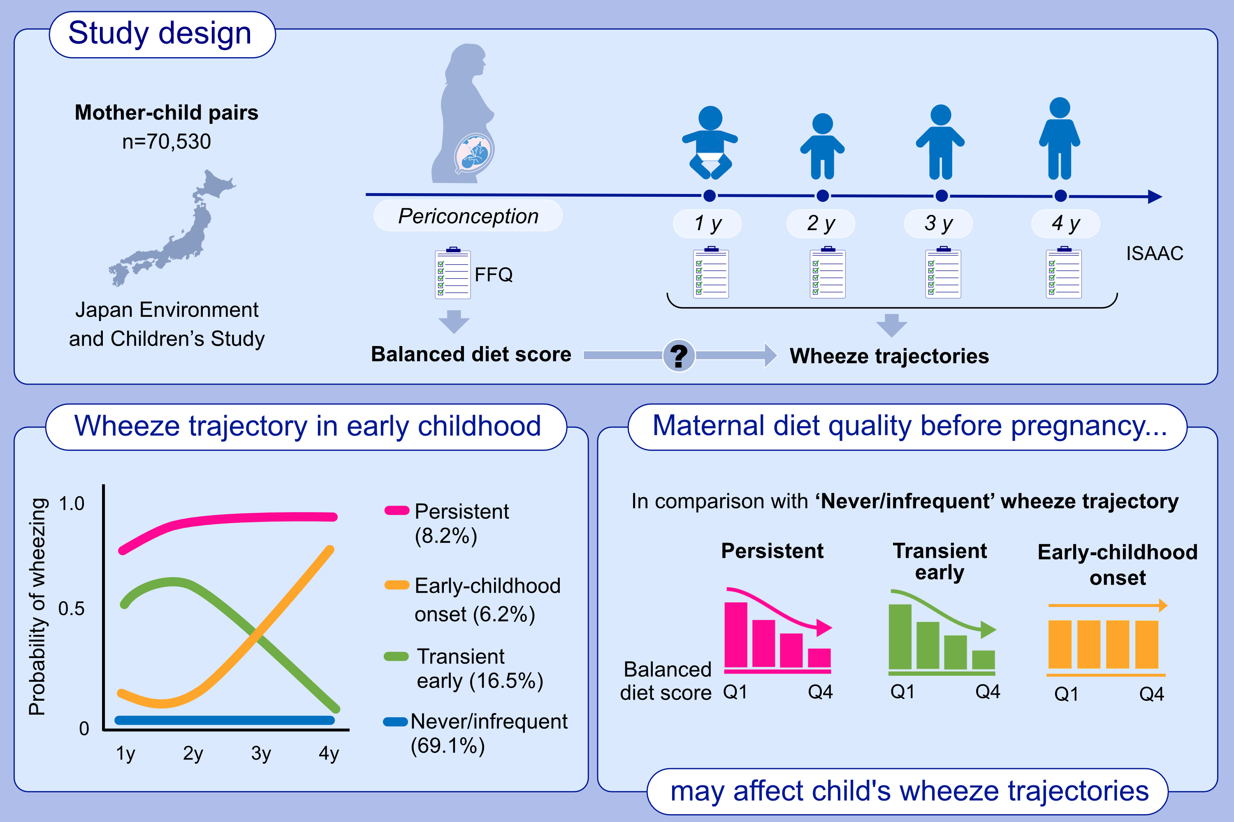
Periconceptional maternal diet quality and offspring wheeze trajectories:
Japan Environment and Children’s Study
Hitomi Okubo, Shoji F. Nakayama, Yukihiro Ohya, Japan Environment and Children's Study Group
Allergy. 2024; pages: 393-403
https://doi.org/10.1111/all.15916
© 2024 EAACI and John Wiley and Sons A/S. Published by John Wiley and Sons Ltd.
Notes:
HIGHLIGHTS
In this nationwide, prospective birth cohort of 70,530 Japanese mother–child pairs, four wheeze trajectories were identified.
Compared with a ‘never/infrequent’ wheeze trajectory, a higher maternal balanced diet score decreased the risk of offspring belonging to the ‘transient early’ and ‘persistent’ wheeze trajectories.
Maternal diet quality before pregnancy may affect wheeze trajectories in early childhood.
Abbreviations: FFQ, food frequency questionnaire; ISAAC, International Study of Asthma and Allergies in Childhood; Q, quartile.

