Slide 1
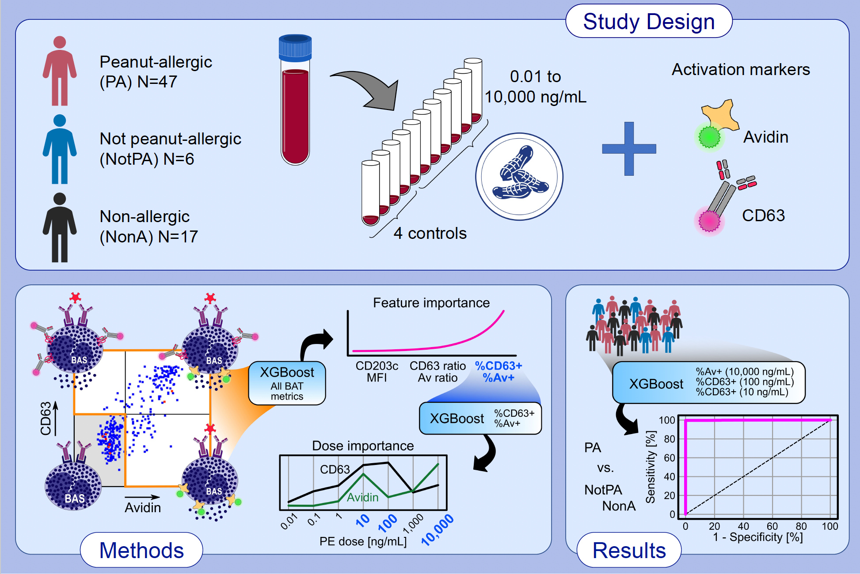
Combining avidin with CD63 improves basophil activation test accuracy in classifying peanut allergy
Nicolas Castaño, Kaiser Chua, Abhinav Kaushik, Sungu Kim, Seth C. Cordts, , et al.
Allergy. 2024; pages:445-455
https://doi.org/10.1111/all.15930
© 2024 EAACI and John Wiley and Sons A/S. Published by John Wiley and Sons Ltd.
Notes:
HIGHLIGHTS
Avidin binding to activated basophils correlates with basophil CD63 expression.
In classifying peanut-allergic vs. not peanut-allergic or non-allergic subjects, combining avidin and CD63 features gives higher classification accuracy than using avidin or CD63 alone.
%Av⁺ at 10,000 ng/mL of peanut extract (PE) and %CD63⁺ at 100 and 10 ng/mL PE give 97.8% sensitivity and 96.7% specificity using an XGBoost model.
Abbreviations: Av, avidin; BAS, basophil; BAT, basophil activation test; MFI, mean fluorescence intensity; PE, peanut extract; XGBoost, extreme gradient boosting, tree-based ensemble machine learning algorithm.

