Slide 1
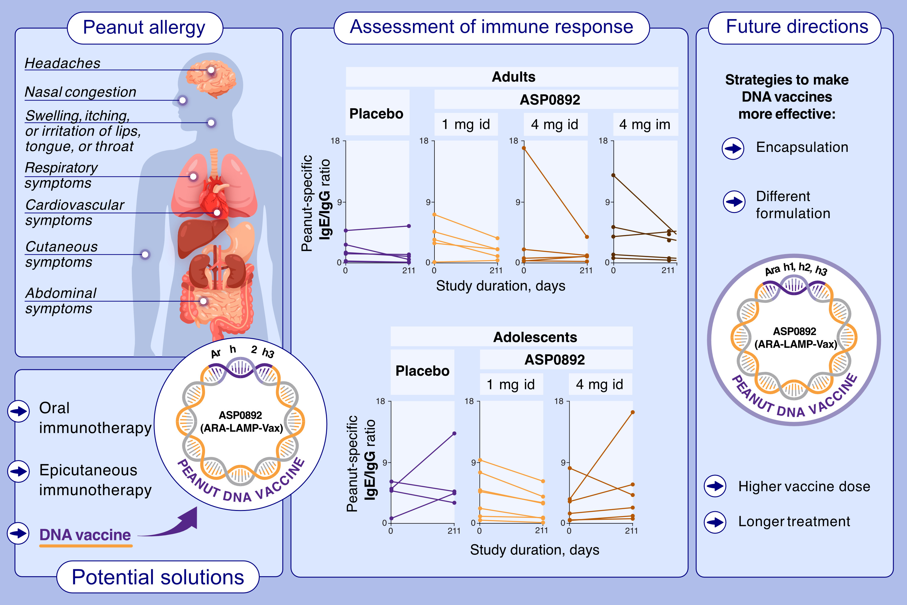
Safety and Immunopharmacology of ASP0892 in Adults or Adolescents With Peanut Allergy: Two Randomized Trials
Brian C. Ferslew, Ronald Smulders, Tong Zhu, Mary B. Blauwet, Tomohiro Kusawake, et al.
Allergy. 2024; pages:456-470
https://doi.org/10.1111/all.15931
© 2024 EAACI and John Wiley and Sons A/S. Published by John Wiley and Sons Ltd.
Notes:
HIGHLIGHTS
This study evaluates the safety, tolerability, and immunogenicity of a peanut vaccine, ASP0892, after intradermal or intramuscular injection in adults and adolescents with peanut allergy in two phase 1 clinical studies.
Both studies of ASP0892 (ARA-LAMP-Vax) vaccine showed no significant safety issues and modest but non-relevant modifications in clinical or immune responses in adults or adolescents with peanut allergy.
The safety and immunogenicity potential of ASP0892 may warrant future explorations of LAMP-Vax vaccines for immunotherapeutic treatment of other diseases.
Abbreviations: ARA, arachis; id, intradermal; Ig, immunoglobulin; im, intramuscular; LAMP, lysosomal-associated membrane protein.

