Slide 1
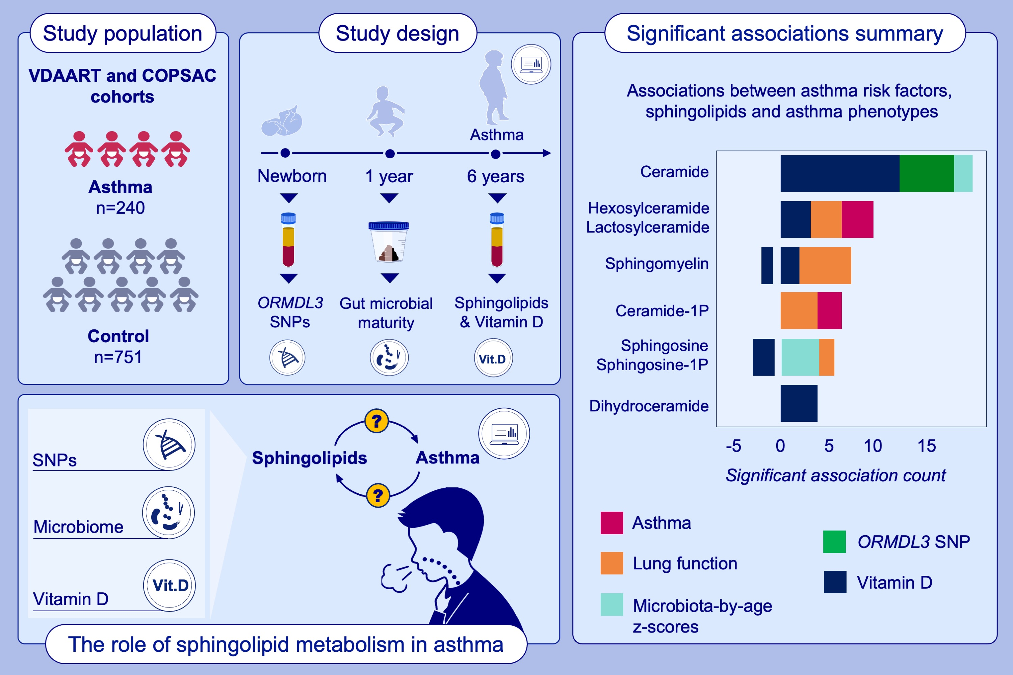
Sphingolipid classes and the interrelationship with pediatric asthma risk factors and clinical asthma phenotypes
Yulu Chen, Antonio Checa, Pei Zhang, Mengna Huang, Rachel S. Kelly, , et al.
Allergy. 2024; pages:404-418
https://doi.org/10.1111/all.15942
© 2024 EAACI and John Wiley and Sons A/S. Published by John Wiley and Sons Ltd.
Notes:
HIGHLIGHTS
In two large pediatric cohorts (n=997), we evaluated the relationship between 77 quantified sphingolipid metabolites and clinical asthma outcomes, taking into account significant asthma risk factors relevant to this pathway.
We found that overall elevations in sphingolipids appeared deleterious; elevations in ceramides were uniquely associated with increases in asthma risk factors only, while elevations in asthma phenotypes were associated with recycling sphingolipids.
Modifying asthma risk factors may play an essential role in regulating sphingolipid homeostasis via ceramides to affect asthma.
Abbreviations: 1P, 1-phosphate; COPSAC, The Copenhagen Prospective Study on Asthma in Childhood; ORMDL3, ORM1-like protein 3; SNP, single nucleotide polymorphism; VDAART, The Vitamin D Antenatal Asthma Reduction Trial; Vit.D, serum vitamin D levels measured at age 6 years.

