Slide 1
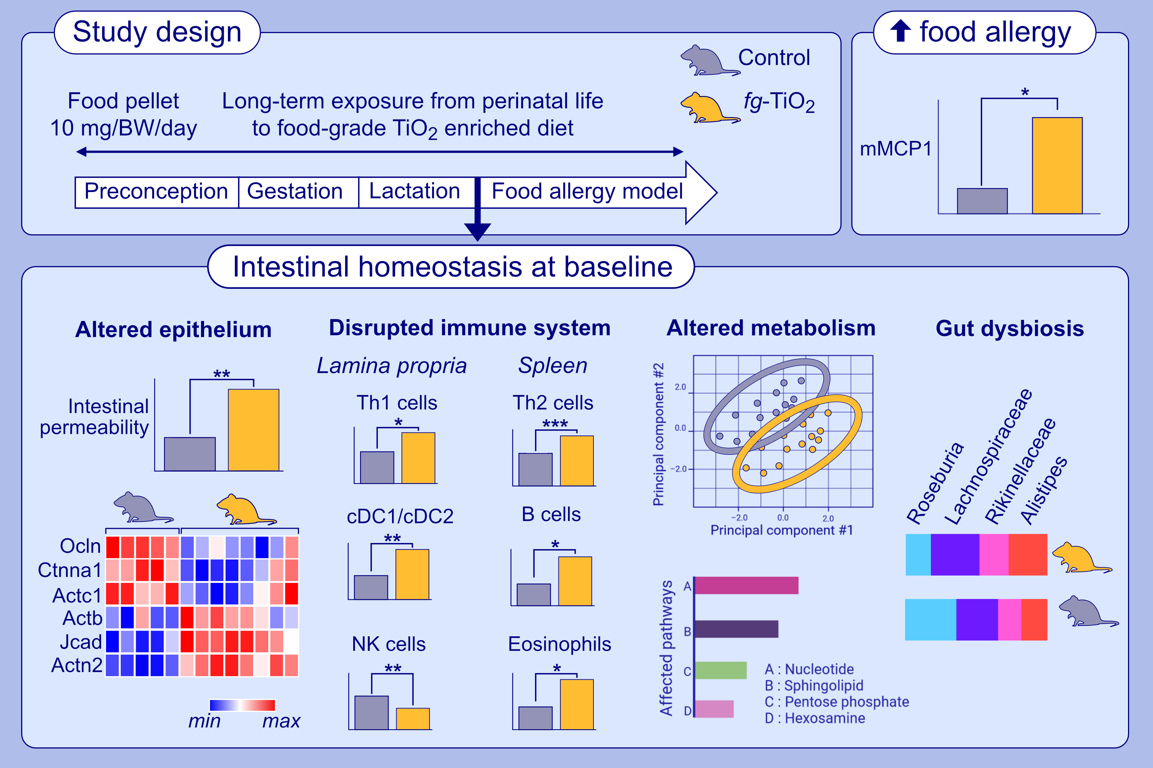
Long-term exposure from perinatal life to food-grade TiO₂ alters intestinal homeostasis and predisposes to food allergy in young mice
Mohammad Issa, Chloé Michaudel, Marine Guinot, Marta Grauso-Culetto, Blanche Guillon, et al.
Allergy. 2024; pages:471-484
https://doi.org/10.1111/all.15960
© 2024 EAACI and John Wiley and Sons A/S. Published by John Wiley and Sons Ltd.
Notes:
HIGHLIGHTS
This study investigates the effect of chronic perinatal exposure to food-grade titanium dioxide (fg-TiO 2), a common food additive.
Chronic perinatal exposure to food-grade TiO₂ (E171) at realistic human doses led to an increased propensity to develop food allergy and an altered induction of oral tolerance in male progeny.
Chronic perinatal exposure to E171 alters the establishment of the different components of intestinal homeostasis in early life in male progeny, i.e., epithelial barrier function, immune system maturation, and microbiota composition, associated with the alteration
of systemic immunity and metabolism.
Abbreviations: Actb, actin beta; Actc1, actin alpha cardiac muscle 1; Actn2, actin alpha 2; cDC, conventional dendritic cells; Ctnna1, catenin 1; fg-TiO₂, food-grade titanium dioxide; Jcad, junctional cadherin 5 associated; mMCP1, mouse mast cell protease; NK, natural killer; Ocln, occludin; Th, T helper.

